Slide 1
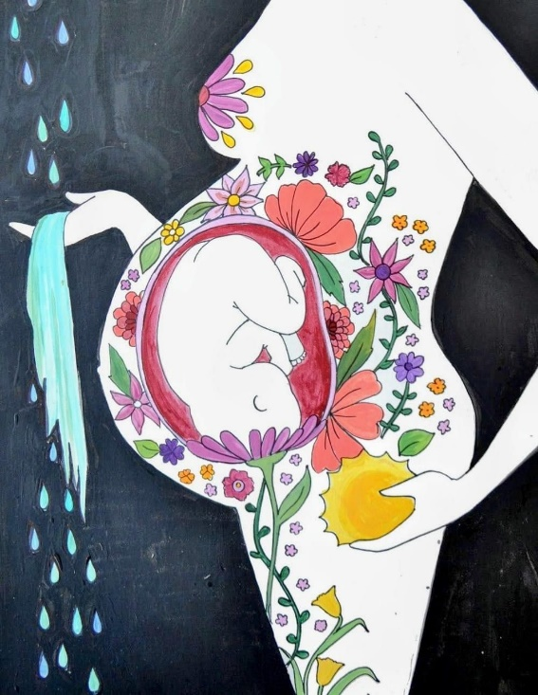
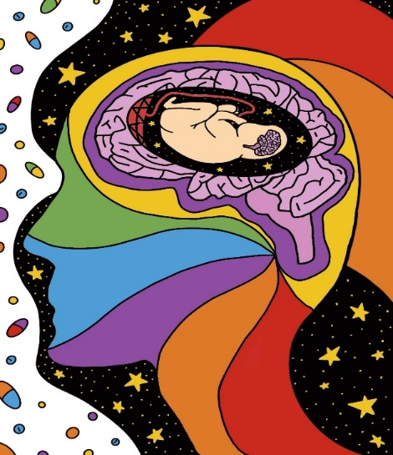

This care bundle has been designed by the Specialist Perinatal Mental Health team in Cwm Taf Morgannwg University Health Board to support pregnant people and new parents with tools and tips for you to try to offer some guidance and support whilst you are experiencing an emotional and difficult time.
Perinatal Care Bundle

Slide 2
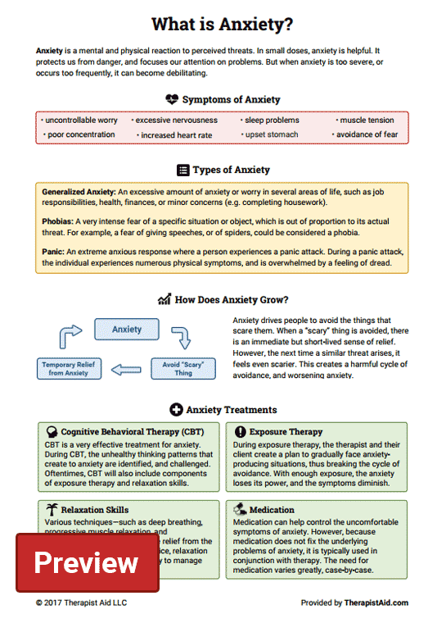


We try to keep this information as up-to-date as possible. Our duty desk is available to support you Monday, Wednesday and Friday between 1:30pm – 3:30pm on 01656 752520
Alternatively, in the event of a mental health crisis please contact the Single Point of Access number which is available 24/7 on:
Bridgend – 01656 752449
RCT – 01443 443617
Merthyr – 01685 721721
Arc Day Centre
ARCInformationandAdvice@bridgend.gov.uk
Mental Health Matters Wales
Union Offices, Quarella Road, Bridgend, CF31 1JW
Admin@mhmwales.org.uk
01656 767045
01656 651450

Slide 3
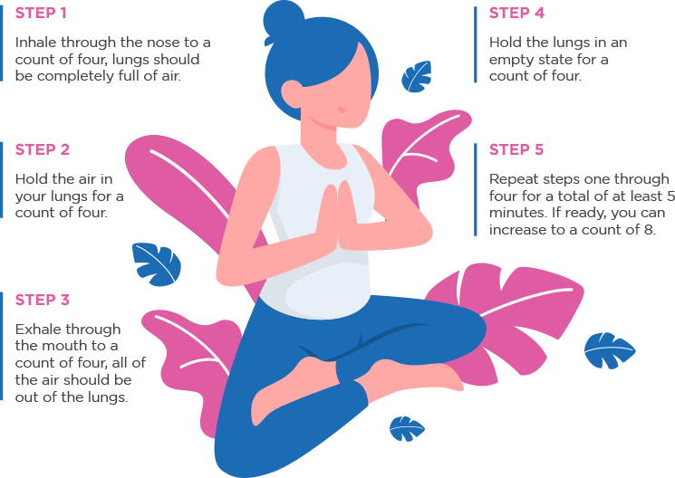

CAB
provide free advice on many issues such as Housing, Family, Law and Courts, Immigration and more
https://www.citizensadvice.org.uk/wales/
Pandas
Their aim is to make sure no parent, family or carer feels alone. They have a variety of support services available to ensure help is delivered in a way that is right for you
https://pandasfoundation.org.uk/
CALL Mental Health Listening line
Provides a confidential mental health listening and emotional support, which is open 24/7. CALL can also signpost to support in local communities and a range of online information.
Phone : 0800132737 Text ‘help’ to 81066 or visit callhelpine.org.uk
Podcasts are useful for those who don’t enjoy reading and can also be listened to on the go or while relaxing. You could also choose to listen to any Podcast you like as a distraction
Happy Mum Happy Baby – Giovanni Fletcher
https://www.happymumhappybaby.com/podcast/
Motherkind – Zoe Blaskkey
https://www.motherkind.co/#new-page-3
BOX BREATHING
This is useful for helping people breathe deeper, and better overall. It is also a powerful stress reliever and an excellent way to calm down a worried and anxiety-filled mind.
Like a box, the pattern of breathing can be symbolised like a box or square with 4 parts.

Slide 4
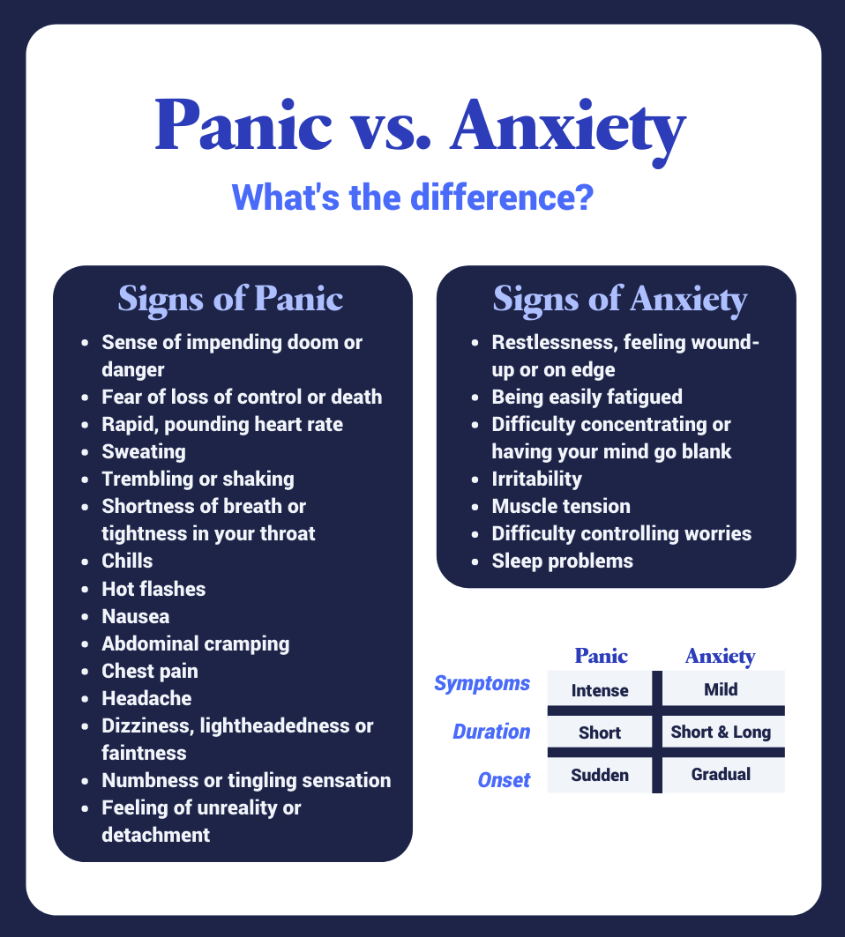
Tommy’s
Our midwife-led information hub covers everything you need to know about having a safe and healthy pregnancy, from conception to birth.
https://www.tommys.org/pregnancy-information
Pregnancy Sickness Support
Working to improve care, treatment and support for people suffering from Nausea and Vomiting in Pregnancy (NVP) and the severe form of the condition; Hyperemesis Gravidarum (HG).
https://www.pregnancysicknesssupport.org.uk/
Children’s Mental Health Charity
For parents/children to access support.
https://www.youngminds.org.uk/
Activity Ideas for Infants
Activity idea for 0 – 5 year olds.
https://www.bbc.co.uk/tiny-happy-people/activities/zjh8hbk
Relate
Relate are the UK’s largest provider of relationship support, and last year we helped over two million people of all ages, backgrounds, sexual orientations and gender identities to strengthen their relationships.
https://www.relate.org.uk/

Slide 5
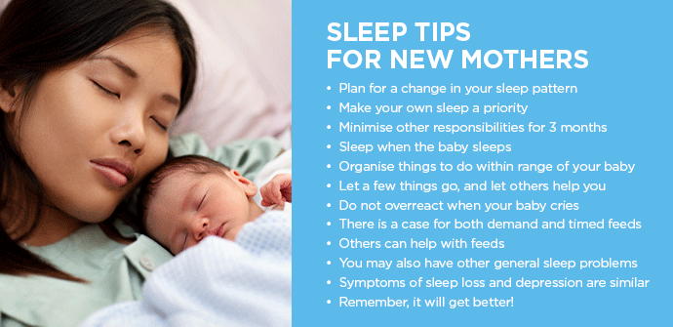
Dad’s Mental Health
Between 1 and 3 out of 10 Dads suffer from low mood, anxiety and post-natal depression. This rises for Dads supporting a partner with PND or after a traumatic birth.
www.reachingoutpmh.co.uk
www.fatherhoodinstitute.org
Lads and Dads
Our Facebook group boasts 900 active members who offer one other advice and support to get through daily struggles. From dealing with grief, to debt advice and even family-courts, there is no subject untouched. None of our members are professionals, just men who have been through it themselves.
https://www.ladsanddads.org/
The Dad Pad
What is the DadPad? It’s the essential guide for new dads, developed with the NHS. Why do you need it? As a new dad you will feel excited, but you may also feel left out, unsure or overwhelmed. The DadPad can help by giving you the knowledge and practical skills that you need. The resource will support you and your partner to give your baby the best possible start in life.
https://thedadpad.co.uk/
What can you try to help with anxiety, fear and panic?
Try talking about your feelings to a friend, family member, health professional or counsellor
Practice breathing exercises
Exercise – running, walking, swimming and yoga
Try to get enough sleep
Eat a healthy balanced diet with regular meals to keep your energy levels stable
Seek support from groups/services

Slide 6
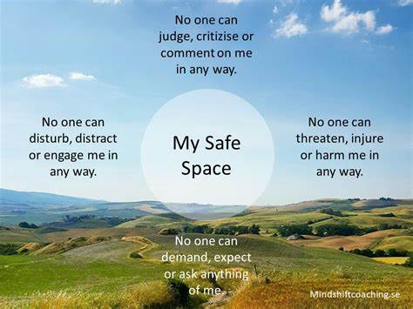
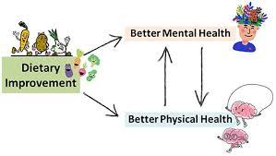
Eating Well
Your brain and body need a mixture of nutrients in order to function well. A diet that’s good for your physical health is also good for your mental health.
Benefits of Postpartum nutrition
It can speed your recovery – an adequate diet and hydration can help heal your body
It promotes milk production – if you are breastfeeding what you eat and drink is important for the quantity and quality of your milk supply
Supports overall wellbeing – a well balanced diet can support the 24/7 stamina that you’ll need as a new mum or soon to be new mum

Slide 7
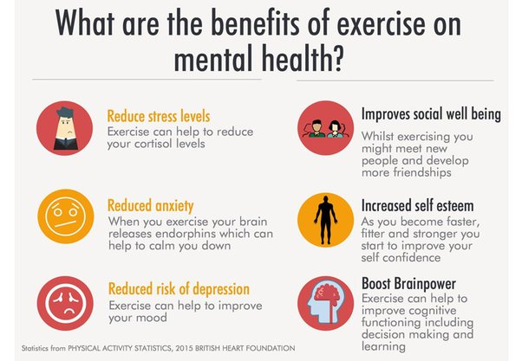
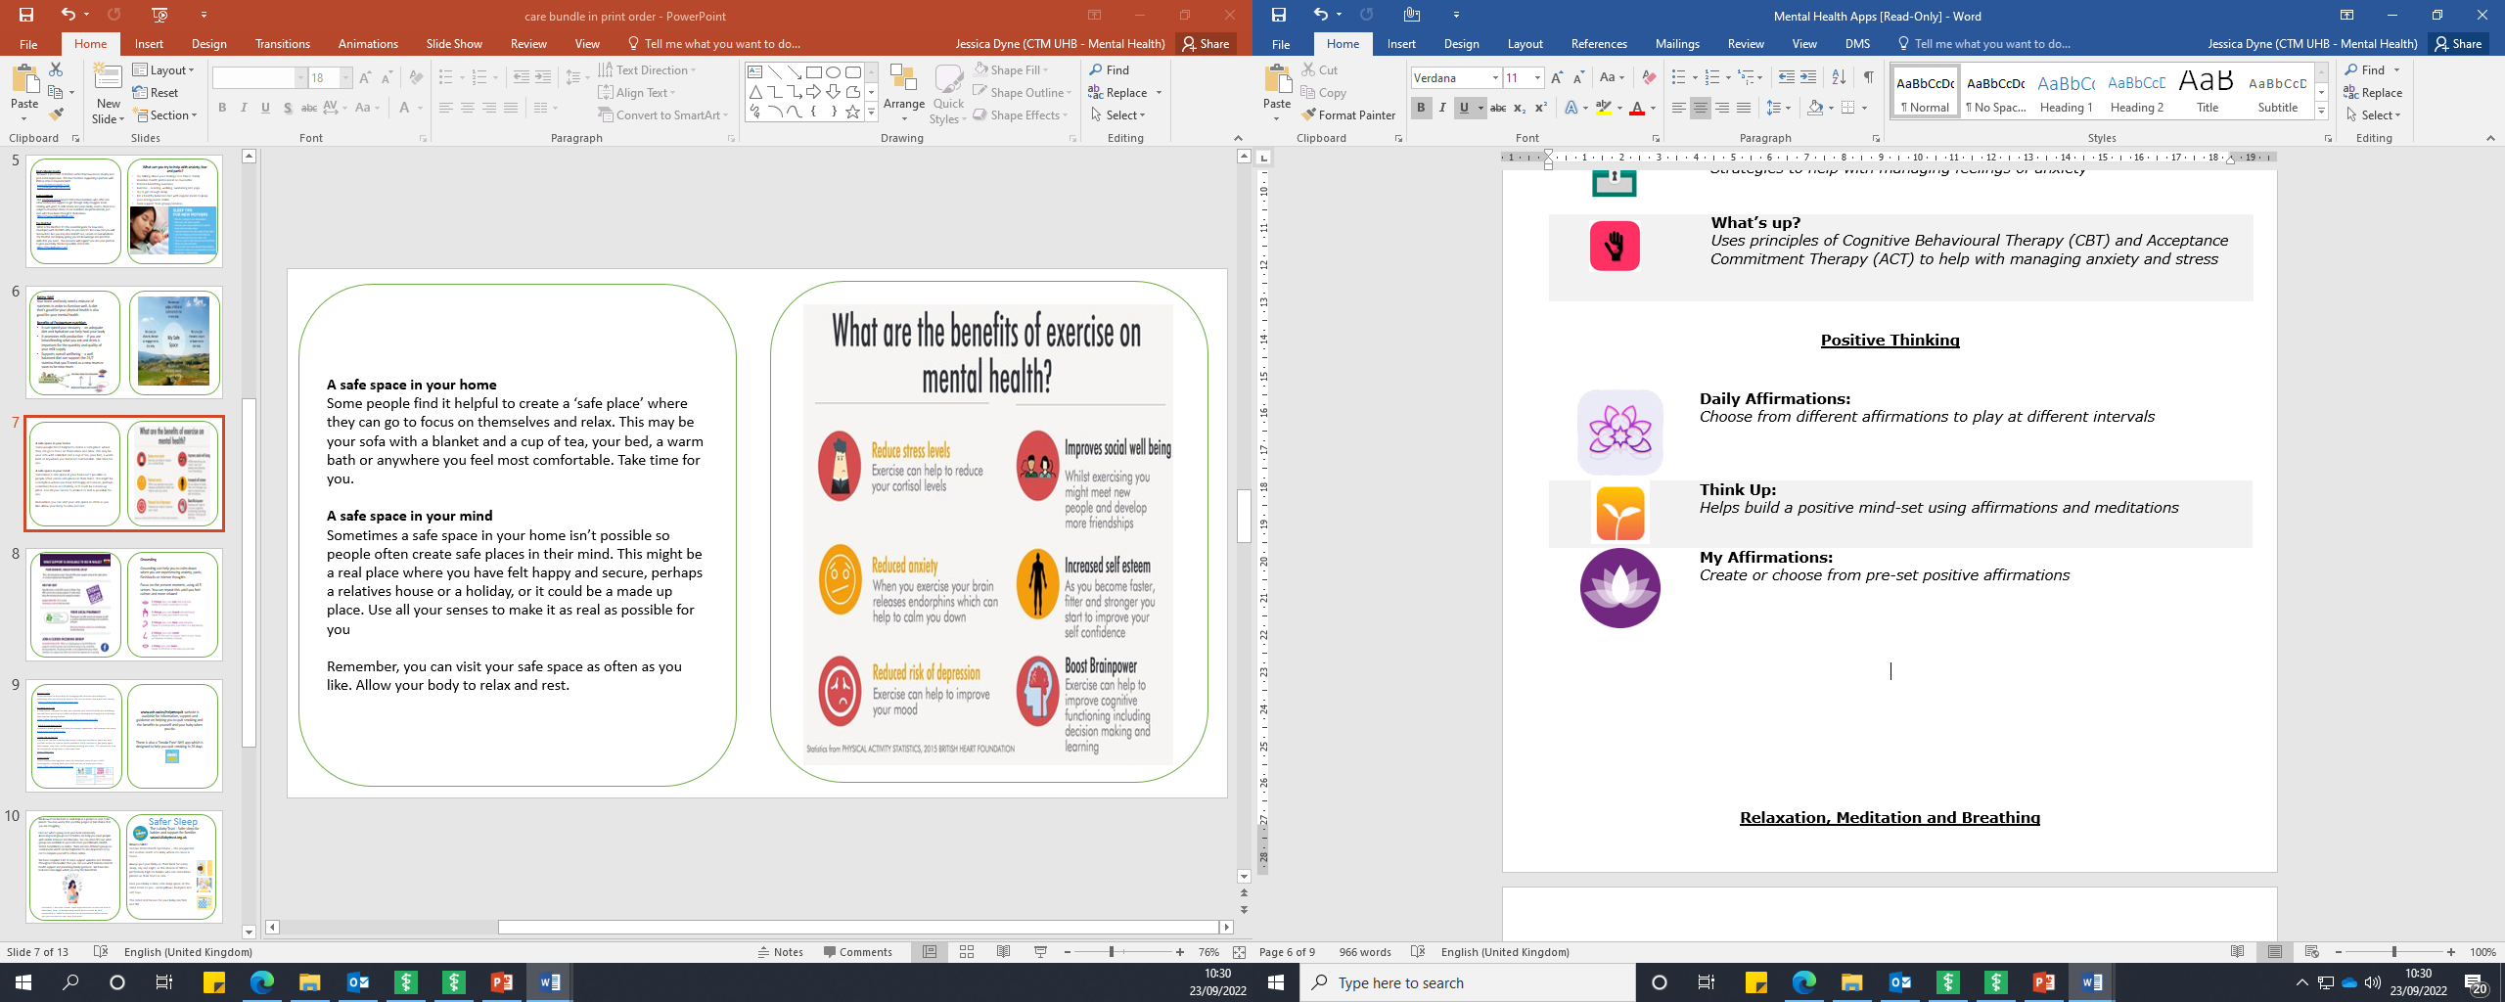
A safe space in your home
Some people find it helpful to create a ‘safe place’ where they can go to focus on themselves and relax. This may be your sofa with a blanket and a cup of tea, your bed, a warm bath or anywhere you feel most comfortable. Take time for you.
A safe space in your mind
Sometimes a safe space in your home isn’t possible so people often create safe places in their mind. This might be a real place where you have felt happy and secure, perhaps a relatives house or a holiday, or it could be a made up place. Use all your senses to make it as real as possible for you
Remember, you can visit your safe space as often as you like. Allow your body to relax and rest.
Below are some Apps you might find useful to use to encourage Positive Thinking

Slide 8
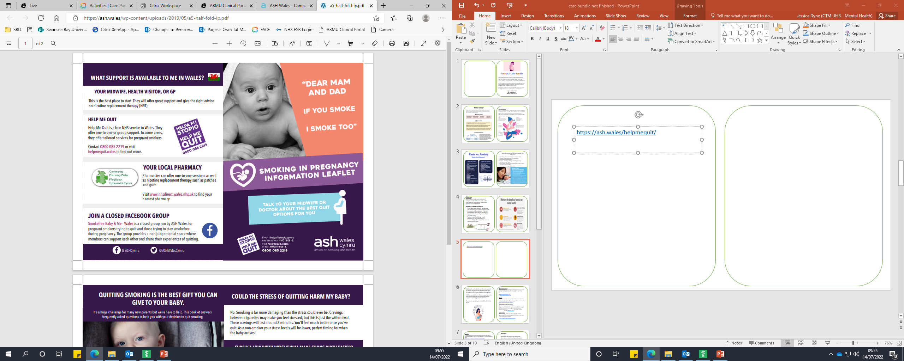
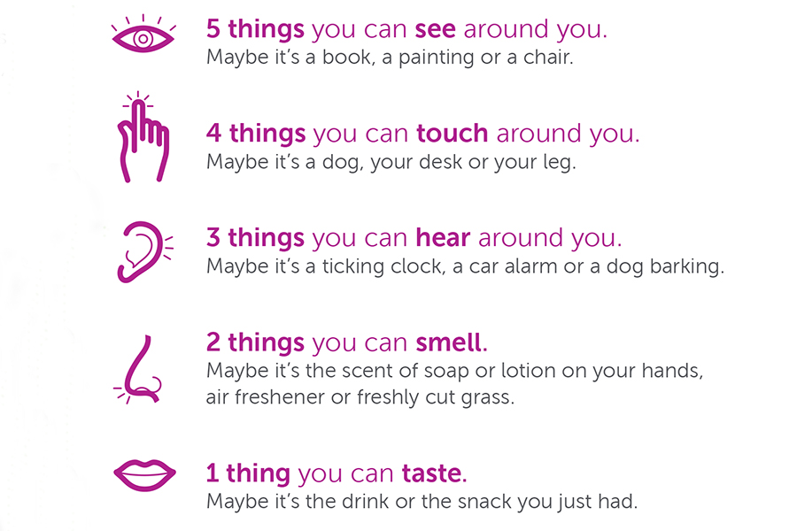
Grounding
Grounding can help you to calm down when you are experiencing anxiety, panic, flashbacks or intense thoughts.
Focus on the present moment, using all 5 senses. You can repeat this until you feel calmer and more relaxed

Slide 9

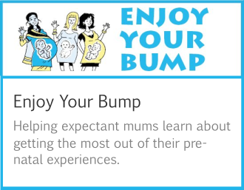
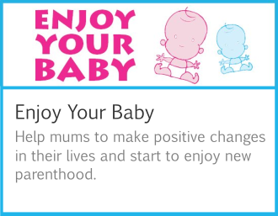
Valleys Steps
Online sessions to learn ways of managing the common psychological difficulties that we all face at times in life such as stress, low mood and anxiety
https://valleyssteps.org/online-sessions/
Activate Your Life
A free course, designed to help you improve your mental health and wellbeing. You will learn practical and effective ways of dealing with thoughts and feelings that may be causing distress.
https://phw.nhs.wales/services-and-teams/activate-your-life/
Mind Active Monitoring
Provides 6 week guided self-help for anxiety, depression, self-esteem and more
www.mind.org.uk/AMWales
Living Life to the Full
Free online courses covering low mood, stress and resilience. Work out why you feel as you do, how to tackle problems, build confidence, get going again, feel happier, stay calm, tackle upsetting thinking and more. Our courses are free for individuals using them in their own lives.
https://llttf.com/
Enjoy Series
Three courses that together cover the formative years of your child’s development. Helping both your child and you to enjoy each other.
https://llttf.com/home/enjoy-series/
www.ash.wales/helpmequit website is available for information, support and guidance on helping you to quit smoking and the benefits to yourself and your baby when you do.
There is also a ‘Smoke Free’ NHS app which is designed to help you quit smoking in 28 days.

Slide 10

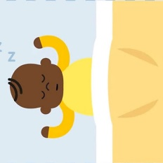
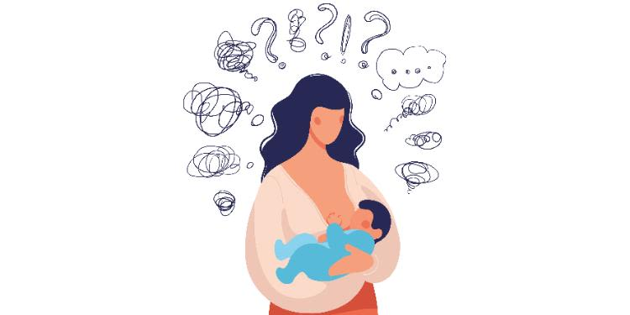
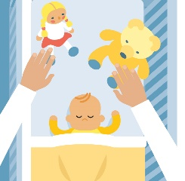
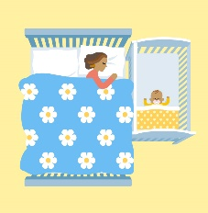
Safer Sleep
We know it can be hard to seek help as a parent or soon to be parent. You may worry that you’ll be judged or feel shame that you are struggling.
Find out what’s going on in your local community
Accessing local groups and activities can help you meet people with similar interests and lifestyles. You can often find out what groups are available in your area from your Midwife, Health Visitor, local library or online. There are also different groups on social media which can be helpful but its also important to try not to compare yourself to others online.
We have compiled a list of some support websites and charities throughout this booklet that you can use which includes mental health support and parenting/family guidance. We have also included some Apps which you may find beneficial
The Lullaby Trust - Safer sleep for babies and support for families
www.lullabytrust.org.uk
What is SIDS?
Sudden Infant Death Syndrome – the unexpected and sudden death of a baby where no cause is found.
Always put your baby on their back for every sleep, day and night, as the chance of SIDS is particularly high for babies who are sometimes placed on their front or side
Give your baby a clear, safe sleep space, in the same room as you - avoid pillows, bumpers and soft toys.
The safest mattresses for your baby are firm
and flat
Disclaimer – We have chosen these Apps/Podcasts as they are free to download. Cwm Taf Morgannwg Health Board cannot be held responsible or liable for additional purchases/adverts/subscriptions and you use them at your own discretion.

Slide 11
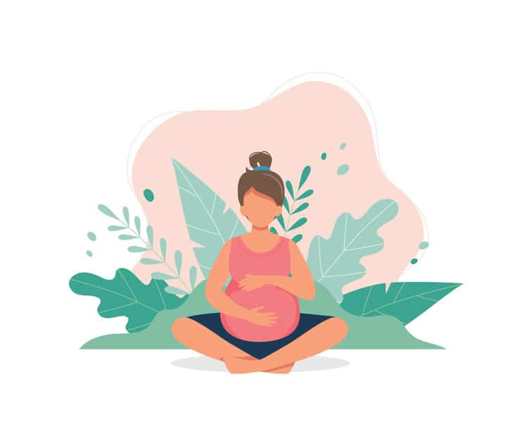
Gingerbread Single Parents Charity
https://www.gingerbread.org.uk/
Free help line, forums, web chat, claiming benefits
Two in Mind –Parenting Made Easier
Becoming a parent is a beautiful journey; from infants’ first step to riding a bicycle. We guide you in every phase of it. Two in Mind is helping parents in parenting for more than a decade. Our team consists of a group of parents who are passionate to train the newly becoming parents and knows how to take care of an infant or a toddler.
https://twoinmind.org
Solihull Approach – Understanding your child
Online course for parents of children aged 6 months to 19 years. The first online course for parents to be awarded the Government’s CANparent Quality Mark. Developed by the Solihull Approach team; health professionals working together with parents and practitioners. It is available in several languages.
https://inourplace.heiapply.com/online-learning/
Apply this code for free access: SWSOL
Baby Buddy App
Baby Buddy App is our free multi-award winning, interactive pregnancy and parenting guide. Baby Buddy provides trusted, evidence-based information and self-care tools to help parents build their knowledge and confidence during the transition to parenthood and throughout the early stages of parenting
https://www.bestbeginnings.org.uk/baby-buddy
Activity Ideas for Adults
Ideas that offer opportunities for self-care and leisure activities.
https://www.annafreud.org/on-my-mind/self-care/
Think about your space:
Your environment can have a big impact on your day to day functioning and wellbeing. Think about the space you spend your time in and how it makes you feel. Here are a few ideas:
A disorganised space can make it difficult to relax. Try and have an area of your home that is arranged as you like it. This could be your bedroom, bathroom or even your garden….
Using the areas in your home for their purpose – enjoying your dinner in front of the TV can be a relaxing treat, but is also an easy habit to get into. If you can, try and eat at the table as this will allow you to have a change of rooms and establish a routine. Try not to spend too much of the day time in your bedroom – use your day areas, such as the living room, kitchen or garden to maintain a day/night routine.

Slide 12
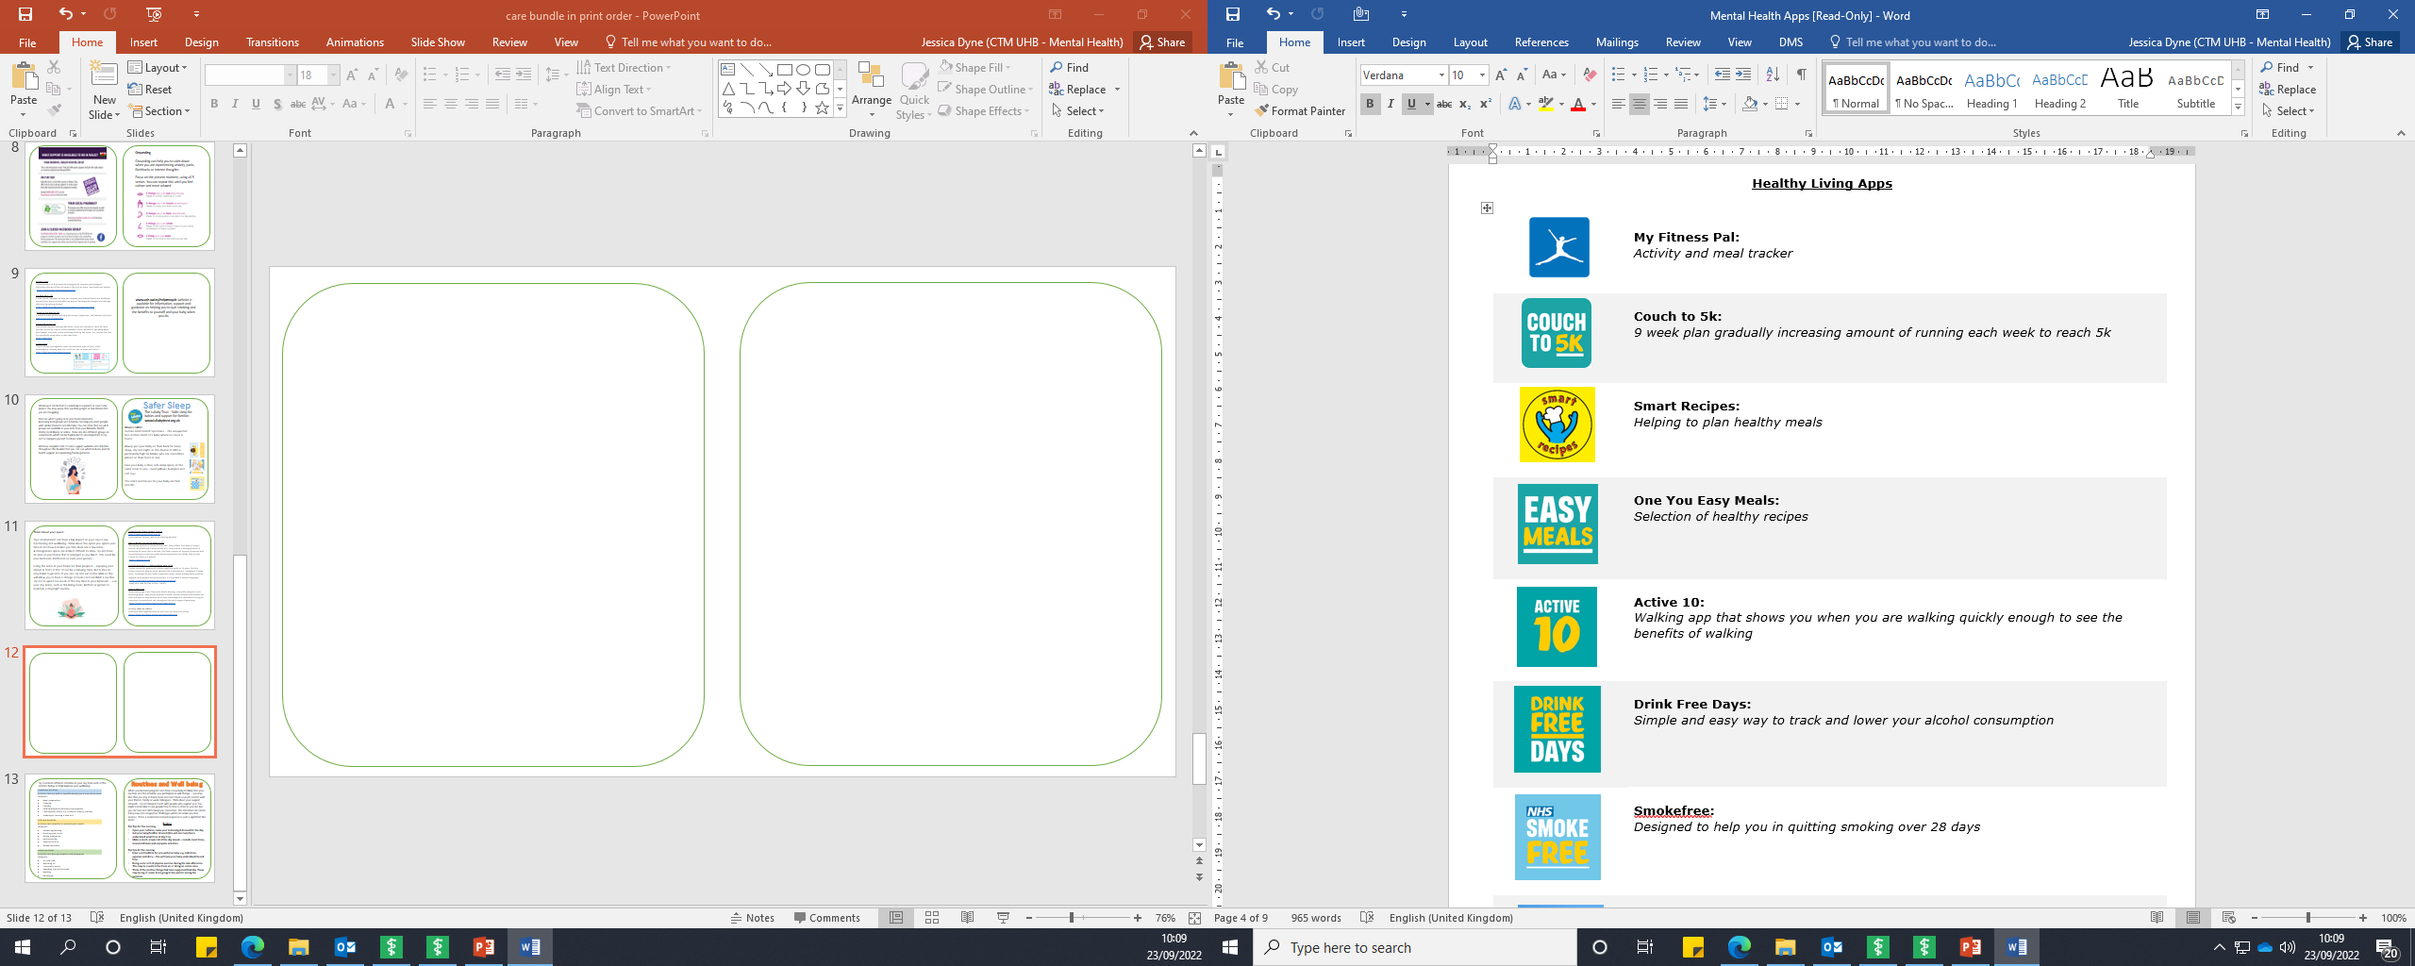
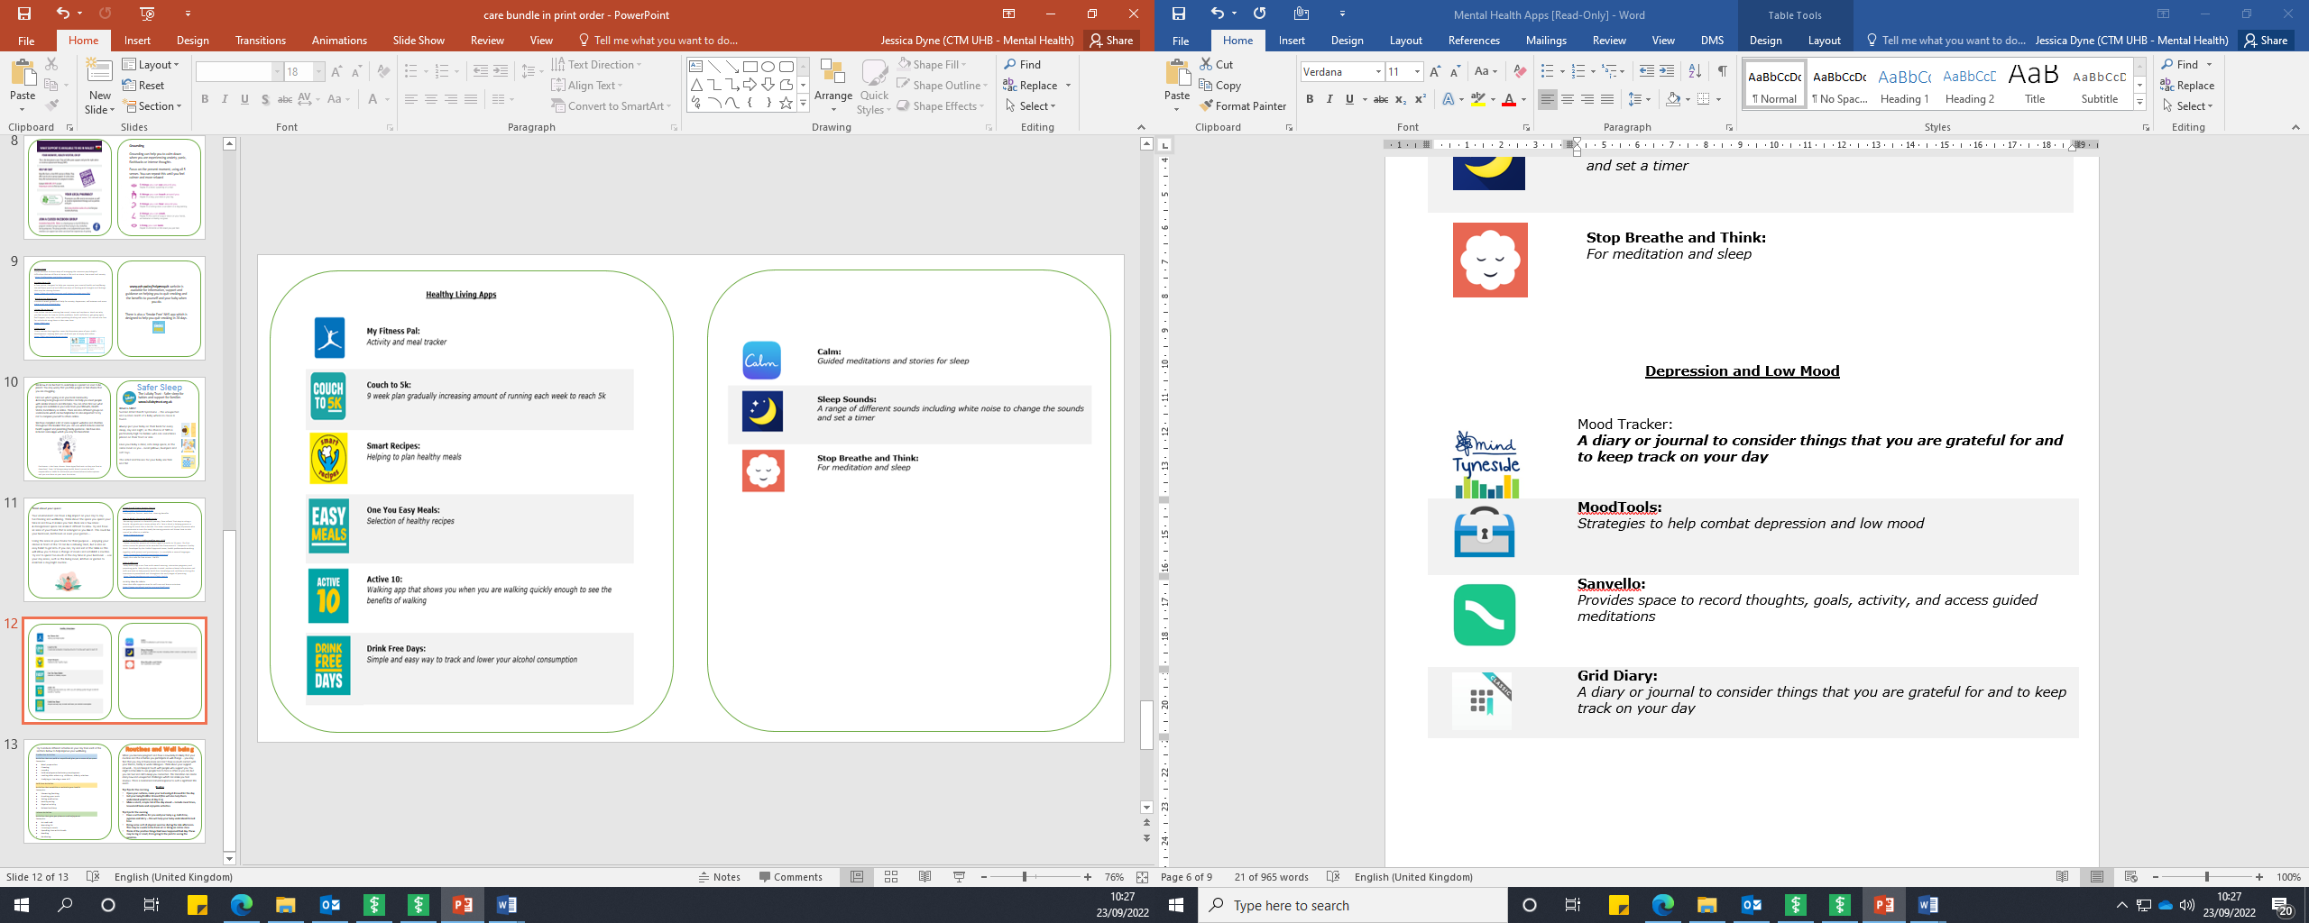
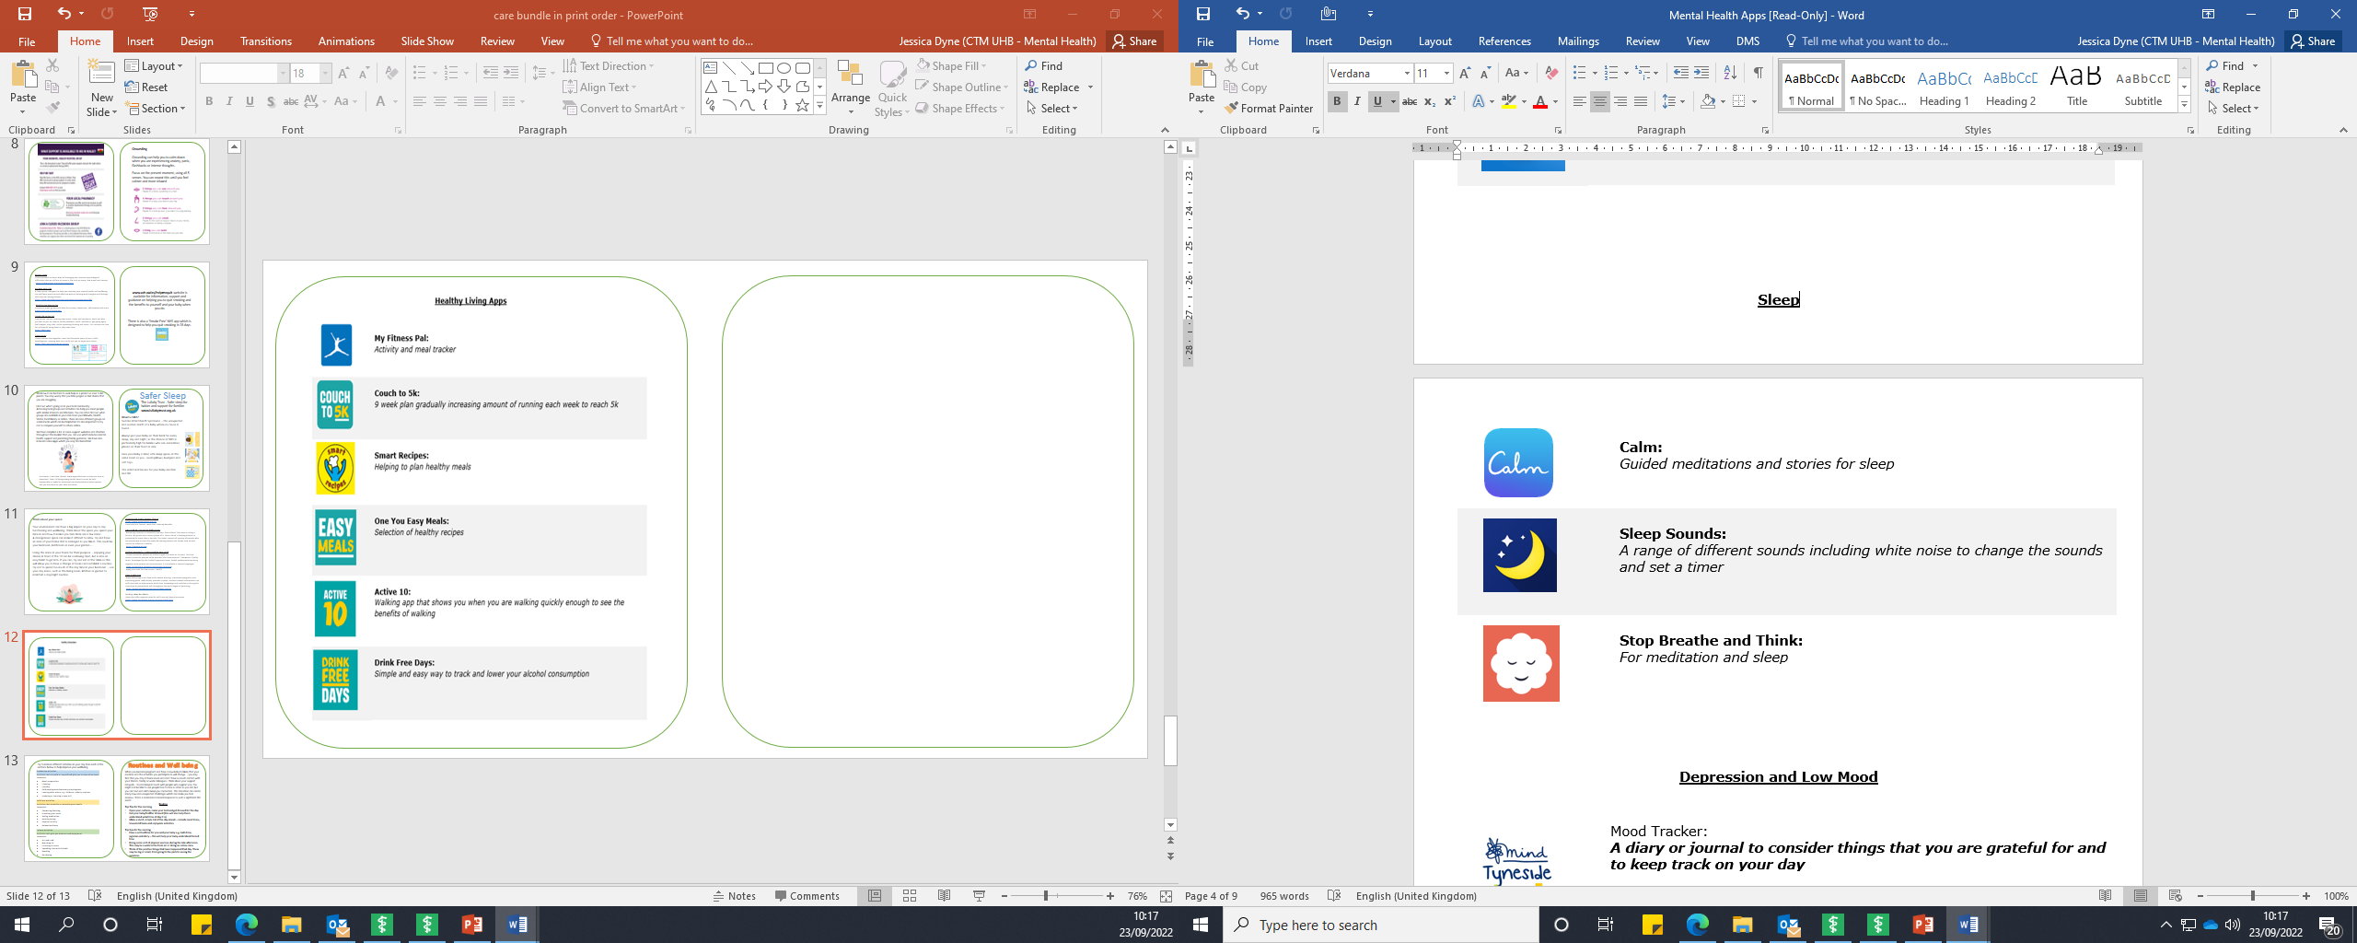
Mind Mood Tracker:
A diary or journal to consider things you are grateful for and to keep track on your day
Mood Tools:
Strategies to help combat depression and low mood
Calm:
Guided meditations and stories for sleep
Sleep Sounds:
A range of different sounds including white noise to aid sleep
Stop Breathe and Think:
For meditation and sleep

Slide 13

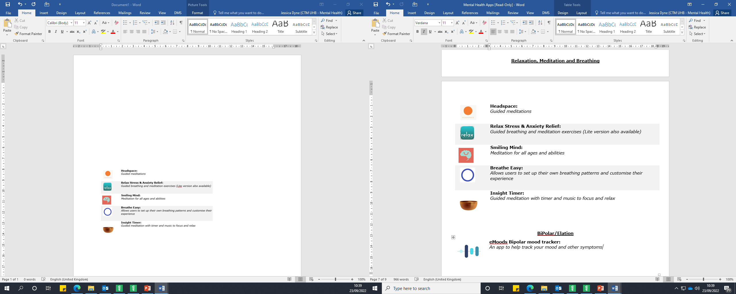
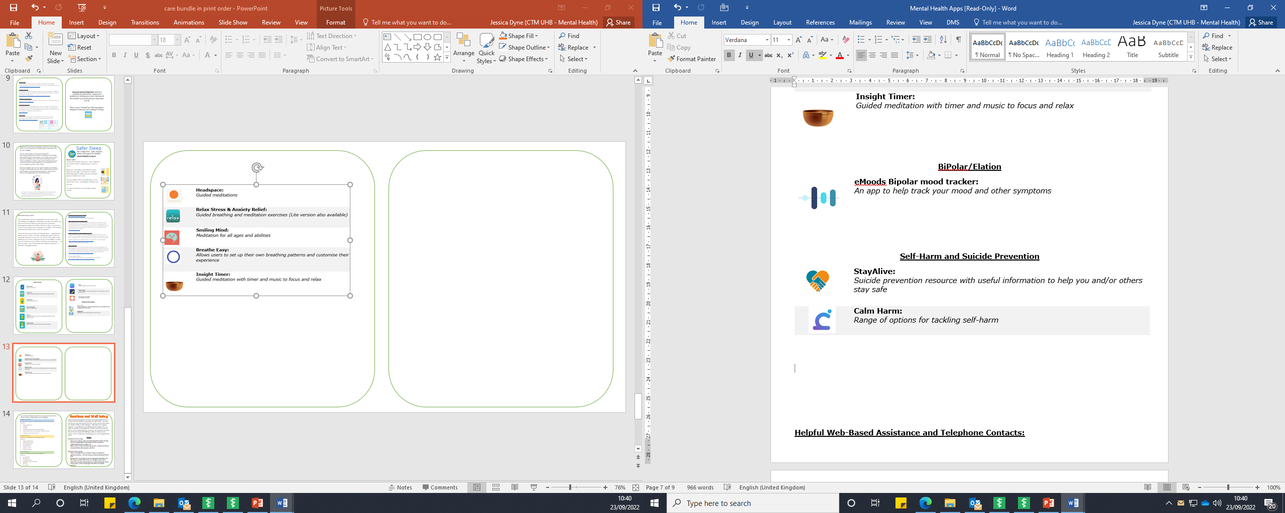
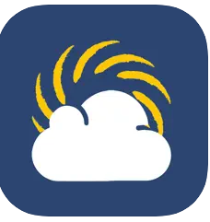
Women’s aid work to provide life-saving services and build a future where domestic abuse is not tolerated.
The below services are in the RCT/Merthyr/Bridgend area and often offer discrete ways of contacting them like Live Chat/email.
Assia Domestic Abuse Service: 01656 815919
Domestic Abuse Resource Team(DART): 01685 388444
RCT Domestic Abuse Services: 01443 400791
Live Fear Free – Free 24 hour helpline 08 08 80 10 800
info@livefearfreehelpine.wales
You can use ‘Clare’s Law’ to check whether someone has an abusive past. You can also do this on behalf of a close friend of family member.
‘Bright Sky’ is a mobile app and website for anyone experiencing domestic abuse, or who is worried about someone else. Only download it if it is safe for you to do so and if you are sure your phone isn’t being
monitored.

Slide 14
Routines and Well being
Try to include different activities in your day from each of the sections below to help improve your wellbeing.
When you become pregnant and have a new baby its likely that your routines and the activities you participate in will change – you may find that you stay at home more and don’t have as much contact with your friends, family or work colleagues. Think about your support network – try and keep in touch with people who support you. You might not be able to see people face to face as often as you did, but you can text and call to keep you connected. This transition can create many new and unexpected challenges which can make you feel anxious. This is a normal and natural response to such a significant life event.
Routine
Top Tips for the morning
Open your curtains, make your bed and get dressed for the day
Get your baby/toddler dressed (this will also help them understand what time of day it is)
Make a short, simple list of the day ahead – include meal times, household tasks and enjoyable activities
Top tips for the evening
Have a set bedtime for you and your baby e.g. bath time, pyjamas and story – this will help your baby understand its bed time
Doing some sort of physical exercise during the late afternoon. This may be a walk in the fresh air or doing an online class
Think of the positive things that have happened that day. These may be big or small, from going to the park to seeing the sunshine.
Productive Activities Activities that are paid or unpaid and give you a sense of purpose
Examples: Meal preparation Cleaning Laundry Paid employment/voluntary employment Looking after others e.g. childcare, elderly relatives Studying or learning a new skill
Self-Care Activities Activities that establish or maintain your health
Examples: Showering/bathing Brushing your teeth Taking medication Healthy eating Physical activity Relaxation/sleep
Leisure Activities Activities that give you pleasure and enjoyment
Examples: Art and craft Watching TV Listening to music Spending time with friends Reading Gardening

