Slide 1
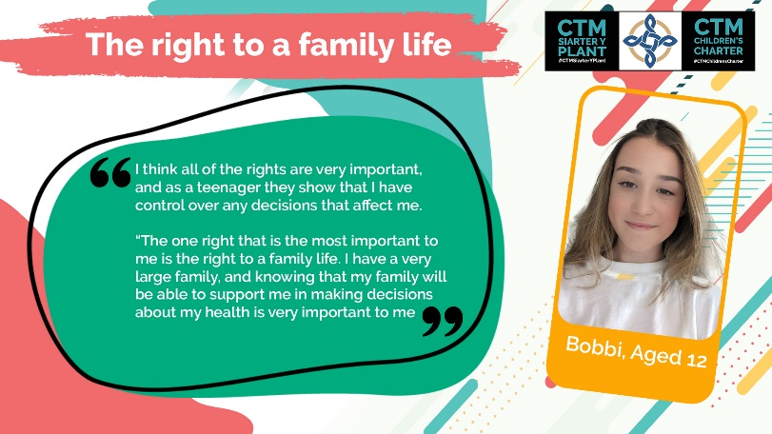
Name of the Right
Why is this important to you?
2 sentences max.
Name and age of child
Example

