Slide 1


Slide 2


Slide 3


Slide 4


Slide 5


Slide 6


Slide 7


Slide 8


Slide 9
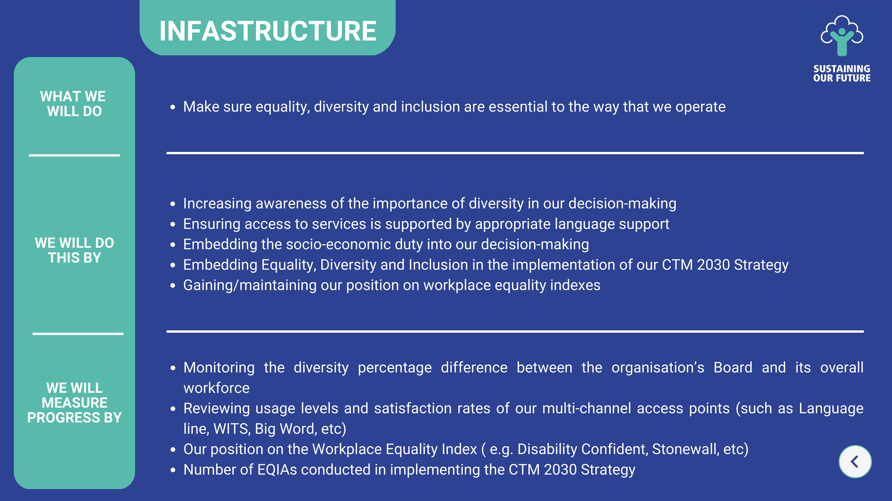

Slide 10


Slide 11
Your Feedback
You can provide us with your feedback on our proposed Equality Objectives HERE

Slide 12

How to contact us
If you have any comments or questions about our proposed Equality Objectives, please contact:
CTM_Equality@wales.nhs.uk

