Slide 1


Cwm Taf Morgannwg University Health Board
Planning Performance and Finance Committee Briefing – Integrated Medium Term Plan 2023-2026
February 2023

Slide 2







Purpose & Expectations
CYNNAL EIN
DYFODOL
YSBRYDOLI
POBL
GWELLA
GOFAL
CREU
IECHYD
Ein Hiechyd
Ein Dyfodol
DATBLYGU CYMUNEDAU
IACHACH GYDA’N GILYDD
Purpose & Expectations
Requirement: A Board Approved Plan by 31 March 2023*
Delivers on statutory obligations
      Performance expectations
      Financially-balanced plan*
Set organisational direction (context CTM 2030)
Aligns performance, service plans, finance, workforce & wider corporate teams’ portfolios
Identify priorities & interdependences
Realistic plans based on organisational capability, aligned to both CTM strategy & national requirements
Data driven, delivery (milestones) & outcome focused (Detailed year 1 action plans)
Provide assurance on delivery (Internal & Welsh Government)
IMTP Update
Board Briefing – February 2023

Slide 3
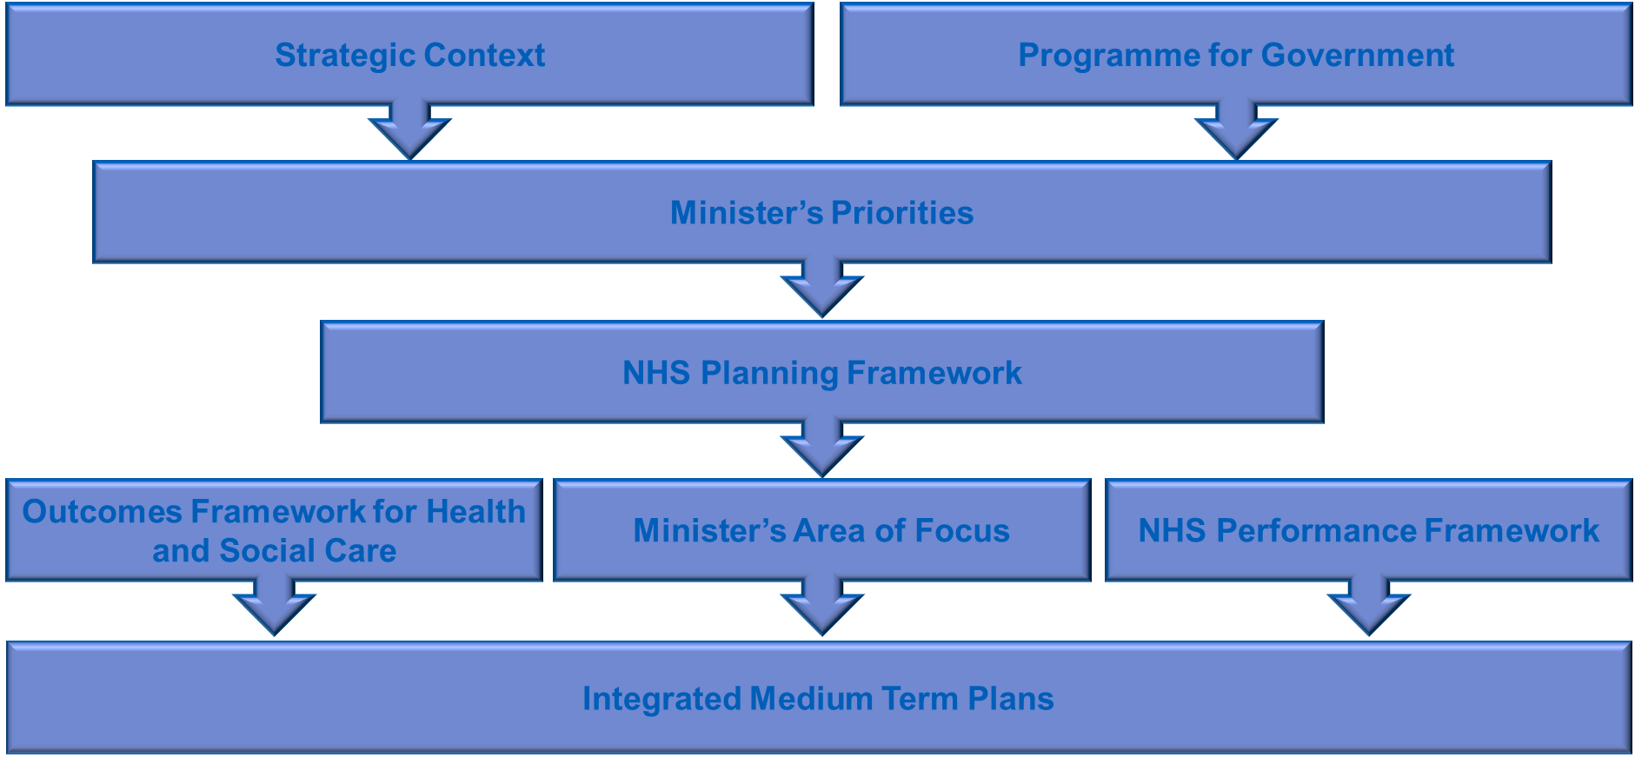
CYNNAL EIN
DYFODOL
YSBRYDOLI
POBL
GWELLA
GOFAL
CREU
IECHYD
Ein Hiechyd
Ein Dyfodol
DATBLYGU CYMUNEDAU
IACHACH GYDA’N GILYDD
Guidance
External Guidance influencing with NHS Planning
IMTP Update
Board Briefing – February 2023

Slide 4
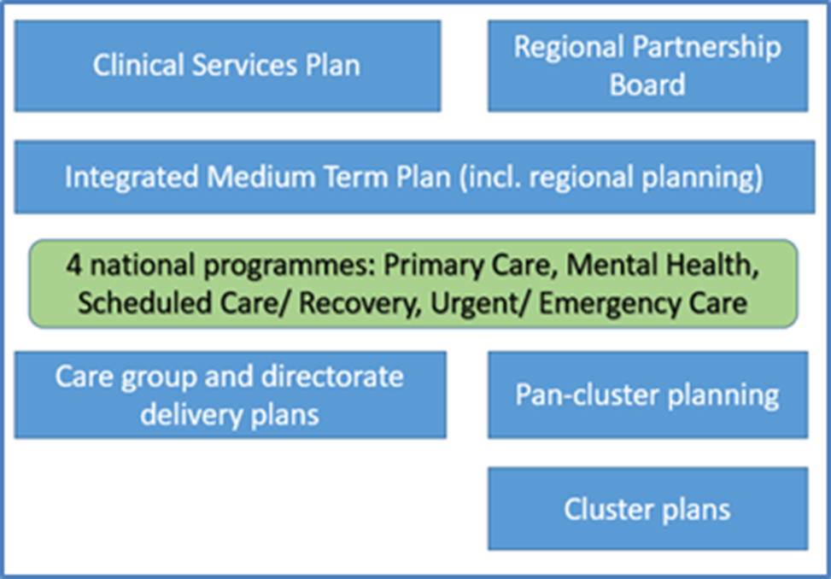
Developing
our Plans
CYNNAL EIN
DYFODOL
Ein Hiechyd
Ein Dyfodol
DATBLYGU CYMUNEDAU
IACHACH GYDA’N GILYDD
YSBRYDOLI
POBL
GWELLA
GOFAL
CREU
IECHYD
Developing our Plans
A combination of top down and bottom up planning:
Ministerial priorities for the next 12 months:
Pathways of Care (Delayed transfers of care)
Urgent & Emergency care
Primary Care Access
Planned Care, Recovery, Diagnostics & Pathways of Care
Cancer Recovery
Mental Health & CAMHS
IMTP Update
Board Briefing – February 2023

Slide 5
CYNNAL EIN
DYFODOL
YSBRYDOLI
POBL
GWELLA
GOFAL
CREU
IECHYD
Ein Hiechyd
Ein Dyfodol
DATBLYGU CYMUNEDAU
IACHACH GYDA’N GILYDD
Plan Timeline
Timeline
Initial care group submissions received December 2022
Plan feedback, testing & further assessment / development
Final care group narrative plans (17/02/2023)
Final financial plan submissions (24/02/2023)
Next Steps
Continued plan testing & refinement
Completion of the minimum data set
Completion of ministerial templates
Planning Performance and Finance Committee update – 28/02/23
Accountable Officer correspondence to Welsh Government – 28/02/2023
Delivery of full draft plan document & appendices for committee and board consideration
Full plan to PPFC – March 2023
Plan presentation to board for formal noting 30/03/23
Welsh Government submission 31/03/23
IMTP Update
Board Briefing – February 2023

Slide 6




Financial Position & Plan

Slide 7
Forecast Out-turn 2022/2023
CYNNAL EIN
DYFODOL
YSBRYDOLI
POBL
GWELLA
GOFAL
CREU
IECHYD
Ein Hiechyd
Ein Dyfodol
DATBLYGU CYMUNEDAU
IACHACH GYDA’N GILYDD
Out-turn
Forecast out-turn 22/23- M10 | Additional spend | Funding | Forecast overspend
 | £m | £m | £m
Core plan | 24.5 | 0 | 24.5
Covid- Programme | 13.9 | -13.9 | 0
Covid - Local | 16.1 | -16.1 | 0
Exceptional costs - Energy | 11.5 | -11.5 | 0
Exceptional costs - RLW Social care | 2.4 | -2.4 | 0
Exceptional costs - NI | 3.1 | -3.1 | 0
Total | 71.5 | -47.0 | 24.5
Without significant NR funding in 22/23 the forecast overspend of £24.5m would have been much higher
IMTP Update
Board Briefing – February 2023

Slide 8
Allocation Letter 2023/2024
CYNNAL EIN
DYFODOL
YSBRYDOLI
POBL
GWELLA
GOFAL
CREU
IECHYD
Ein Hiechyd
Ein Dyfodol
DATBLYGU CYMUNEDAU
IACHACH GYDA’N GILYDD
Welsh Government Allocation
2023/2024 pay awards will be funded
Contribution for non pay pressures £15.2m ( 1.5% )
Funding for Covid programme costs – Vaccination, TTP and PPE
No funding for other Covid costs
No funding for Energy cost pressures
PCR - £26.1m reduced by £7.7m for Regional contribution top slice
Minimum savings expectation = levels achieved in 22/23
Impact assessments needed for all major spending decisions & efficiency programmes
IMTP Update
Board Briefing – February 2023

Slide 9
Draft Financial Plan 2023/2024
CYNNAL EIN
DYFODOL
YSBRYDOLI
POBL
GWELLA
GOFAL
CREU
IECHYD
Ein Hiechyd
Ein Dyfodol
DATBLYGU CYMUNEDAU
IACHACH GYDA’N GILYDD
Draft Financial Plan
 | Draft Plan
 | 2023/2024
R = recurring NR = non recurring | R | NR | Total
 | £m | £m | £m
B'Fwd Core Plan deficit | 60.9 | 0.0 | 60.9 | Slide 6
B'Fwd Ongoing local Covid costs | 10.0 | 0.0 | 10.0 | Slide 7
B'Fwd Ongoing Exceptional energy costs | 0.0 | 17.8 | 17.8
Brought forward financial challenge at 1 April 2023 | 71 | 17.8 | 88.7
Income changes
Share of core un-earmarked £90m funding | -13.7 | 0.0 | -13.7
Share of core un-earmarked £10.4m MH funding | -1.5 | 0.0 | -1.5
Additional funding:
NHS Pay awards and GMS, Pharmacy and GDS contractor allocations for 23/24 | tbc | 0.0 | tbc
Earmarked funding- Planned care recovery reduction | 7.7 | 0.0 | 7.7
Earmarked funding- VBHC reduction | 0.2 | 0.0 | 0.2
Earmarked funding- Testing & Tracing | 0.0 | -2.7 | -2.7
Earmarked funding- Vaccination | 0.0 | -6.4 | -6.4
Invest to Save repayments | 0.0 | 1.2 | 1.2
All Wales top slices | 0.0 | 0.0 | 0.0
Sub total income changes | -7.3 | -7.9 | -15.2
IMTP Update
Board Briefing – February 2023

Slide 10
Draft Financial Plan 2023/2024
CYNNAL EIN
DYFODOL
YSBRYDOLI
POBL
GWELLA
GOFAL
CREU
IECHYD
Ein Hiechyd
Ein Dyfodol
DATBLYGU CYMUNEDAU
IACHACH GYDA’N GILYDD
Draft Financial Plan
 | Draft Plan
 | 2023/24
R = recurring NR = non recurring | R | NR | Total
 | £m | £m | £m
Cost pressures and investments
Other inflationary costs ( Excluding pay awards and contractor professions) | 26.1 | 0.0 | 26.1 | Slide 98
Service and demand pressures | 12.3 | 0.0 | 12.3 | Slide 10
Service improvement - locally determined | 0.0 | 0.0 | 0.0
Earmarked funding- Planned care recovery reduction | -7.7 | 0.0 | -7.7
Earmarked funding- VBHC reduction | -0.2 | 0.0 | -0.2
Earmarked funding- Testing & Tracing | 0.0 | 2.7 | 2.7
Earmarked funding- Vaccination | 0.0 | 6.4 | 6.4
Other Non-recurring costs | 0.0 | 3.2 | 3.2
Other Non-recurring benefits | 0.0 | -3.0 | -3.0
Contingency | 1.0 | 0.0 | 1.0
Sub total cost pressures and investments | 31.4 | 9.3 | 40.7
Savings and overspend reduction targets | -27.3 | 0.0 | -27.3 | Slide 11
Total change on previous year | -3.2 | 1.4 | -1.8
Revised surplus/deficit | 67.7 | 19.2 | 86.9
IMTP Update
Board Briefing – February 2023

Slide 11
Underlying Deficit: Core Plan
CYNNAL EIN
DYFODOL
YSBRYDOLI
POBL
GWELLA
GOFAL
CREU
IECHYD
Ein Hiechyd
Ein Dyfodol
DATBLYGU CYMUNEDAU
IACHACH GYDA’N GILYDD
Underlying Deficit: Core
 | £m
B'Fwd 1 April 2022 | 44.5
Planned surplus | -16.5
Planned Recurrent Deficit 31 March 2023 | 28.0
Recurrent CRES shortfalls 22/23 | 7.2
Other recurrent overspends 22/23 | 25.7
Forecast Core Recurrent Deficit 31 March 2023 | 60.9
The main drivers for the £32m deterioration in the forecast underlying deficit of £60.9m compared to the 22/23 plan of £28.0m are:
Recurrent shortfall of savings delivery of £7.2m against the £17.3m savings plan.
Continuation of historic delegated underlying deficits of £11m, indicated as a risk to our 22/23 plan.
Primary care prescribing growth during 22/23 in excess of plan £9.4m
Shortfall of £1.9m pay award funding for 2022/23.
Secondary care drugs & NICE have exceed the planned growth by £1.0m
CHC Price Inflation in excess of 22/23 plan £0.5m
IMTP Update
Board Briefing – February 2023

Slide 12
Underlying Deficit: Covid Response Costs
CYNNAL EIN
DYFODOL
YSBRYDOLI
POBL
GWELLA
GOFAL
CREU
IECHYD
Ein Hiechyd
Ein Dyfodol
DATBLYGU CYMUNEDAU
IACHACH GYDA’N GILYDD
Underlying Deficit: Covid
COVID response | Q1 actual | Q4 forecast | Bfwd 23/24 | Comment
 | £m | £m | £m
Cleaning standards | 0.36 | 0.47 | 2.3
Capacity & facilities | 1.79 | 0.65 | 4.4
Prescribing | 0.10 | 0.10 | 0.4
Workforce | 1.92 | 0.92 | 2.9
Other | 0.45 | 0.26 | 0.0
Sub Total | 4.62 | 2.4 | 10.0 | Significant reduction from Q1 to Q4 and this level of expenditure is assumed to continue through 23/24.
Dental income losses | 0.69 | 0.37 |  | Assumed funding continues via 30% abatement to income target
Long Covid | 0.09 | 0.38 |  | Funding confirmed
Flu extension | 0 | 0.39 |  | Assumed funding continues
Nosocomial | 0 | 0.23 |  | Funding confirmed
Total | 5.40 | 3.77 | 10.0
IMTP Update
Board Briefing – February 2023

Slide 13
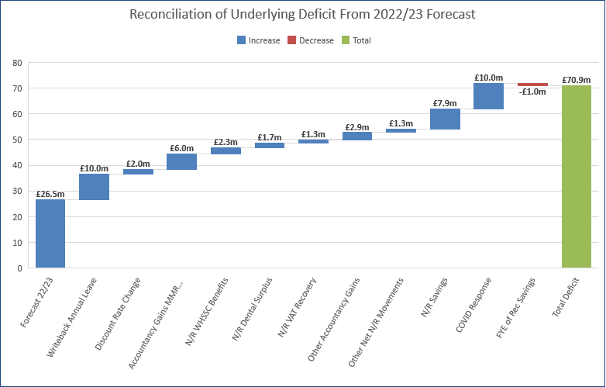
Underlying Deficit
Bridge from 2022/23
Forecast Out-turn
CYNNAL EIN
DYFODOL
YSBRYDOLI
POBL
GWELLA
GOFAL
CREU
IECHYD
Ein Hiechyd
Ein Dyfodol
DATBLYGU CYMUNEDAU
IACHACH GYDA’N GILYDD
Reconciliation
 | £'m
Forecast 22/23 | 26.5
Writeback Annual Leave | 10.0
Discount Rate Change | 2.0
Accountancy Gains MMR M9 | 6.0
N/R WHSSC Benefits | 2.3
N/R Dental Surplus | 1.7
N/R VAT Recovery | 1.3
Other Accountancy Gains | 2.9
Other Net N/R Movements | 1.3
N/R Savings | 7.9
FYE of Rec Savings | -1.0
COVID On-going Response | 10.0
Total Deficit | 70.9
Planned £26.5m deficit remains the forecast for 2022/23 position.
Position underpinned by:
£10m non recurrent annual leave benefits
£7.9m non recurrent savings
£8.9m accountancy gains
£7.3m 22/23 in year non recurrent benefits
£10.0m On-going COVID response
IMTP Update
Board Briefing – February 2023

Slide 14
New Cost Pressures: Inflationary Costs
CYNNAL EIN
DYFODOL
YSBRYDOLI
POBL
GWELLA
GOFAL
CREU
IECHYD
Ein Hiechyd
Ein Dyfodol
DATBLYGU CYMUNEDAU
IACHACH GYDA’N GILYDD
New Cost Pressures
 | £m | Comment
CHC inflation- estimate 10% on £50m | 5.0 | NCCU estimates are higher. Risk of £2.4m included in risk table .
FNC inflation- estimate 10% on £5m | 0.5
Non-pay inflation- estimate 9.2% on £100m | 9.2 | Based upon DoF CPI agreement.
Primary care prescribing inflation - estimate 4.5% on £100m | 4.2 | This is consistent with our estimate of the actual price growth in 22/23.
Primary care prescribing inflation - FYE of CAT M price changes | 2.1 | Assumes Q4 price changes continue for 23/24. This excludes NCSO where we are assuming forecast 22/23 out-turn will continue in 23/24. Included in risk table.
LTA Inflation- core 1.5% | 2.3 | Assumes that we pass on the 1.5% uplift to other Health Boards.
Agency inflation | 2.5 | Estimate is based on 5% of £56m. Not part of pay award funding in 22/23.
Consultant commitment awards | 0.3
Total | 26.1
IMTP Update
Board Briefing – February 2023

Slide 15
New Cost Pressures:
Service & Demand
CYNNAL EIN
DYFODOL
YSBRYDOLI
POBL
GWELLA
GOFAL
CREU
IECHYD
Ein Hiechyd
Ein Dyfodol
DATBLYGU CYMUNEDAU
IACHACH GYDA’N GILYDD
New Cost Pressures
 | £m | Comment
CHC growth | 1.4 | This is consistent with our estimate of the actual volume growth in 22/23 ( exc D2RA).
Primary care prescribing - volume growth | 1.7 | This is consistent with our estimate of the actual volume growth in 22/23.
NICE - internal | 1.0 | Potential risk
NICE - external | 2.0 | This is consistent with our estimate of the actual volume growth in 22/23.
Internal unavoidable cost pressures | 2.0 | Statutory and contractual obligations
Claims WRP | 0.2
WHSSC demand and cost pressures | 2.1 | Consistent with latest WHSSC ICP
EASC demand and cost pressures | 0.9 | TBC as awaiting EASC plans
NCCU | 0.0
DHCW - National priorities | 1.0 | Work on going to confirm unavoidable pressures
Total | 12.3
IMTP Update
Board Briefing – February 2023

Slide 16
Savings Plans
CYNNAL EIN
DYFODOL
YSBRYDOLI
POBL
GWELLA
GOFAL
CREU
IECHYD
Ein Hiechyd
Ein Dyfodol
DATBLYGU CYMUNEDAU
IACHACH GYDA’N GILYDD
Savings Plans
The draft savings target for 23/24 of £27.3m is big step up from what the Health Board has delivered in recent years. The target is ambitious and the risk has been included in our Risk table.
The first cut bottom up plans submitted in December identified only £7.3m of saving plans. Our financial review meetings have focused on the need to improve the savings position and the second cut plans are due on 24 February.
The draft plan for 23/24 is based on a Control Total approach, where Care Groups need to deliver a 2% improvement on their forecast out-turn positions for 22/23. This means that, in addition to a new 2% improvement target, they will also need to deliver circa £10m of net NR benefits delivered in 22/23 and manage new In year pressures.
The second cut plans due on the 24th February will also identify pipeline savings plans for years 2 & 3.
The Value & Efficiency programme is also due to submit their enabling programmes by the 24th February.
IMTP Update
Board Briefing – February 2023

Slide 17
CYNNAL EIN
DYFODOL
YSBRYDOLI
POBL
GWELLA
GOFAL
CREU
IECHYD
Ein Hiechyd
Ein Dyfodol
DATBLYGU CYMUNEDAU
IACHACH GYDA’N GILYDD
Draft Plans Compared
to First Cut Plans
Plan Comparison
Draft plan v First cut plans | Draft plan | First cut plans | Difference
 | £m | £m | £m
Internal cost pressures | 2.0 | 6.1 | 4.1
Savings | -27.3 | -7.3 | 20.0
Risks | 0 | 15.8 | 15.8
Total | -25.3 | 14.6 | 39.9
IMTP Update
Board Briefing – February 2023

Slide 18
Risk & Opportunities
CYNNAL EIN
DYFODOL
YSBRYDOLI
POBL
GWELLA
GOFAL
CREU
IECHYD
Ein Hiechyd
Ein Dyfodol
DATBLYGU CYMUNEDAU
IACHACH GYDA’N GILYDD
Risk & Opportunities
 | Risk | Opportunity
 | £m | £m
Shortfall against planned savings delivery of £27.3m | 15.0
Return to Cost & Volume LTA arrangements in 23/24 | 2.0
Contracting risks with other Health Boards | 5.1
Provider & Commissioner relationship for exceptional inflation/cost pressures – WAST/Velindre/NWSSP/DHCW | tbc
Funding included in anticipated allocations (Slide 7) not fully funded by WG | tbc
CHC price inflation in 23/24 exceeds the £5m (10%) included in draft plan | 2.4
Potential additional RLW funding for 23/24 - not yet confirmed |  | 2.4
Primary care prescribing - NCSO costs greater than 22/23 out-turn | tbc
Primary care prescribing - CATM price risk in 23/24 | tbc
Pension changes to 1995 scheme and more staff opting back in | 1.5
Increased GPOOH rates due to annual leave | 0.5
Significant uncertainty surrounding energy costs for 23/24 | tbc | tbc
Uncertainty surrounding which local costs can be charged against the Regional PCR top slice of £7.7m | 7.7
Additional balance sheet opportunities - above £3m included in draft plan |  | 5.0
Movement in Annual leave provision |  | tbc
Retrospective vat recoveries - Primary care and Microsoft contract |  | 1.0
Potential to recharge NWSSP for increased energy costs for laundry |  | 1.5
Potential restriction of investment/cost pressures – WHSSC/EASC/DHCW |  | 1.0
Total | 34.2 | 9.9
IMTP Update
Board Briefing – February 2023

Slide 19
WG Enhanced Monitoring Requirements
CYNNAL EIN
DYFODOL
YSBRYDOLI
POBL
GWELLA
GOFAL
CREU
IECHYD
Ein Hiechyd
Ein Dyfodol
DATBLYGU CYMUNEDAU
IACHACH GYDA’N GILYDD
Enhanced Monitoring Requirements
Enhanced Monitoring requirements:
  Commit to developing and submitting a credible 3-year IMTP in line with the current planning framework.
  Set out the actions in place to develop the plan and respond to the financial deficit and report monthly on progress.
Conditions for de-escalation:
  The development of a credible three-year medium-term plan or an approvable annual plan.
  Agreement of a robust three-year financial plan to meet its financial duties.
  Agreement of and sustainable progress made towards a finance improvement trajectory
IMTP Update
Board Briefing – February 2023

Slide 20
Milestones
CYNNAL EIN
DYFODOL
YSBRYDOLI
POBL
GWELLA
GOFAL
CREU
IECHYD
Ein Hiechyd
Ein Dyfodol
DATBLYGU CYMUNEDAU
IACHACH GYDA’N GILYDD
Continue to test the draft plan with WG ( Shared on 6 Feb) and benchmark our position with other Health Boards. The financial challenge across Wales is also very significant/unaffordable.
Care Groups & Directorates to submit second cut finance plans by 24/02/2023 . Continued focus on developing robust, deliverable savings and recovery plans.
Health board wide Enabling Projects (Medical, Nursing, Medicines, Non Pay etc) to also submit their detailed plans /deliverables for 23/24 by 24th February, including clarity on any investment requirements.
Agree the Cost reduction plan for ongoing Covid response costs.
Detailed plans needed for the following Ring fenced allocations by 24th February:
      Planned Care Recovery
      Six Goals
      RIF
      Dental
      Mental Health
      Vaccination and TTP
Detailed plans & funding sources also needed for the following significant cost pressures (not included in the latest draft plan):
      Overseas nursing recruitment
      Swansea Bay repatriation schemes ( Orthopaedics and Breast)
      Aneurin Bevan Contracting risks
      Records Digitisation project
IMTP Update
Board Briefing – February 2023

Slide 21
Next Steps
CYNNAL EIN
DYFODOL
YSBRYDOLI
POBL
GWELLA
GOFAL
CREU
IECHYD
Ein Hiechyd
Ein Dyfodol
DATBLYGU CYMUNEDAU
IACHACH GYDA’N GILYDD
Submit an Accountable Officer letter to WG by 28 February if unable to submit a balanced IMTP.
Agree the Accountability structure and Accountability letters before the start of 23/24.
Develop our savings plans/pipeline savings for years 2 and 3 to help inform a credible 3 year plan.
IMTP Update
Board Briefing – February 2023

Slide 22
Care Groups

Slide 23
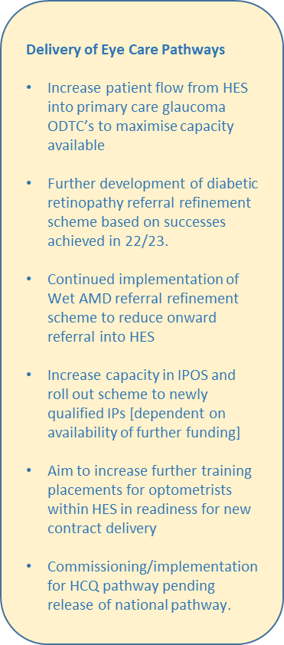
Primary &
Community Care
CYNNAL EIN
DYFODOL
YSBRYDOLI
POBL
GWELLA
GOFAL
CREU
IECHYD
Ein Hiechyd
Ein Dyfodol
DATBLYGU CYMUNEDAU
IACHACH GYDA’N GILYDD
Ministerial Expectations:
Primary & Community Care Group Transformation Portfolio
    8 work streams including:
      Cross cutting pathways
      Primary care contracting reform and access
      Workforce
      Digital
      Estates
      Enablers
      Community hospital development
      Out of hospital service development
Improved access to GP and Community Services
Increased access to dental services
Improved use of community pharmacy
Improved use of optometry services
IMTP Update
Board Briefing – February 2023

Slide 24
CYNNAL EIN
DYFODOL
YSBRYDOLI
POBL
GWELLA
GOFAL
CREU
IECHYD
Ein Hiechyd
Ein Dyfodol
DATBLYGU CYMUNEDAU
IACHACH GYDA’N GILYDD
Primary Care Plans
GMS Contract Reform
Aim: Implementation of the new unified contract and to maximise access to quality GMS services
Access Standards – to ensure all practices are compliant with standards and are providing equitable service delivery across the CTM footprint.
Support practices to monitor and improve patient experience
To ensure robust monitoring processes are put in place
To review all current enhanced services to ensure that they are value based. Links with the cross cutting pathways programme 3
Sustainability – develop robust sustainability plans
Redesign of Primary Care Support Unit
Aim: Return current managed practice to independent status to release workforce to support sustainability plan
Review skillset of current salaried GP workforce and identify opportunities for service development with clusters and communities.
Utilise primary care team to support sustainability within Independent Practices.
Dental Services Contract Reform:
Aim: Implement the new dental services contract reform for 2023/24 and to maximise access to quality dental services.
Ensure revised monitoring processes in place in line with amended WG measures for DCR 23/24
Continued engagement with WG/practices on activity & monitoring processes for 23/24
and implementation of new contract from 01/04/24
Continue to realign contracts where necessary/re-commission activity to improve access
Development of new practice [Bridgend]/ dev. of intermediate services
Establish collaboration groups/cluster lead as part of ACD
Salaried Service Redesign:
Review clinical/A & C staffing structure across DTU/CDS/EDS [undertake OCP to realign services & roles]
Develop plan to review CDS estate across CTM with view to closing clinics/pooling workforce to improve access
Streamline IT software to enhance clinic utilisation and data collection across all services
Optometry Services Contract Reform
Aim: Implement the new general optometry service (GOS) contract reform and to maximise access to quality optometry services.
Engage with Occupational Health Dept on WG expectations under new contract
Engagement with SEWROC/contractors around the new optometry contract
Establish levels of WGOS services to be delivered and equity across the CTM footprint
Establish contract monitoring team
Establish contract monitoring processes
Communicate with Secondary Care on revised/new clinical optometry pathways
Establish collaboration groups/cluster lead as part of ACD
Ensure maximum take up of
Maximise access to optometry services
IMTP Update
Board Briefing – February 2023

Slide 25
Urgent &
Emergency Care
CYNNAL EIN
DYFODOL
YSBRYDOLI
POBL
GWELLA
GOFAL
CREU
IECHYD
Ein Hiechyd
Ein Dyfodol
DATBLYGU CYMUNEDAU
IACHACH GYDA’N GILYDD
Ministerial Expectations:
SDEC T&F to explore the capital opportunities to improve SDEC offer at the sites
SDEC T&F group to embed, review and refine medical and surgical SDEC offer at all sites
Acute Medicine T&F Group identify gains in reduced LOS from D2RA and reduced bed occupancy and Improve and sustain LOS in Acute Medical Units
Hot Clinic Task & Finish group to embed hot clinic model, review and refine and gain a better understanding of demand
Acute Frailty Task & Finish Group to review and refine phase 1 of Acute Frailty model and implement phase 2
Pathway 1 T&F Group to implement Stay Well @ Home (SW@H) in Q1 and review and refine model in Q2 & Q3
Implementation of ambulance handover improvement plan
Implementation of a 24/7 urgent care service, accessible via NHS 111 Wales to support improved access and GMS sustainability
Implementation of Same Day Emergency Care services that complies with the following: Is open 5 days a week moving to 7 days a week 12 hours a day by end of Q2 Is accessible at key times evidenced by the emergency care demand profile in of each hospital site Is direct access and bypasses Emergency depts Delivers a service for at least medical and surgical same day care Is accessible to by WAST clinicians as set out in their clinician referral policy to support reduction in handover as set out in the six goals handbook. Demonstrate utilisation of allocated resources by WG and measures impact as set out by the national programme
Health boards must honour commitments that have been made to reduce handover waits
IMTP Update
Board Briefing – February 2023

Slide 26
Urgent &
Emergency Care
CYNNAL EIN
DYFODOL
YSBRYDOLI
POBL
GWELLA
GOFAL
CREU
IECHYD
Ein Hiechyd
Ein Dyfodol
DATBLYGU CYMUNEDAU
IACHACH GYDA’N GILYDD
Principles
Financial sustainability
Patient safety and experience
Workforce well-being
Sustainable workforce – medical/nursing/Ops
SDEC – (to develop further through 6 Goals Programme)
Acute Frailty – imp of the outcomes of the Acute Frailty T&F group - Acute Frailty offering at the front door (SDEC/SWA) and flow into and out of hospital.
Escalation procedures and processes across USC – ensuring that these are robust and consistent pan CTM
Flow and discharge – right patient to the right ward/ GP interface with ED/review ED footprints for optimum efficiencies/RATZ to ensure snr decision making at the front door/streaming triaging/moving pts out of ED for red release /care of pts whilst waiting to be offloaded from ambulance/embedding a standard and expected outcomes for Huddles/on-boarding/Red2Green implementation/Safe 2 Start e.g. feeding into 10 am bed meeting/e-whiteboards.
Deliver a sustainable and reliable proves for improving the acute stroke service (contribution to wider pathway working with other CGs and support to the regional work. Ref to the Snap KPIs)
Major Trauma – compliance with regional standards of MT Care. Development of an Action Plan.
Critical Care – support and implement the recs of the CC Re-configuration Programme.
Virtual Ward – Pilot via development of an Acute Respiratory Virtual Ward (link with Nav Hub and comm Resp nurses)
IMTP Update
Board Briefing – February 2023

Slide 27
CYNNAL EIN
DYFODOL
YSBRYDOLI
POBL
GWELLA
GOFAL
CREU
IECHYD
Ein Hiechyd
Ein Dyfodol
DATBLYGU CYMUNEDAU
IACHACH GYDA’N GILYDD
Planned Care
Ministerial Expectations
52 weeks Outpatient Assessment and 104 weeks treatment recovery milestones to be achieved by 30 June 2023 and maintained throughout 2023/24 moving to 36 weeks RTT standards by March 2024
Address the capacity gaps within specific specialities to prevent further growth in waiting list volumes and set foundation for delivery of targets by March 2025 (This must include transforming outpatients follow up care, reducing follow up by 25% against 2019/20 levels by October 2023 and repurposing that capacity)
Implement regional diagnostic hubs, to reduce secondary care waiting times and meet waiting time ambition in spring 2024
Implement pathway redesign – adopting ‘straight to test model’ and onward referral as necessary
IMTP Update
Board Briefing – February 2023

Slide 28
CYNNAL EIN
DYFODOL
YSBRYDOLI
POBL
GWELLA
GOFAL
CREU
IECHYD
Ein Hiechyd
Ein Dyfodol
DATBLYGU CYMUNEDAU
IACHACH GYDA’N GILYDD
Planned Care
Planned Care Improvement
All 156 week waits for Stage 1 will be offered a TCI by the end of March
Dermatology are being outsourced down to 104 weeks
Ophthalmology being treated via Spa Medica, St Josephs and internal capacity
ENT through super Saturday clinics
IMTP Update
Board Briefing – February 2023

Slide 29
CYNNAL EIN
DYFODOL
YSBRYDOLI
POBL
GWELLA
GOFAL
CREU
IECHYD
Ein Hiechyd
Ein Dyfodol
DATBLYGU CYMUNEDAU
IACHACH GYDA’N GILYDD
Planned Care
Ov 104 Weeks Stage 1, RTT at 31 MAR 2023
Specialty | PatientsWithTCIInTarget | PatientsWITHOUTTCIInTarget | AllPatients | Cumulative
Dermatology | 43 | 1368 | 1411 | 27.0%
Ophthalmology | 85 | 1307 | 1392 | 53.7%
Ear Nose and Throat Service | 83 | 810 | 893 | 70.8%
Urology | 62 | 750 | 812 | 86.4%
Breast Surgery | 11 | 220 | 231 | 90.8%
Orthopaedics | 26 | 66 | 92 | 92.5%
General Medicine | 0 | 83 | 83 | 94.1%
Gastroenterology | 8 | 54 | 62 | 95.3%
Restorative Dentistry | 0 | 54 | 54 | 96.4%
Rheumatology | 8 | 43 | 51 | 97.3%
Colorectal | 11 | 36 | 47 | 98.2%
Oral Surgery | 0 | 32 | 32 | 98.9%
General Surgery | 21 | 4 | 25 | 99.3%
Cardiology | 3 | 18 | 21 | 99.7%
Stroke Medicine | 0 | 6 | 6 | 99.8%
Anaesthetics | 0 | 2 | 2 | 99.9%
Upper GI Surgery | 0 | 2 | 2 | 99.9%
Orthodontics | 0 | 1 | 1 | 99.9%
Paediatrics | 0 | 1 | 1 | 100.0%
Gynaecology | 0 | 1 | 1 | 100.0%
Respiratory Medicine | 0 | 1 | 1 | 100.0%
 |  | 4859
IMTP Update
Board Briefing – February 2023

Slide 30
CYNNAL EIN
DYFODOL
YSBRYDOLI
POBL
GWELLA
GOFAL
CREU
IECHYD
Ein Hiechyd
Ein Dyfodol
DATBLYGU CYMUNEDAU
IACHACH GYDA’N GILYDD
Planned Care
Planned Care Improvement
End of June 2023 Targets
  Delivery of the 104 week target for stage 4 in all specialties excluding
    Gynaecology – end Q2
    ENT - end Q3
    Urology – end Q3
  Delivery of the 52 week target for stage 1 in all specialties excluding
    Ophthalmology – end Q3
    ENT – end Q3
    Dermatology – end Q2
    Urology – end Q3
    Orthodontics/Restorative dentistry
End of March 2024
  Working towards a 78 week RTT position
IMTP Update
Board Briefing – February 2023

Slide 31
CYNNAL EIN
DYFODOL
YSBRYDOLI
POBL
GWELLA
GOFAL
CREU
IECHYD
Ein Hiechyd
Ein Dyfodol
DATBLYGU CYMUNEDAU
IACHACH GYDA’N GILYDD
Planned Care
Planned Care Improvement
Stage 1
  Outpatient Capacity
  Unwarranted levels of demand in key specialties
Stage 4
  Theatre capacity challenges
  Consultant capacity in key
Stage 1
    Additional outsourcing prior to March 23
    Additional appointments to key specialties
    Application of new INNU policy
    Establishment of interface services in Dermatology and ENT
Stage 4
    Additional insourcing to open 2 theatres at POW
    Revised Orthopaedic Trauma model
    Centralisation of Urology and H&N oncalls
    Application of new INNU policy
IMTP Update
Board Briefing – February 2023

Slide 32
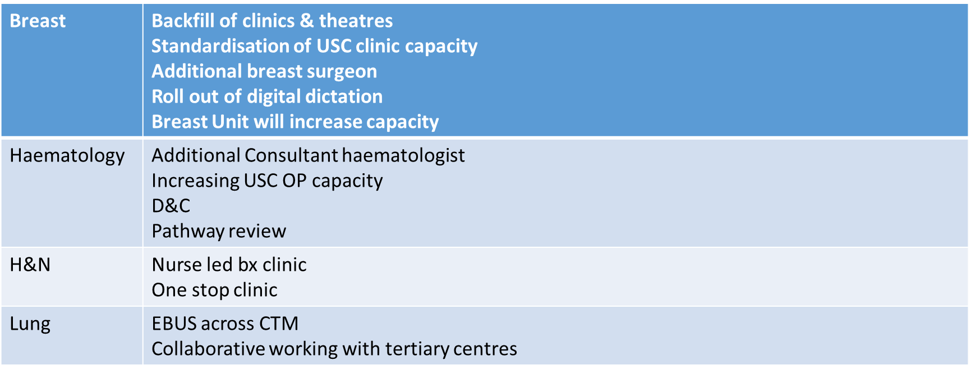
CYNNAL EIN
DYFODOL
YSBRYDOLI
POBL
GWELLA
GOFAL
CREU
IECHYD
Ein Hiechyd
Ein Dyfodol
DATBLYGU CYMUNEDAU
IACHACH GYDA’N GILYDD
Planned Care
Cancer Improvement
Reduction in backlog of patients waiting over 62 days to enable delivery of 75% of patients starting their first definitive cancer treatment 62 days from point of suspicion
Implement the agreed national cancer pathways within the national target – demonstrating annual improvement toward achieving target by March 2026
IMTP Update
Board Briefing – February 2023

Slide 33
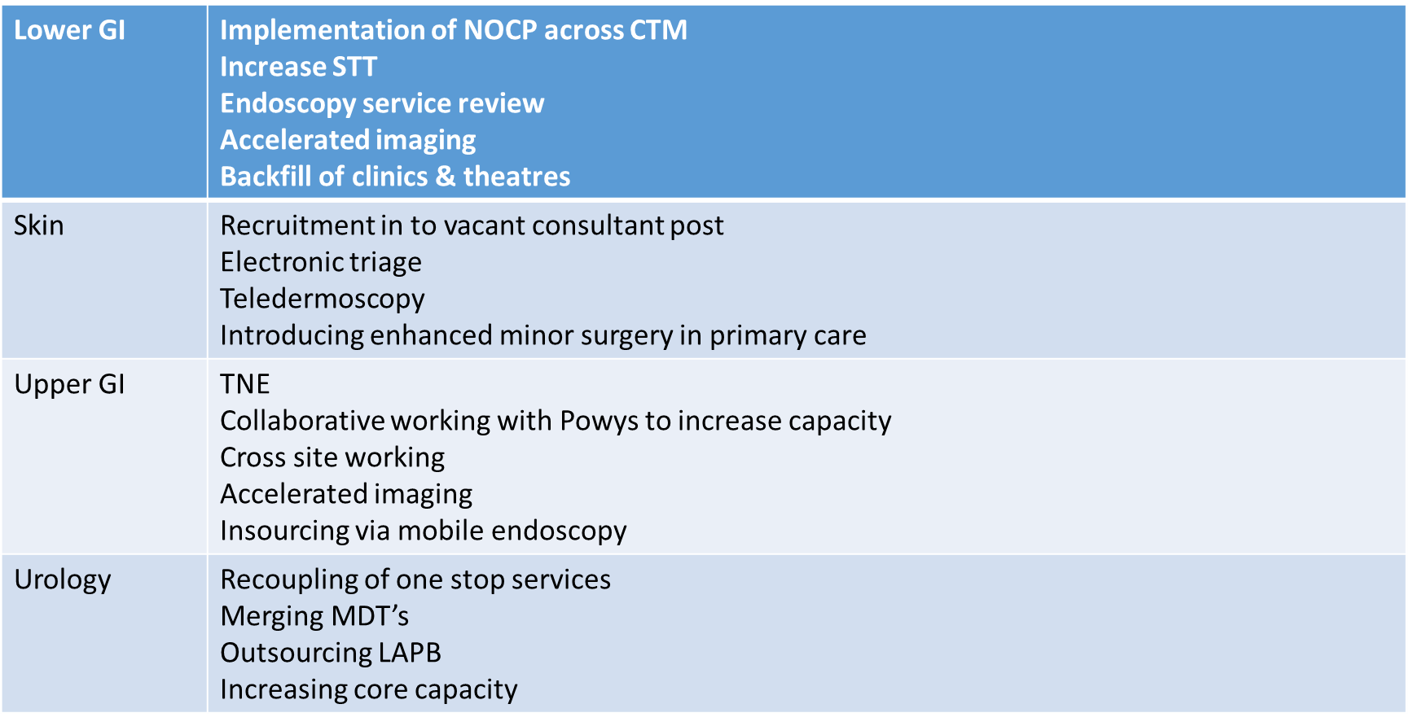
CYNNAL EIN
DYFODOL
YSBRYDOLI
POBL
GWELLA
GOFAL
CREU
IECHYD
Ein Hiechyd
Ein Dyfodol
DATBLYGU CYMUNEDAU
IACHACH GYDA’N GILYDD
Planned Care
Cancer Improvement
IMTP Update
Board Briefing – February 2023

Slide 34
CYNNAL EIN
DYFODOL
YSBRYDOLI
POBL
GWELLA
GOFAL
CREU
IECHYD
Ein Hiechyd
Ein Dyfodol
DATBLYGU CYMUNEDAU
IACHACH GYDA’N GILYDD
Planned Care
Regional Planning
Ophthalmology:
Strategy
Regional cataract service business case
    For approval by boards March 2023
Diagnostics:
Community Diagnostic Centres
      Service specification in development for regional approval
Endoscopy
Pathology
Orthopaedics
IMTP Update
Board Briefing – February 2023

Slide 35
Mental Health
& LD
CYNNAL EIN
DYFODOL
YSBRYDOLI
POBL
GWELLA
GOFAL
CREU
IECHYD
Ein Hiechyd
Ein Dyfodol
DATBLYGU CYMUNEDAU
IACHACH GYDA’N GILYDD
Ministerial Requirements
Recover waiting time performance to performance framework standards for all age LPMHSS assessment and intervention and Specialist CAMHS.
Implement 111 press 2 on a 24/7 basis for urgent mental health issue
Primary Prevention and Wellbeing
Whole Schools Approach (Improving Care)
    NEST
MH in Primary Care– an Integrated Approach (Improving Care)
Early Intervention in Psychoses
Perinatal Mental Health
Dementia Standards - Community Engagement & Dementia Connectors
IMTP Update
Board Briefing – February 2023

Slide 36
Mental Health
& LD
CYNNAL EIN
DYFODOL
YSBRYDOLI
POBL
GWELLA
GOFAL
CREU
IECHYD
Ein Hiechyd
Ein Dyfodol
DATBLYGU CYMUNEDAU
IACHACH GYDA’N GILYDD
Secondary Prevention and Wellbeing
111#2 urgent and routine single point of access (Improving Care)
Wellbeing Retreats and alternatives to admission - All Age (Improving Care)
Psychiatric Liaison Model (Improving Care)
A Psychologically Informed Workforce (Inspiring People & Improving Care)
Dementia Standards - Hospital Charter & Learning & Development
IMTP Update
Board Briefing – February 2023

Slide 37
Mental Health
& LD
CYNNAL EIN
DYFODOL
YSBRYDOLI
POBL
GWELLA
GOFAL
CREU
IECHYD
Ein Hiechyd
Ein Dyfodol
DATBLYGU CYMUNEDAU
IACHACH GYDA’N GILYDD
Tertiary Prevention and Wellbeing
Inpatient care models and accommodation (Improving Care)
Substance Misuse Detox Models & Pathways (Creating Health)
Annual Health Checks – WISE Programme (Creating Health)
Learning Disability in Primary Care and secondary acute care (Creating Health)
High Intensity Rehabilitation – Inpatient (Improving Care)
Community Rehabilitation bed and community based models (Improving Care)
Women’s Trauma bed and community based models
Dementia Standards - Memory Assessment & Metrics (Improving Care)
IMTP Update
Board Briefing – February 2023

Slide 38
Children &
Families
CYNNAL EIN
DYFODOL
YSBRYDOLI
POBL
GWELLA
GOFAL
CREU
IECHYD
Ein Hiechyd
Ein Dyfodol
DATBLYGU CYMUNEDAU
IACHACH GYDA’N GILYDD
Priority Development Areas:
Children and young people’s community services
Children and young people’s acute services
Safeguarding
Maternity and neonatal services
Gynaecology
Integrated sexual health services
IMTP Update
Board Briefing – February 2023

Slide 39
Children &
Families
CYNNAL EIN
DYFODOL
YSBRYDOLI
POBL
GWELLA
GOFAL
CREU
IECHYD
Ein Hiechyd
Ein Dyfodol
DATBLYGU CYMUNEDAU
IACHACH GYDA’N GILYDD
Children & Young People’s Community Services
Neurodevelopmental service and pathway
    Review of current pathway and service redesign.
Obesity in children and young people
Paediatric Bladder and Bowel Services
Transformation of Health Visiting Services
Transformation of School Nursing Services
Breastfeeding Services
IMTP Update
Board Briefing – February 2023

Slide 40
People

Slide 41



Our People
CYNNAL EIN
DYFODOL
YSBRYDOLI
POBL
GWELLA
GOFAL
CREU
IECHYD
Ein Hiechyd
Ein Dyfodol
DATBLYGU CYMUNEDAU
IACHACH GYDA’N GILYDD
Our People Priorities
Support and improve the physical, emotional and financial well–being and safety of our people
Improve what it is like to work at CTM through positive employee experience
Create a culture that is inclusive, recognises and celebrates difference, and is anti-racist
Improve our culture across the Health Board to ensure CTM can be at its best
Enhance our leadership and management capability, creating compassionate and collective leadership
Support workforce and service change within the Health Board to deliver our four goals and clinical strategy ambitions.
Develop and deliver strategic workforce plans which fill our gaps, as well as modernising our workforce now and for the future
Create a thriving Welsh language culture and identity, improving skills and awareness
Create pathways to employment for our local communities, linked to workforce plans, as an anchor institution
Improve the quality of our workforce data and use this to drive intelligence and improved performance
IMTP Update
Board Briefing – February 2023

Slide 42
Our People
CYNNAL EIN
DYFODOL
YSBRYDOLI
POBL
GWELLA
GOFAL
CREU
IECHYD
Ein Hiechyd
Ein Dyfodol
DATBLYGU CYMUNEDAU
IACHACH GYDA’N GILYDD
Key Workforce Challenges & Opportunities
Operational pressures:
  Pressures: Flow, urgent and emergency services, elective recovery
  Ongoing service change
Recruitment & Retention:
  Skills shortages & hard to fill roles
  Competitive labour market
  Ageing workforce
  High levels of turnover
  Increased numbers of leavers aged 21-35
  Over reliance on temporary workforce
Medical & Nursing Productivity – how do we maximise the efficiency, effectiveness & sustainability of precious resource?
IMTP Update
Board Briefing – February 2023

Slide 43
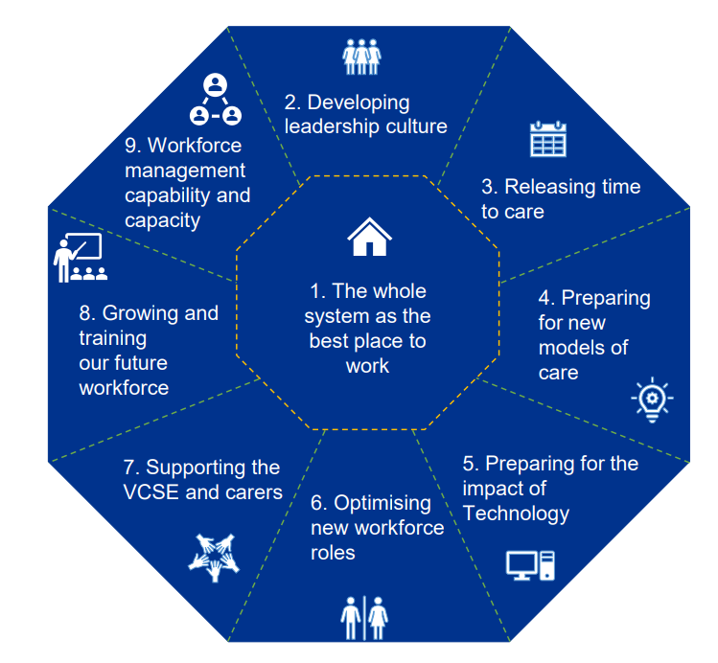
Our People
CYNNAL EIN
DYFODOL
YSBRYDOLI
POBL
GWELLA
GOFAL
CREU
IECHYD
Ein Hiechyd
Ein Dyfodol
DATBLYGU CYMUNEDAU
IACHACH GYDA’N GILYDD
Strategic Workforce Planning
KPMG Project
Designed to kick start a refreshed organisational approach to strategic workforce planning. This work will support us to respond in an agile and effective way to the challenges we are facing, as well as leverage emerging opportunities for doing things differently. Outputs will be:
  A maturity assessment that maps out capacity and capability against trends and future requirements across 9 lenses
  A Tactical & Transformational Opportunities Analysis, including a benefits profile and implementation plan
  A Workforce Forecast Model for the next 5-10 years
Supply & Demand: Recruitment & Retention
Formation of Retention Group to oversee agenda & development of new initiatives
Input & influence in HEIW & Welsh Government work programmes
Deep dive into our turnover data
Overseas Recruitment Programmes
Refreshed approach to Medical Recruitment
Workforce Modernisation, including expansion of alternative roles & pathways to employment
Longer term planning of Health & Social care partnerships and multi-agency working
IMTP Update
Board Briefing – February 2023

Slide 44
Digital & Data

Slide 45
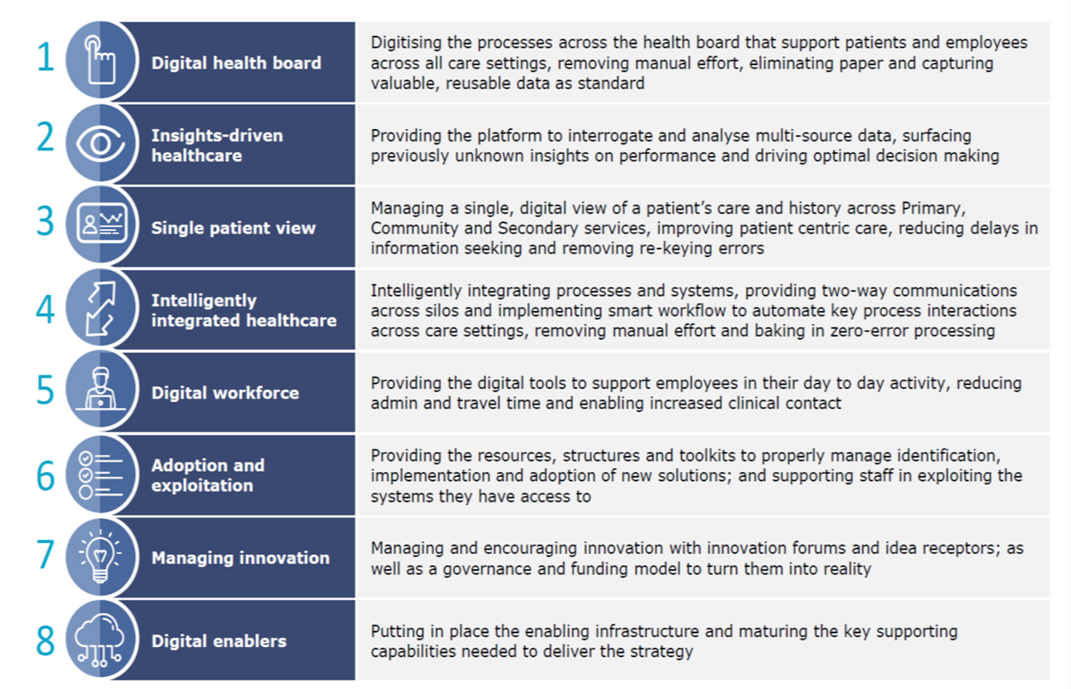
Digital & Data:
Strategic Overview
CYNNAL EIN
DYFODOL
YSBRYDOLI
POBL
GWELLA
GOFAL
CREU
IECHYD
Ein Hiechyd
Ein Dyfodol
DATBLYGU CYMUNEDAU
IACHACH GYDA’N GILYDD
Strategic Overview
Underlying Themes
Digital Structure / Setting Foundations
Health Board Alignment
Maximising Existing Tools
Data Driven Service Development
Digital & Data Capabilities
Enabling Digital Ways of Working
Regional Working
Patient Centred Contact
Automate where we can
Strategic Partner(s)
IMTP Update
Board Briefing – February 2023

Slide 46






Ein Hiechyd
Ein Dyfodol
DATBLYGU CYMUNEDAU
IACHACH GYDA’N GILYDD
Digital & Data:
Ambition v. Affordability
CYNNAL EIN
DYFODOL
YSBRYDOLI
POBL
GWELLA
GOFAL
CREU
IECHYD
Core Requirements & Expectations
Meeting an Ambition & Appetite to work differently
Significant Digital Debt – The Resource Gap – Digital Capacity – Digital Capabilities
reliance on outdated Devices / Core Technology / Systems
reliance on Business as Usual Solutions without sustainable long term funding
reliance on Business Intelligence / Data Driven Service Design / Telling our Story
reliance on the need to deliver Compliance activities at pace
need for Digital Education & visible Digital & Data presence
Cwm Taf Morgannwg UHB
Escalation Meeting

Slide 47
Ein Hiechyd
Ein Dyfodol
DATBLYGU CYMUNEDAU
IACHACH GYDA’N GILYDD
Digital & Data:
Ambition v. Affordability
CYNNAL EIN
DYFODOL
YSBRYDOLI
POBL
GWELLA
GOFAL
CREU
IECHYD
Core Programmes of Work & Expectations
Alignment of Core Systems across the Health Board & Core Infrastructure Replacement
Maximising existing tools – electronic test requesting, patient referrals, eForm development
National Systems
  Welsh Nursing Care Record
  Welsh Community Care Information System
  Welsh Critical Care System
All Wales Procurements – ePrescribing, LINC, RISP
eWhiteboards Development
Patient Centred Contact Programme – including NHS Wales App, Supporting Platform, Remote Monitoring, Virtual Ward
Theatre Management System Development
Key Issue: Short Term – Non-Recurrent Funding or Some of the above continues to be unfunded
Cwm Taf Morgannwg UHB
Escalation Meeting

Slide 48
Ein Hiechyd
Ein Dyfodol
DATBLYGU CYMUNEDAU
IACHACH GYDA’N GILYDD
Digital & Data:
Ambition v. Affordability
CYNNAL EIN
DYFODOL
YSBRYDOLI
POBL
GWELLA
GOFAL
CREU
IECHYD
The Gap
Short Term resources ending in 2023 – circa 20 staff will leave the team
Investment in Compliance areas are critical to enable programmes of work
Service change / training roles to bridge the digital capability gap
Increase in core service costs (e.g. DHCW SLA)
Digital Patient Notes Programme
The “unknowns” – national & all wales procurements
Difficult choices will need to be made on what we support & what we need to plan for in subsequent years
IMTP Update
Board Briefing – February 2023
Cwm Taf Morgannwg UHB
Escalation Meeting

