Slide 1

Ein Hiechyd
Ein Dyfodol
DATBLYGU CYMUNEDAU
IACHACH GYDA’N GILYDD
SAS Achievements Showcase Conference
Kier Hardie Health Park
27 May 2022
Digital @ Cwm Taf Morgannwg University Health Board

Slide 2






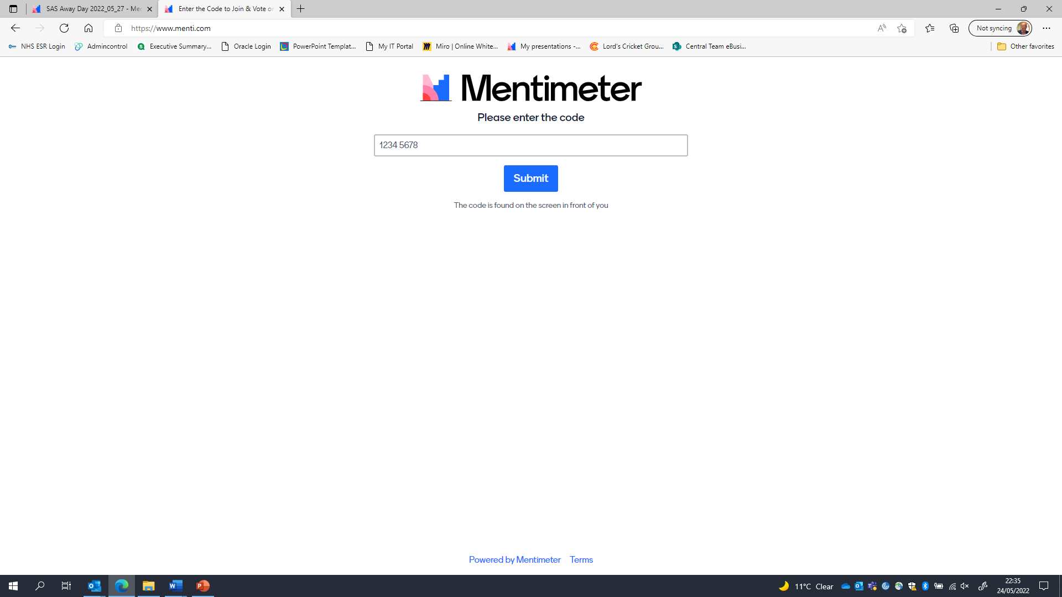
Introduction to Mentimeter…
CYNNAL EIN
DYFODOL
YSBRYDOLI
POBL
GWELLA
GOFAL
CREU
IECHYD
Ein Hiechyd
Ein Dyfodol
DATBLYGU CYMUNEDAU
IACHACH GYDA’N GILYDD
Using any device with an internet connection
  Please open a browser and go to…
  www.Menti.com
SAS Showcase Conference – May 2022

Slide 3
CYNNAL EIN
DYFODOL
YSBRYDOLI
POBL
GWELLA
GOFAL
CREU
IECHYD
Ein Hiechyd
Ein Dyfodol
DATBLYGU CYMUNEDAU
IACHACH GYDA’N GILYDD
Meeting the Ambition
Recognising the current team of professionals
Developing a structure to meet the needs of the Health Board
Clarity on the priorities & scope of work
Devising a plan for strategic partnerships
Process improvement … onboarding … user experience
Stock piling … not without risk
Building the plan for Bridgend
Addressing the Data Challenge
Improving our communication & engagement
Maximising the Now
Standardisation
Stabilising Foundations
Ownership
Direction
Service & Digital Agreement
Building Key Partnerships
SAS Showcase Conference – May 2022

Slide 4
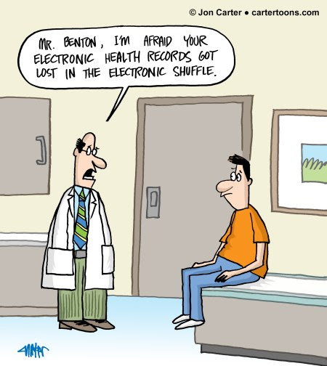
Insight into the Current Plan…
CYNNAL EIN
DYFODOL
YSBRYDOLI
POBL
GWELLA
GOFAL
CREU
IECHYD
Ein Hiechyd
Ein Dyfodol
DATBLYGU CYMUNEDAU
IACHACH GYDA’N GILYDD
Over 100 “active” digital projects
Clarity on service lead
Some projects that have not been fully scoped
28 projects identified with funding for 2022/2023
Percentage of projects are delayed
A number of key strategic projects not funded
    For example:
    ED System, Nursing System, Open Eyes Phase2
A number of projects span multiple financial years
SAS Showcase Conference – May 2022

Slide 5

The Opportunity…
CYNNAL EIN
DYFODOL
YSBRYDOLI
POBL
GWELLA
GOFAL
CREU
IECHYD
Ein Hiechyd
Ein Dyfodol
DATBLYGU CYMUNEDAU
IACHACH GYDA’N GILYDD
Recognising the now …
Hardware / Infrastructure
Process Variation
Training & Visibility of Support
Maximising the Capability…
Mobile working / Clinical laptops
Digital end to end referral management from primary care to the OPD (including 2 way communication)
MDT & the Welsh Nursing Care Record
Increasing Availability of Clinical Information
Digital test requesting & results notification
Digital ITU
Digital visibility of the majority of clinic letters & clinical investigations
Digitally visible scanned ‘paper old notes’
O365 & mobile access to email / OneDrive
SAS Showcase Conference – May 2022

Slide 6
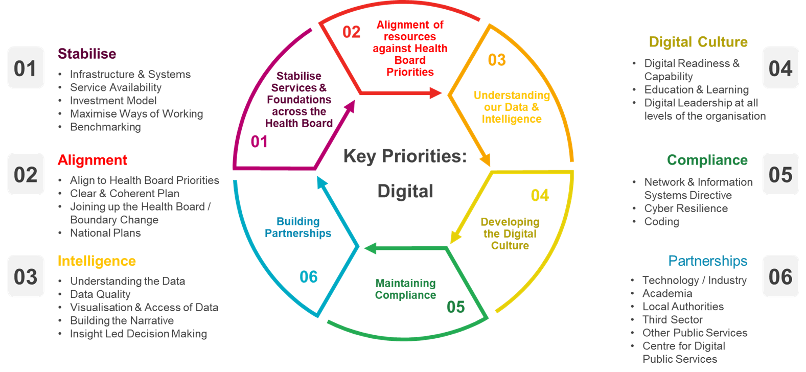
Building for the Future…
CYNNAL EIN
DYFODOL
YSBRYDOLI
POBL
GWELLA
GOFAL
CREU
IECHYD
Ein Hiechyd
Ein Dyfodol
DATBLYGU CYMUNEDAU
IACHACH GYDA’N GILYDD
SAS Showcase Conference – May 2022

Slide 7
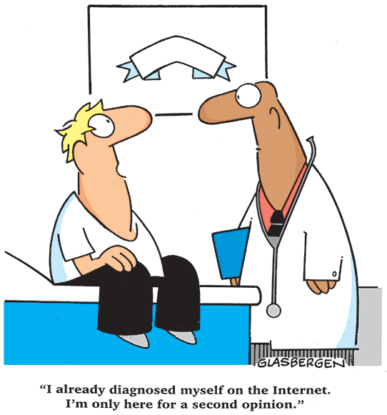
Current Year 1 Plan …
CYNNAL EIN
DYFODOL
YSBRYDOLI
POBL
GWELLA
GOFAL
CREU
IECHYD
Ein Hiechyd
Ein Dyfodol
DATBLYGU CYMUNEDAU
IACHACH GYDA’N GILYDD
Joint approval & ownership on top priorities …
    Bridgend & Alignment of the Health Board
    Stabilising the Infrastructure
    Improved responsiveness to supporting the organisation
    Performance Dashboards / Increasing Use of Data
    Strategies for Digital & Data aligned to CTM 2030
    Roadmap for Patient Platform / Patient Facing Technologies
Increasing Clinical Input into Digital
Senior Responsible Officer(s) / Leadership
Clarity on process for changes to the plan
A digital structure that responds to the operating model / CTM 2030 Strategy
SAS Showcase Conference – May 2022

