Slide 1


Cwm Taf Morgannwg University Health Board
Annual Plan
May 2023

Slide 2







Background
CYNNAL EIN
DYFODOL
YSBRYDOLI
POBL
GWELLA
GOFAL
CREU
IECHYD
Ein Hiechyd
Ein Dyfodol
DATBLYGU CYMUNEDAU
IACHACH GYDA’N GILYDD
As confirmed by the Board on 30th March 2023, the 2023-2026 planning submission to Welsh Government was not able to be formally approved by the Board on the basis that it was not possible for the Health Board to meet its legal duties for financial balance over three years.
The plan which forms an annual plan format was noted for submission to Welsh Government, with an overall financial position of a predicted overspend of £79.6m, which was consistent with existing financial strategy to at least break-even in year and on the following assumptions:
Only limited investments will be made in key areas (Planned care £5.5m, Stroke £0.5m, Digital £1m, overseas recruitment £1.5m)
There are resultant risks in delivery of the plan across quality, performance and finance
Welsh Government response: the plan of 31st March 2023 not approvable – due to financial position, risks in financial position, also to delivery. Seeking improvement in 31st May re-submission.
IMTP
May 2023

Slide 3
Purpose
CYNNAL EIN
DYFODOL
YSBRYDOLI
POBL
GWELLA
GOFAL
CREU
IECHYD
Ein Hiechyd
Ein Dyfodol
DATBLYGU CYMUNEDAU
IACHACH GYDA’N GILYDD
Consider the proposed 31st May 2023 submission
Proposal:
  Remain as per the 31st March 2023 financially
  Continue to seek to de-risk the plans by improving savings position
  Submit revised ministerial templates with more detail on delivery
IMTP
May 2023

Slide 4
In-year financial opportunities
CYNNAL EIN
DYFODOL
YSBRYDOLI
POBL
GWELLA
GOFAL
CREU
IECHYD
Ein Hiechyd
Ein Dyfodol
DATBLYGU CYMUNEDAU
IACHACH GYDA’N GILYDD
Executives continue to review the feasibility of a range of opportunities, including ‘difficult choices’
The final options appraisal will be shared with IMs on completion, prior to submission to WG.
Categories are as follows:
Delays to service improvements or dilution of service standards: Considered unsupportable since equality impact assessments highlight differential impact on those with the greatest burden of disease. This is counter to UHB strategic intention
Service changes: Will require due consultation processes; so benefits will be impossible to realise this year but are articulated for years 2 & 3
Some temporary service changes and support service changes can be considered with potential contribution to the savings plan in year 1
More robust equitable access criteria – will be supported
Back office schemes: will be taken up to strengthen the savings plan
National policies – to continue to discuss with national colleagues
Outcome: Further work to arrive at plans and figures to close gap in 23/24 savings plan
IMTP
May 2023

Slide 5
Financial Plan update

Slide 6
Month 1
Overall Summary
CYNNAL EIN
DYFODOL
YSBRYDOLI
POBL
GWELLA
GOFAL
CREU
IECHYD
Ein Hiechyd
Ein Dyfodol
DATBLYGU CYMUNEDAU
IACHACH GYDA’N GILYDD
Year to Date
Position
As at M1, we are reporting a total deficit of £6.6m, which is in line with the draft plan of £6.6m ( i.e. 1/2th of the forecast deficit of £79.6m).
The Core plan position is reporting a £5.9m deficit which is in line with 1/12th of the forecast deficit of £70.9m. This includes a £2m shortfall against the M1 savings target of £2.3m, offset by £2m of favourable operating variances across the Care Groups and Directorates
Exceptional energy costs is reporting a £0.7m deficit. This is consistent with 1/12th the forecast deficit of £8.7m for 23/24.
The COVID Programme expenditure is £0.6m is matched with anticipated funding from WG to give a break-even position.
Forecast Position
Forecast Core plan deficit has remained at £70.9m.
  The savings plans at M1 are reporting a shortfall of £18.3m against the target of £27.3m.
  There remain further risks to the plan of £16.7m (excluding savings risks), see page 18 (Risks & Opportunities)
Forecast Exceptional energy costs have remained at £8.7m.
Forecast COVID costs have increased to £11.7. This represents an increase of £2.6m compared to the draft financial plan, but the increase is anticipated to be funded in full by WG.
2023-24 Finance Report – Month 1

Slide 7
Ein Hiechyd
Ein Dyfodol
DATBLYGU CYMUNEDAU
IACHACH GYDA’N GILYDD
Savings - Background
CYNNAL EIN
DYFODOL
YSBRYDOLI
POBL
GWELLA
GOFAL
CREU
IECHYD
The draft financial plan for 23/24 is based on a ‘Control Total’ approach which requires the Care Groups and Directorates to deliver a maximum allowable overspend of £23.8m.To meet the Control Total Care Groups and Directorates will need to deliver a £28.3m Savings target from their M11 forecast out-turn positions for 22/23. In addition, since their forecast recurrent positions were greater than the In year positions, the Care Groups and Directorates will also need to deliver £11.7m of savings to cover the Non Recurrent benefits reported in 22/23.In summary:
Any reported overspends against the Delegated Control Total will therefore be due to.:
Shortfalls in savings to meet the £28.3m target for 23/24
Shortfalls in savings to cover the £11.7m of NR benefits reported in 22/23
Other operating variances
Delegated savings plans should only be reported against the 23/24 Savings target of £28.3m once the £11.7m of NR benefits reported in 22/23 have been covered.
 | Delegated | Non Delegated | Total
 | £'m | £'m | £'m
Assessed Underlying Position | 63.8 | -29.6 | 34.2
Savings required to cover the NR Benefits from 22/23 assumed to be delivered in 23/24 plan | -11.7 | 4.8 | -6.9
New 23/24 Savings Target | -28.3 | 1 | -27.3
Control Total | 23.8 | -23.8 | 0
2023-24 Savings Report – Month 1

Slide 8
CYNNAL EIN
DYFODOL
YSBRYDOLI
POBL
GWELLA
GOFAL
CREU
IECHYD
Ein Hiechyd
Ein Dyfodol
DATBLYGU CYMUNEDAU
IACHACH GYDA’N GILYDD
Month 1
Savings Summary
Year to Date
The M1 YTD position is reporting an adverse variance against the Control Total for delegated budgets of £56k. This is offset by a £75k favourable variance for Non Delegated budgets to give a £19k favourable position against the M1 Control Total. The M1 Delegated overspend of £56k includes:
  A shortfall against the M1 YTD Delegated 23/24 savings target of £2.1m.
  A shortfall against the M1 YTD Delegated B/Fwd savings target of £0.5m.
  Other favourable Operating Variances of £2.6m which have not yet been recognised as savings.
23/24 Savings Forecast
The forecast delegated 23/24 WG Savings achievement is £9.0m compared to the £28.3m savings target ,giving an adverse variance of £19.3m for delegated budgets.
The M1 savings plans are reporting a deterioration of £7.9m compared to the submitted IMTP at the 31st March 2023 (£16.9m).
The forecast recurrent delegated savings achievement is £9.3m compared to the recurrent target of £28.3m, giving a recurrent adverse variance of £19.0m.
Only 32% of the savings target has been identified in plans, with the recurrent plans being 33%.
Brought Forward Savings Forecast
The forecast delegated brought forward savings achievement is £7.0m compared to the £11.7m savings target, giving an adverse variance of £4.7m for delegated budgets.
The forecast recurrent delegated savings achievement is £2.1m compared to the recurrent target of £11.7m, giving a recurrent adverse variance of £9.6m.
Only 60% of the savings target has been identified in plans, with the recurrent plans falling to 18%.
2023-24 Savings Report – Month 1

Slide 9
Month 1
Savings Performance
CYNNAL EIN
DYFODOL
YSBRYDOLI
POBL
GWELLA
GOFAL
CREU
IECHYD
Ein Hiechyd
Ein Dyfodol
DATBLYGU CYMUNEDAU
IACHACH GYDA’N GILYDD
 | Year to Date Variance – Month 1
DELEGATED BUDGETS | 23/24 Savings | B/Fwd Savings | Other Operating Variances | Variance from Control Total
 | £'000 | £'000 | £'000 | £'000
Women & Children | 159 | 24 | (226) | (43)
Mental Health & LD | 230 | 173 | (284) | 119
Planned Care | 281 | 82 | (334) | 29
Diagnostics, Therapies & Specialties (CSS) | 104 | 11 | 7 | 122
Diagnostics, Therapies & Specialties (Med Mgt) | 438 | 132 | (548) | 22
Diagnostics, Therapies & Specialties (Therapies) | 52 | 0 | (91) | (39)
Unscheduled Care | 284 | (49) | 47 | 281
Primary Care & Community | 178 | 59 | (371) | (134)
Facilities Non Hub | 92 | 20 | (224) | (112)
Corporate Executives | 191 | 72 | (534) | (271)
Contracting & Commissioning | 83 | 0 | 0 | 83
TOTAL DELEGATED BUDGETS | 2,090 | 524 | (2,558) | 56
NON DELEGATED BUDGETS | (83) | (404) | 412 | (75)
TOTAL | 2,007 | 120 | (2,146) | (19)
Key Points :
The M1 YTD position is reporting an adverse variance against the Delegated Control Total of £56k. This is offset by a £75k favourable variance for Non Delegated budgets to give a total M1 favourable variance of £19k.
The M1 Delegated overspend of £56k includes:
  A shortfall against the M1 YTD Delegated 23/24 savings target of £2.1m.
  A shortfall against the M1 YTD Delegated B/Fwd savings target of £0.5m.
  Other favourable Operating Variances of £2.6m which have not yet been recognised as savings.
2023-24 Savings Report – Month 1

Slide 10
Month 1
Risks and Opportunities
CYNNAL EIN
DYFODOL
YSBRYDOLI
POBL
GWELLA
GOFAL
CREU
IECHYD
Ein Hiechyd
Ein Dyfodol
DATBLYGU CYMUNEDAU
IACHACH GYDA’N GILYDD
 | Month 1 | IMTP | Comment
 | £m | £m
Savings delivery risks:
Shortfall against planned savings delivery of £27.3m. | 9.1 | 7.5 | The latest shortfall at M1 is £18.3m and the risk has been estimated at 50%.
Forecast recurrent overspends in Care Groups not recognised in the plan. Risk of not delivering the £7.0m of NR benefits in 22/23 again in 23/24. | 3.5 | 3.5
Funding risks:
Assumed WG funding for dental – 30% abatement of the dental income target | 1.0 | 1.0 | Further clarification needed on funding assumptions for 23/24
Assumed funding for the impact of RLW in 23/24 | 1.2 | 1.2 | Further clarification needed on funding assumptions for 23/24.
Assumed funding for Regional Planned care Recovery solutions | 3.8 | 3.8 | Further clarification needed on funding assumptions for 23/24.
Risk of the 23/24 pay award not being fully funded given the £1.9m recurrent shortfall in 22/23 | 1.0 | 1.0 | Further clarification needed on funding assumptions for 23/24.
Risk of the additional costs for the extra bank holiday in 23/24 not being fully funded | 0.6 | 0.6 | Further clarification needed on funding assumptions for 23/24.
Cost pressure risks:
Return to pre Covid Cost & Volume LTA arrangements in 23/24 | 1.0 | 1.0
Contracting risks with other Health Boards | 3.1 | 1.5 | See comment on Page 17.
Provider and commissioner relationship for exceptional inflationary cost pressures such as energy – WAST and Velindre | 0.0 | Tbc | WAST and Velindre not assuming extra funding for energy cost pressures in their draft LTAs.
Primary care prescribing – inflation and volume growth different to plan assumptions | Tbc | Tbc | Prescribing data is 2m in arrears and we will not have Q1 data until August 2023.
Significant uncertainty surrounding the expected energy cost pressure | Tbc | Tbc
NICE costs exceed planned growth of £3.0m | Tbc | Tbc
Non Pay Inflation exceeds the £4.9m provision made in the plan (4.9%) | 0.0 | Tbc
Pension changes – Increased pension costs if staff opt back in following changes to the 1995 scheme | 0.8 | 0.8
Winter plans – All schemes funded non recurrently in 22/23 need to stop by 31 March | 0.8 | 0.8
Total Risks | 25.8 | 22.6
Key Points :
The draft plan highlighted several significant risks and opportunities.
As at M1 we are reporting total risks of £25.8m offset by total opportunities of £4m ( next page) to give a net position of £21.8m.
The most significant risk is the savings plan position , where the latest plans are currently £18.3m short of the £27.3m savings target.
There are also significant risks associated with the WG funding assumptions for 23/24. The risk table includes £7.6m of funding risks where further clarification is needed on the assumptions for 23/24.
There is also a £3.1m risk with ABUHB regarding the LTA arrangements for 23/24.
2023-24 Finance Report – Month 1

Slide 11
Month 1
Risks and Opportunities
CYNNAL EIN
DYFODOL
YSBRYDOLI
POBL
GWELLA
GOFAL
CREU
IECHYD
Ein Hiechyd
Ein Dyfodol
DATBLYGU CYMUNEDAU
IACHACH GYDA’N GILYDD
 | Month 1 | IMTP | Comment
 | £m | £m
Contingencies / Opportunities
Further balance sheet review within 22/23 | (2.5) | (2.5)
Retrospective vat recoveries – Primary care and Microsoft contract | (0.5) | (0.5)
Provision for an adverse movement in discount rates in 23/24 (following a positive movement in 22/23) not required | (1.0) | (1.0)
Potential to recharge NWSSP for increased energy costs for laundry | 0.0 | (0.6) | The M1 position and forecast assume that the recharge is made and recovered.
Total Opportunities | (4.0) | (4.6)
Total | 21.8 | 18.0
Key Points :
No issues to note at M1.
2023-24 Finance Report – Month 1

Slide 12
Ein Hiechyd
Ein Dyfodol
DATBLYGU CYMUNEDAU
IACHACH GYDA’N GILYDD
Conclusion
CYNNAL EIN
DYFODOL
YSBRYDOLI
POBL
GWELLA
GOFAL
CREU
IECHYD
The draft plan submitted to WG at the end of March included a forecast deficit of £79.6m. The plan also highlighted £18m of risks , most notably a £7.5m risk of not delivering sufficient savings in 23/24 to meet the £27.3m Savings target. This will require a significant step up in savings compared to recent years.
The M1 savings plans are currently £9m and further work is ongoing to improve this position prior to the next submission to WG on 31 May. All Care Groups and directorates have been asked to submit any changes to their M1 plans by Friday 26 May.
The main focus of the Health Board continues to be ‘de-risking’ the draft plan for 23/24. However, at this stage it is not feasible to reduce the forecast deficit of £79.6m
2023-24 Savings Report – Month 1

Slide 13




Delivery – Care Group Plans

Slide 14
Summary
CYNNAL EIN
DYFODOL
YSBRYDOLI
POBL
GWELLA
GOFAL
CREU
IECHYD
Ein Hiechyd
Ein Dyfodol
DATBLYGU CYMUNEDAU
IACHACH GYDA’N GILYDD
Plans have been developed with a focus on delivery quality and safety and progressing towards delivery of ministerial expectations. Updated status is set out:
Care Group | Status
Primary and Community Care | Plans remain as per original submission. Plans have been reviewed and strengthened (Appendices 1-3)
Planned Care | Revised ministerial expectations (issued May 2023) will be met. The intention to move towards delivery of 78 weeks for RTT pathways by March 2024 is maintained
Urgent and Emergency Care | Plans seek to maintain the improved ambulance handover position.
Diagnostics, Therapies and Health Sciences | Regional planning template (Appendix 9) provides a summary of the regional work. Radiology, and endoscopy are built into the regional funding proposal submitted to Welsh Government.
Mental Health | Plans have been reviewed and strengthened (appendices 10 -11)
Children and Families | Plans remain as per submission. No ministerial templates relating to C&F specifically.
IMTP
May 2023

Slide 15
Urgent &
Emergency Care
CYNNAL EIN
DYFODOL
YSBRYDOLI
POBL
GWELLA
GOFAL
CREU
IECHYD
Ein Hiechyd
Ein Dyfodol
DATBLYGU CYMUNEDAU
IACHACH GYDA’N GILYDD
Ministerial Expectations:
SDEC T&F to explore the capital opportunities to improve SDEC offer at the sites
SDEC T&F group to embed, review and refine medical and surgical SDEC offer at all sites
Acute Medicine T&F Group identify gains in reduced LOS from D2RA and reduced bed occupancy and Improve and sustain LOS in Acute Medical Units
Hot Clinic Task & Finish group to embed hot clinic model, review and refine and gain a better understanding of demand
Acute Frailty Task & Finish Group to review and refine phase 1 of Acute Frailty model and implement phase 2
Pathway 1 T&F Group to implement Stay Well @ Home (SW@H) in Q1 and review and refine model in Q2 & Q3
Implementation of ambulance handover improvement plan
Implementation of a 24/7 urgent care service, accessible via NHS 111 Wales to support improved access and GMS sustainability
Implementation of Same Day Emergency Care services that complies with the following: Is open 5 days a week moving to 7 days a week 12 hours a day by end of Q2 Is accessible at key times evidenced by the emergency care demand profile in of each hospital site Is direct access and bypasses Emergency depts Delivers a service for at least medical and surgical same day care Is accessible to by WAST clinicians as set out in their clinician referral policy to support reduction in handover as set out in the six goals handbook. Demonstrate utilisation of allocated resources by WG and measures impact as set out by the national programme
Health boards must honour commitments that have been made to reduce handover waits

Slide 16
Urgent &
Emergency Care
CYNNAL EIN
DYFODOL
YSBRYDOLI
POBL
GWELLA
GOFAL
CREU
IECHYD
Ein Hiechyd
Ein Dyfodol
DATBLYGU CYMUNEDAU
IACHACH GYDA’N GILYDD
IMTP
May 2023

Slide 17
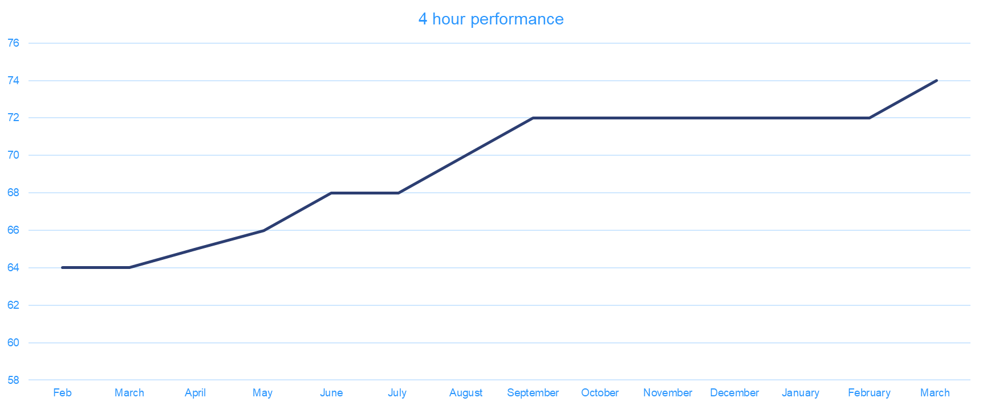
Urgent &
Emergency Care
CYNNAL EIN
DYFODOL
YSBRYDOLI
POBL
GWELLA
GOFAL
CREU
IECHYD
Ein Hiechyd
Ein Dyfodol
DATBLYGU CYMUNEDAU
IACHACH GYDA’N GILYDD
IMTP
May 2023

Slide 18
CYNNAL EIN
DYFODOL
YSBRYDOLI
POBL
GWELLA
GOFAL
CREU
IECHYD
Ein Hiechyd
Ein Dyfodol
DATBLYGU CYMUNEDAU
IACHACH GYDA’N GILYDD
Planned Care
Ministerial Expectations
52 weeks Outpatient Assessment and 104 weeks treatment recovery milestones to be achieved by 30 June 2023 and maintained throughout 2023/24 moving to 36 weeks RTT standards by March 2024
Address the capacity gaps within specific specialities to prevent further growth in waiting list volumes and set foundation for delivery of targets by March 2025 (This must include transforming outpatients follow up care, reducing follow up by 25% against 2019/20 levels by October 2023 and repurposing that capacity)
Implement regional diagnostic hubs, to reduce secondary care waiting times and meet waiting time ambition in spring 2024
Implement pathway redesign – adopting ‘straight to test model’ and onward referral as necessary
May 2023 updated requirements will be met: (This presumes the expenditure of the £5.5m.)
Ensure all patients who have waited >3 years for an Outpatient Appt. have a booked appointment by August 2023
97% of patients will complete their treatment within 104 weeks by the end of Q3.
99% of patients will complete their treatment within 104 weeks by end of Q4.
A significant improvement on cancer waiting times.
IMTP
May 2023

Slide 19
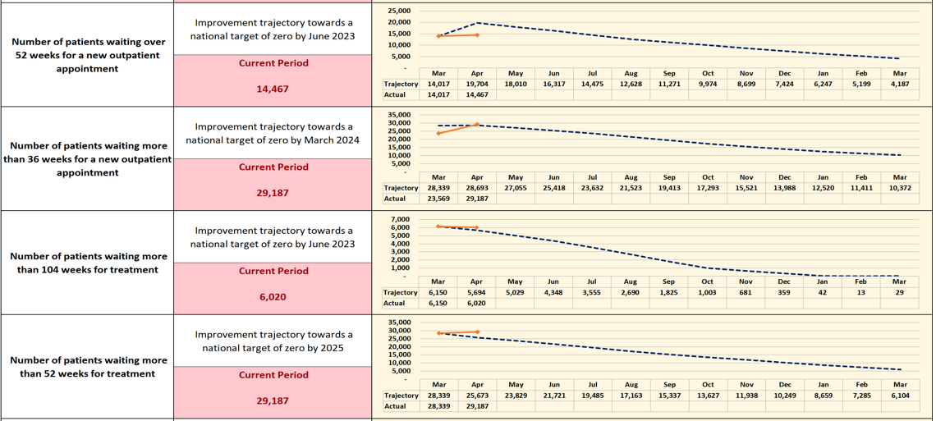
CYNNAL EIN
DYFODOL
YSBRYDOLI
POBL
GWELLA
GOFAL
CREU
IECHYD
Ein Hiechyd
Ein Dyfodol
DATBLYGU CYMUNEDAU
IACHACH GYDA’N GILYDD
Planned Care
IMTP
May 2023

Slide 20
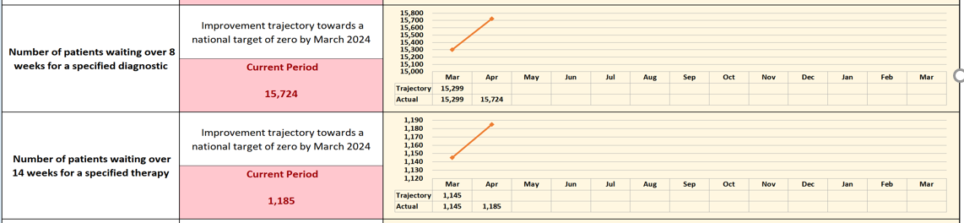
CYNNAL EIN
DYFODOL
YSBRYDOLI
POBL
GWELLA
GOFAL
CREU
IECHYD
Ein Hiechyd
Ein Dyfodol
DATBLYGU CYMUNEDAU
IACHACH GYDA’N GILYDD
Planned Care –
Diagnostics/ Therapies
Improvement trajectory for diagnostics and therapies.
IMTP
May 2023

Slide 21

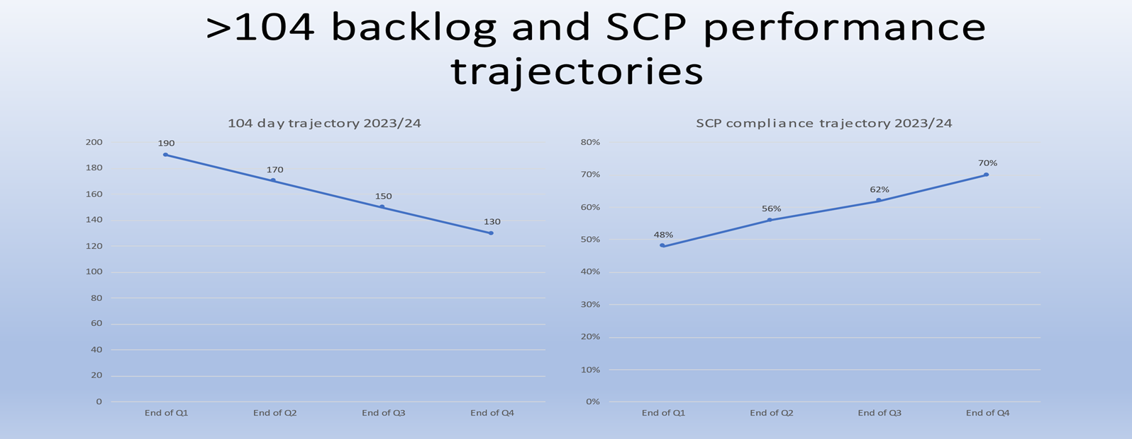
CYNNAL EIN
DYFODOL
YSBRYDOLI
POBL
GWELLA
GOFAL
CREU
IECHYD
Ein Hiechyd
Ein Dyfodol
DATBLYGU CYMUNEDAU
IACHACH GYDA’N GILYDD
Planned Care –
Cancer
Cancer Improvement
Reduction in backlog of patients waiting over 62 days to enable delivery of 75% of patients starting their first definitive cancer treatment 62 days from point of suspicion
Implement the agreed national cancer pathways within the national target – demonstrating annual improvement toward achieving target by March 2026
IMTP
May 2023

Slide 22
CYNNAL EIN
DYFODOL
YSBRYDOLI
POBL
GWELLA
GOFAL
CREU
IECHYD
Ein Hiechyd
Ein Dyfodol
DATBLYGU CYMUNEDAU
IACHACH GYDA’N GILYDD
Planned Care
Regional Planning
Ophthalmology:
Cataract business case approved by UHBs – funding sought from regional/ planned care funds held by WG
Diagnostics:
Community Diagnostic Hubs (Radiology)
    Service specification for procurement due to issue w/c/ 22/5/23 (Funding model to be finalised. 23/24 funding for CTMUHB radiology iterim solution being sought from regional/ PC funds held by WG
Endoscopy
    Model under development (In year- CTM solution in place. Funding sought from WG PC funds)
Pathology
Scoping cellular pathology options
Orthopaedics:
IMTP
May 2023

Slide 23
CYNNAL EIN
DYFODOL
YSBRYDOLI
POBL
GWELLA
GOFAL
CREU
IECHYD
Ein Hiechyd
Ein Dyfodol
DATBLYGU CYMUNEDAU
IACHACH GYDA’N GILYDD
Planned Care
Regional Planning – retained planned care recovery funds
A regional proposal for the retained planned care monies was submitted to Welsh Government.
The global breakdown of organisational share is set out below.
The CTMUHB share has been requested for services during 2023-24 as set out below:
Ophthalmology - £5,125,028
Endoscopy - £2,900,000
Radiology - £1,000,000
Total regional request 23/24 £28,999,241
ABUHB total share £12,005,327 | CAVUHB total share £7,968,886 | CTMUHB total share £9,025,028
IMTP
May 2023

Slide 24
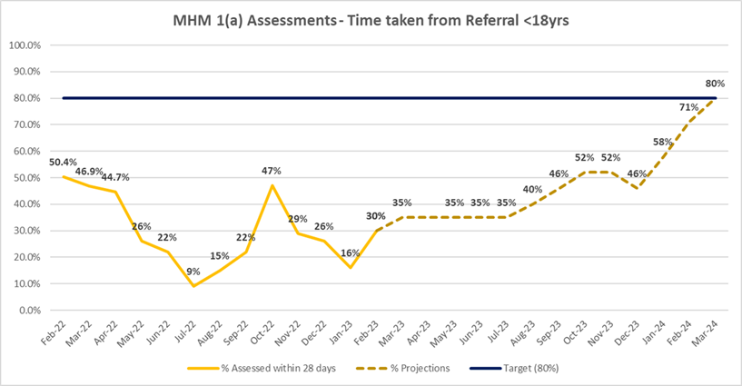
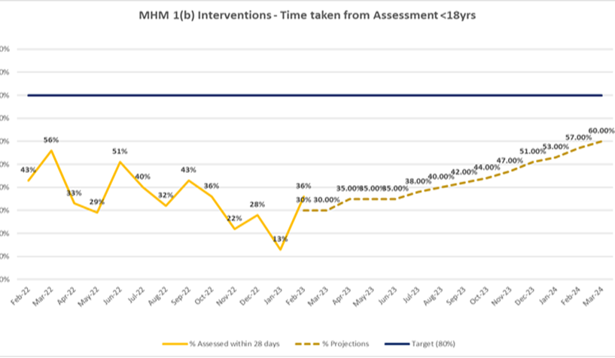
CYNNAL EIN
DYFODOL
YSBRYDOLI
POBL
GWELLA
GOFAL
CREU
IECHYD
Ein Hiechyd
Ein Dyfodol
DATBLYGU CYMUNEDAU
IACHACH GYDA’N GILYDD
Mental health
Mental Health Improvement
Implementation of 111 press 2 for urgent mental health issues by April 2023 – go live 25th April 2023.
Maintenance of delivery against adult mental health measure.
CAMHS improvement trajectories:
 | Target | January 2023 | February 2023
Part 1A | 80% | 84% | 88%
Part 1B | 80% | 89% | 92%
Part 2 | 90% | 88% | 88%
IMTP
May 2023

