Slide 1
Ambulance Handover Performance Summary and EASC Weekly data set
KEY HEADLINES
Compared to Pre-COVID levels, ambulance attendances have dropped on all three acute sites
The proportion of ambulances that are being discharged remains stable at 48%
Handover times by site:-
  PCH improving
  RGH consistent
  POW variable and of key focus
MITIGATIONS
• Working closely with WAST to understand conveyances given the proportion of attendances that get discharged as part of Workstream 1 and 2 of the Six Goals Programme
Focused review of POW handover process with ongoing diagnostic and senior nurse presence in ED for 2 week period
• Improvement of patient streaming to get them to the right place at the right time through Workstream 2
• Ongoing review of demand v bed base to ensure bed capacity on each site is adequate
Focus on timely discharges through goals 5 and 6 to ensure capacity available during peak demand

Slide 2
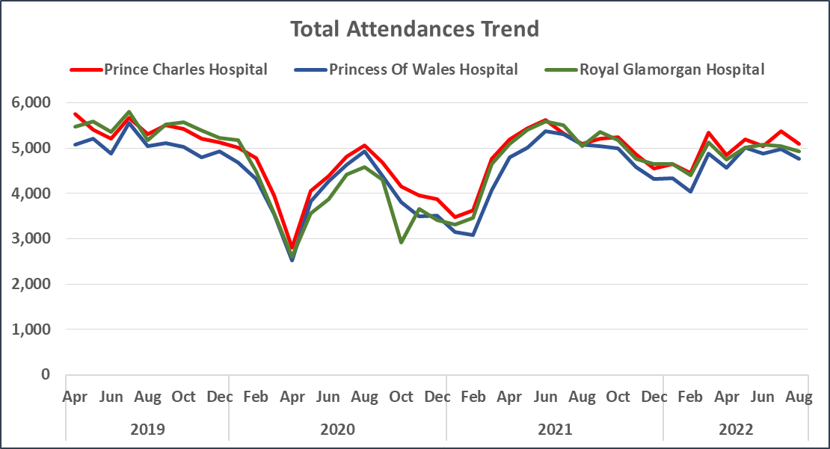
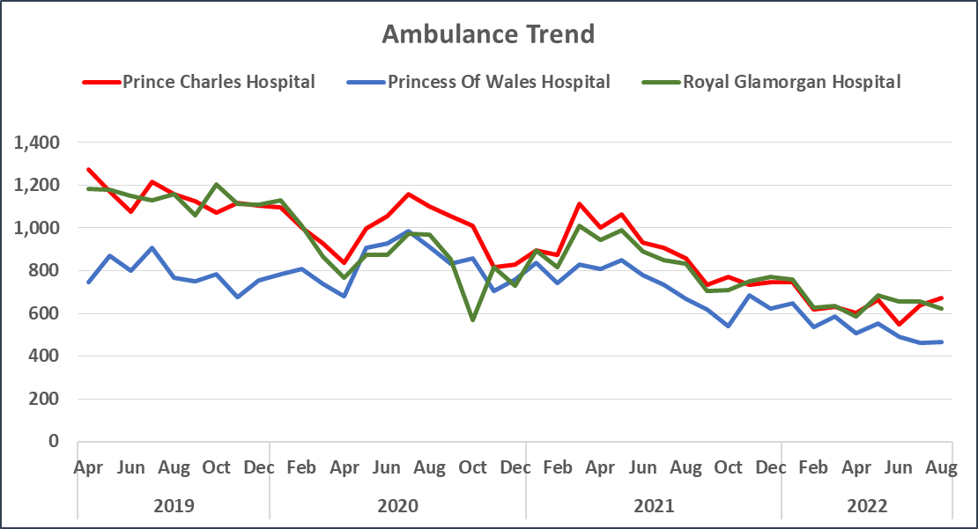
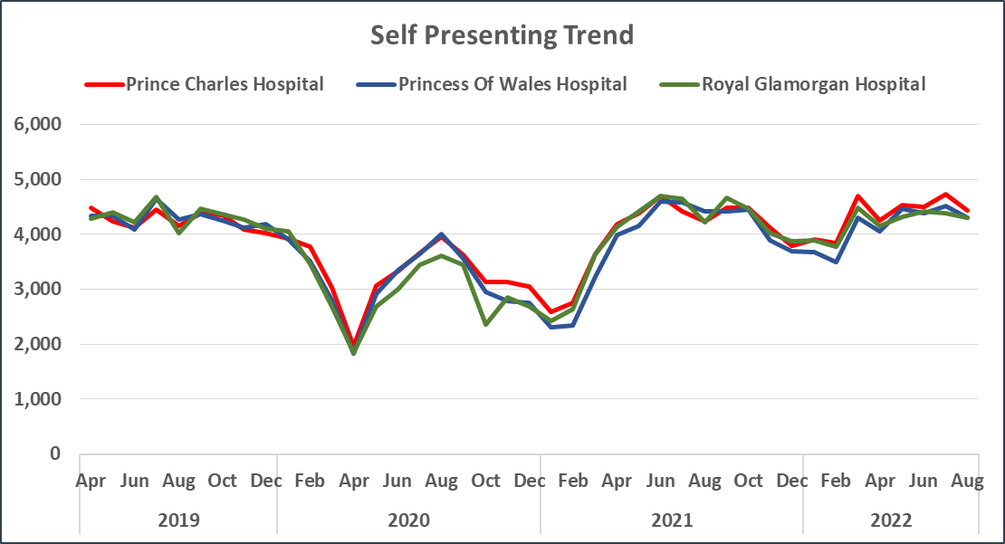
A&E Attendances – Trends

Slide 3
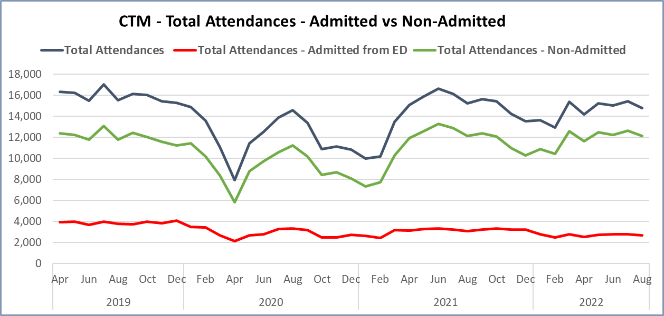
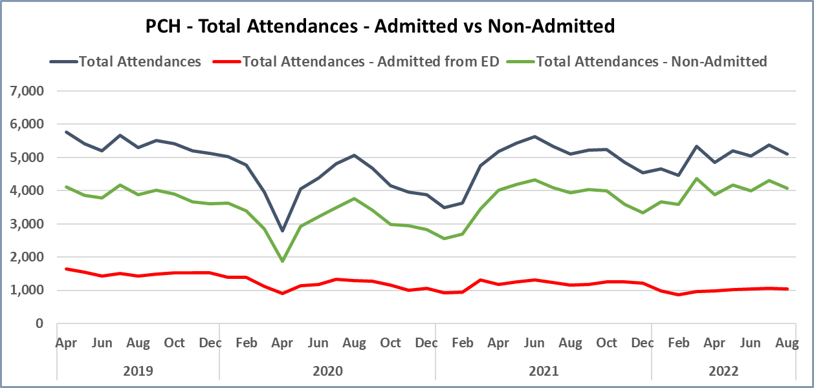
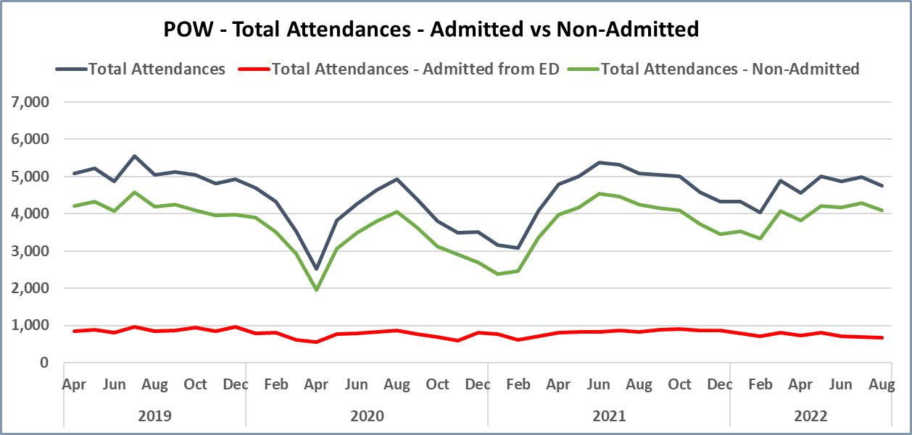
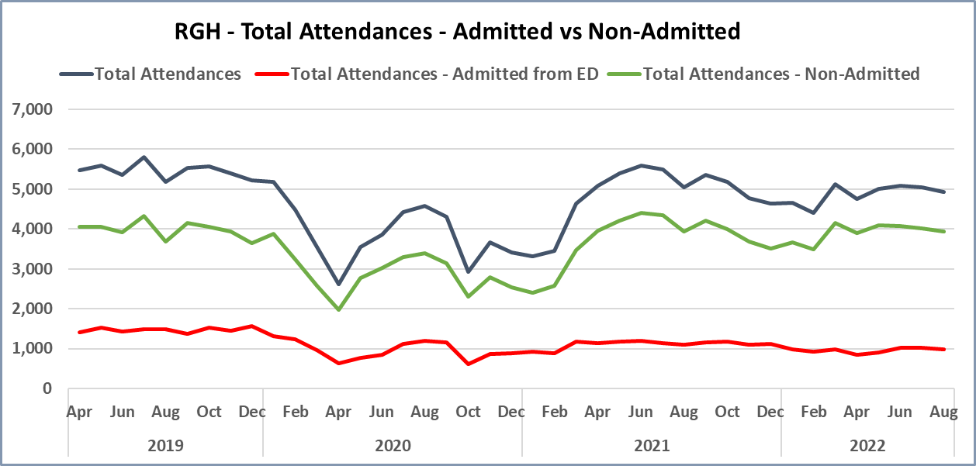
A&E Attendances – Admitted vs Non-Admitted

Slide 4
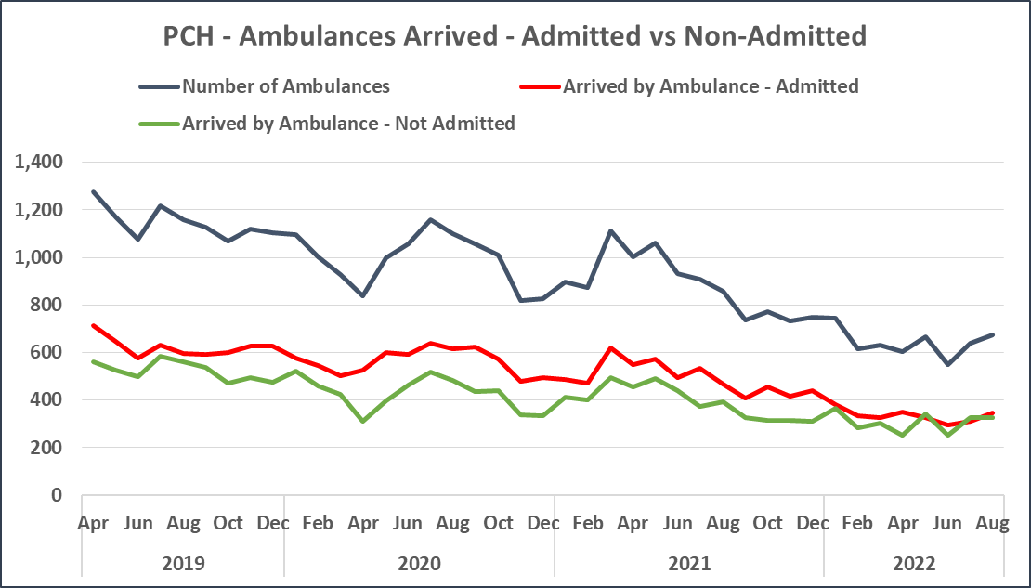
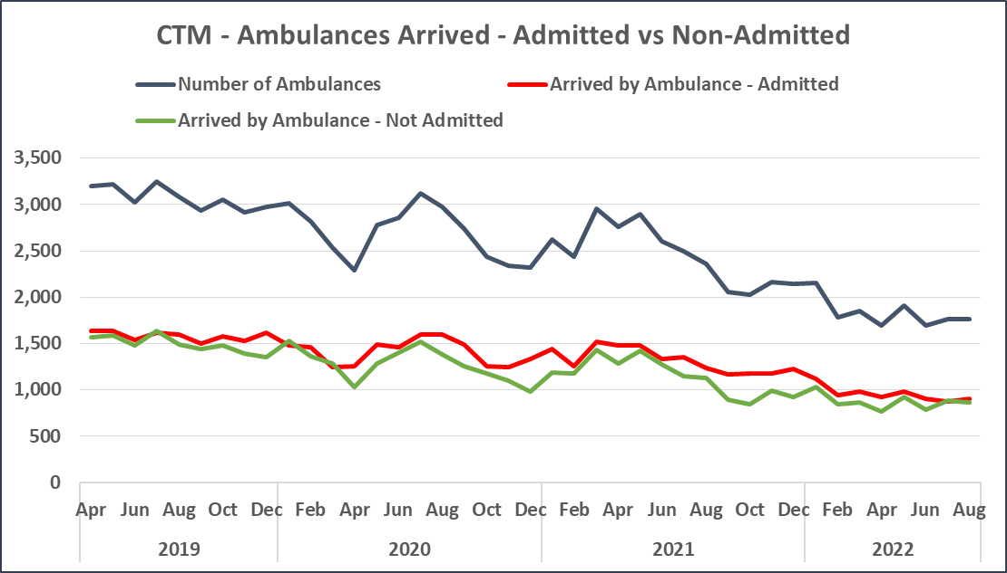
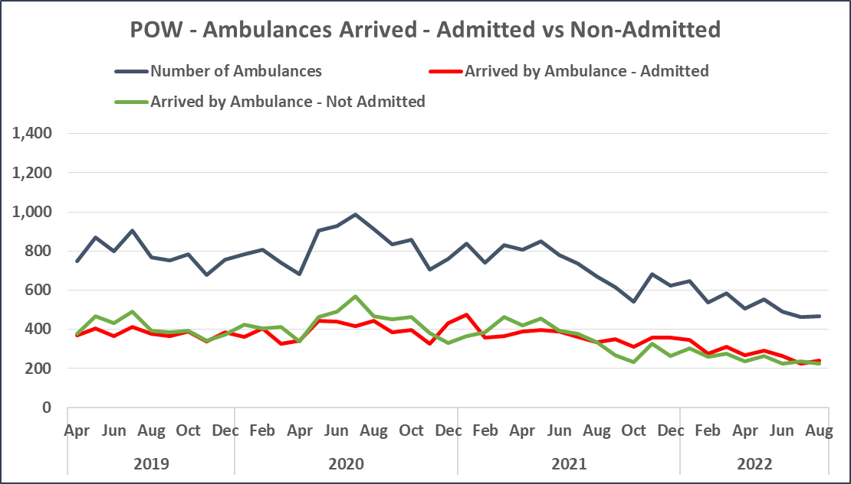
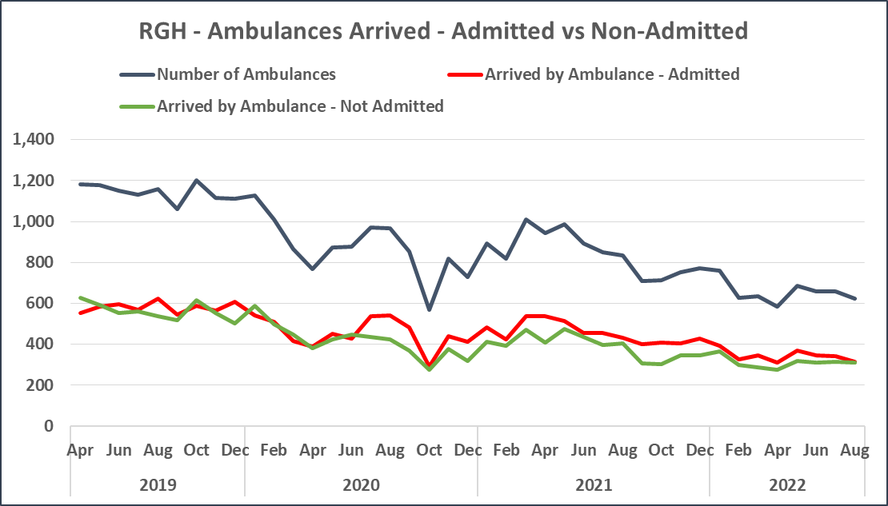
A&E Attendances - Arrived by Ambulance – Admitted vs Non-Admitted

Slide 5
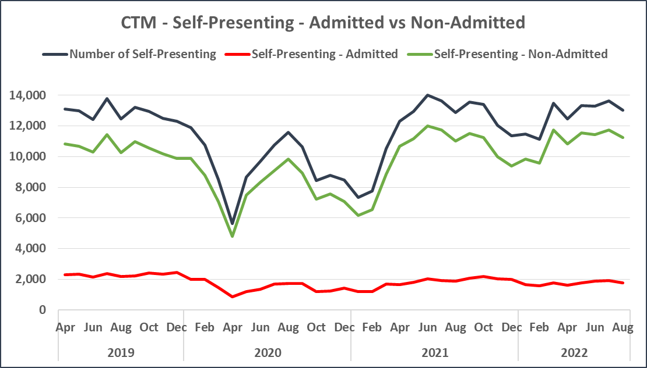
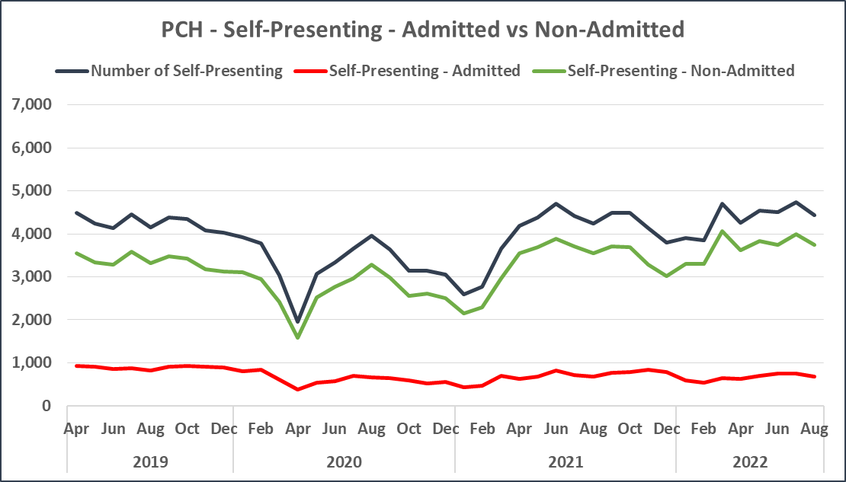
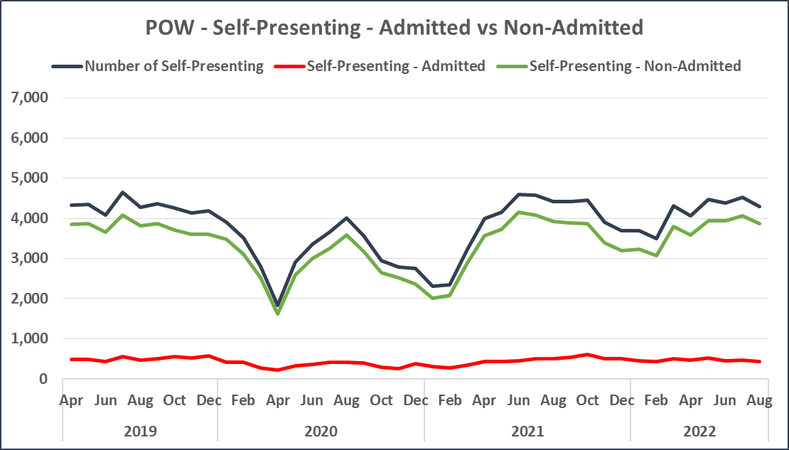
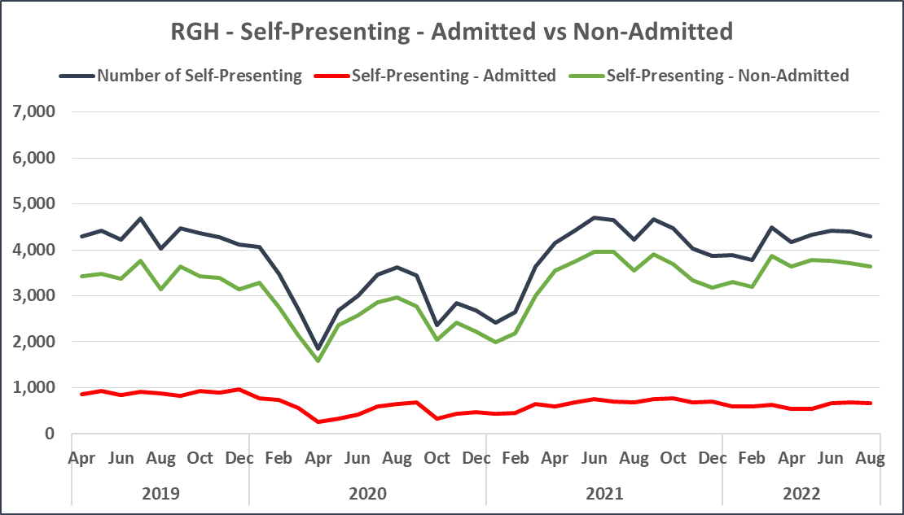
A&E Attendances – Self Presenting – Admitted vs Non-Admitted

Slide 6
A&E Attendances - % of Admitted vs % of Non-Admitted

Slide 7
Ambulance 15 Min Performance – Admitted vs Non-Admitted (Sep 21-Aug 22)
Source: Ambulance Handover Table WAST
Source: A&E Attendances Table

Slide 8
Ambulance Not Admitted by Discharge Hour – (Sep 21 – Aug 22)

