Slide 1

Welcome
Community Leaders’ Network

Slide 2
What to expect from today…
‘Refocus and resetting’ workshop of the CLN
Defining the CLN’s value as an important strategic partnership for the Cwm Taf Morgannwg region.
Workshop Overview
  Welcome & context (5 mins)
  Part 1: Speed Networking (20 mins)
  Part 2: Vision & value (25 mins)
  Part 3: Priority setting (2026/27) (35 mins)
  Close & next steps (5 mins)

Slide 3


Part 1: Speed Networking
Find somebody in the room who you don’t know or have never worked with
In your pair, spend 2 mins per person getting to know their organisation (4-5mins)
At the sound of the bell find a new partner
Complete these conversations x 3
Who am I (my organisation and role)?
What do I bring to the CLN and how can I help make a difference?
How can the CLN help me?

Slide 4
Part 2: CLN Vision & Values
Work in small groups to:
Refresh the Network’s reason for being
  Distinctive value: What does this Network offer that wouldn’t happen if it didn’t exist?
  Future-facing: In two years’ time, how would we know this Network is genuinely making a difference?
Define:
  What’s shaping the work right now? What policy, community or environmental factors will most shape our communities over the next 12–24 months?
  What do we know about the health of our CTM population, current and into the future (across the life span?)
  What’s changing (or important?) for our communities?
Working towards a co-created vision statement for the CLN

Slide 5
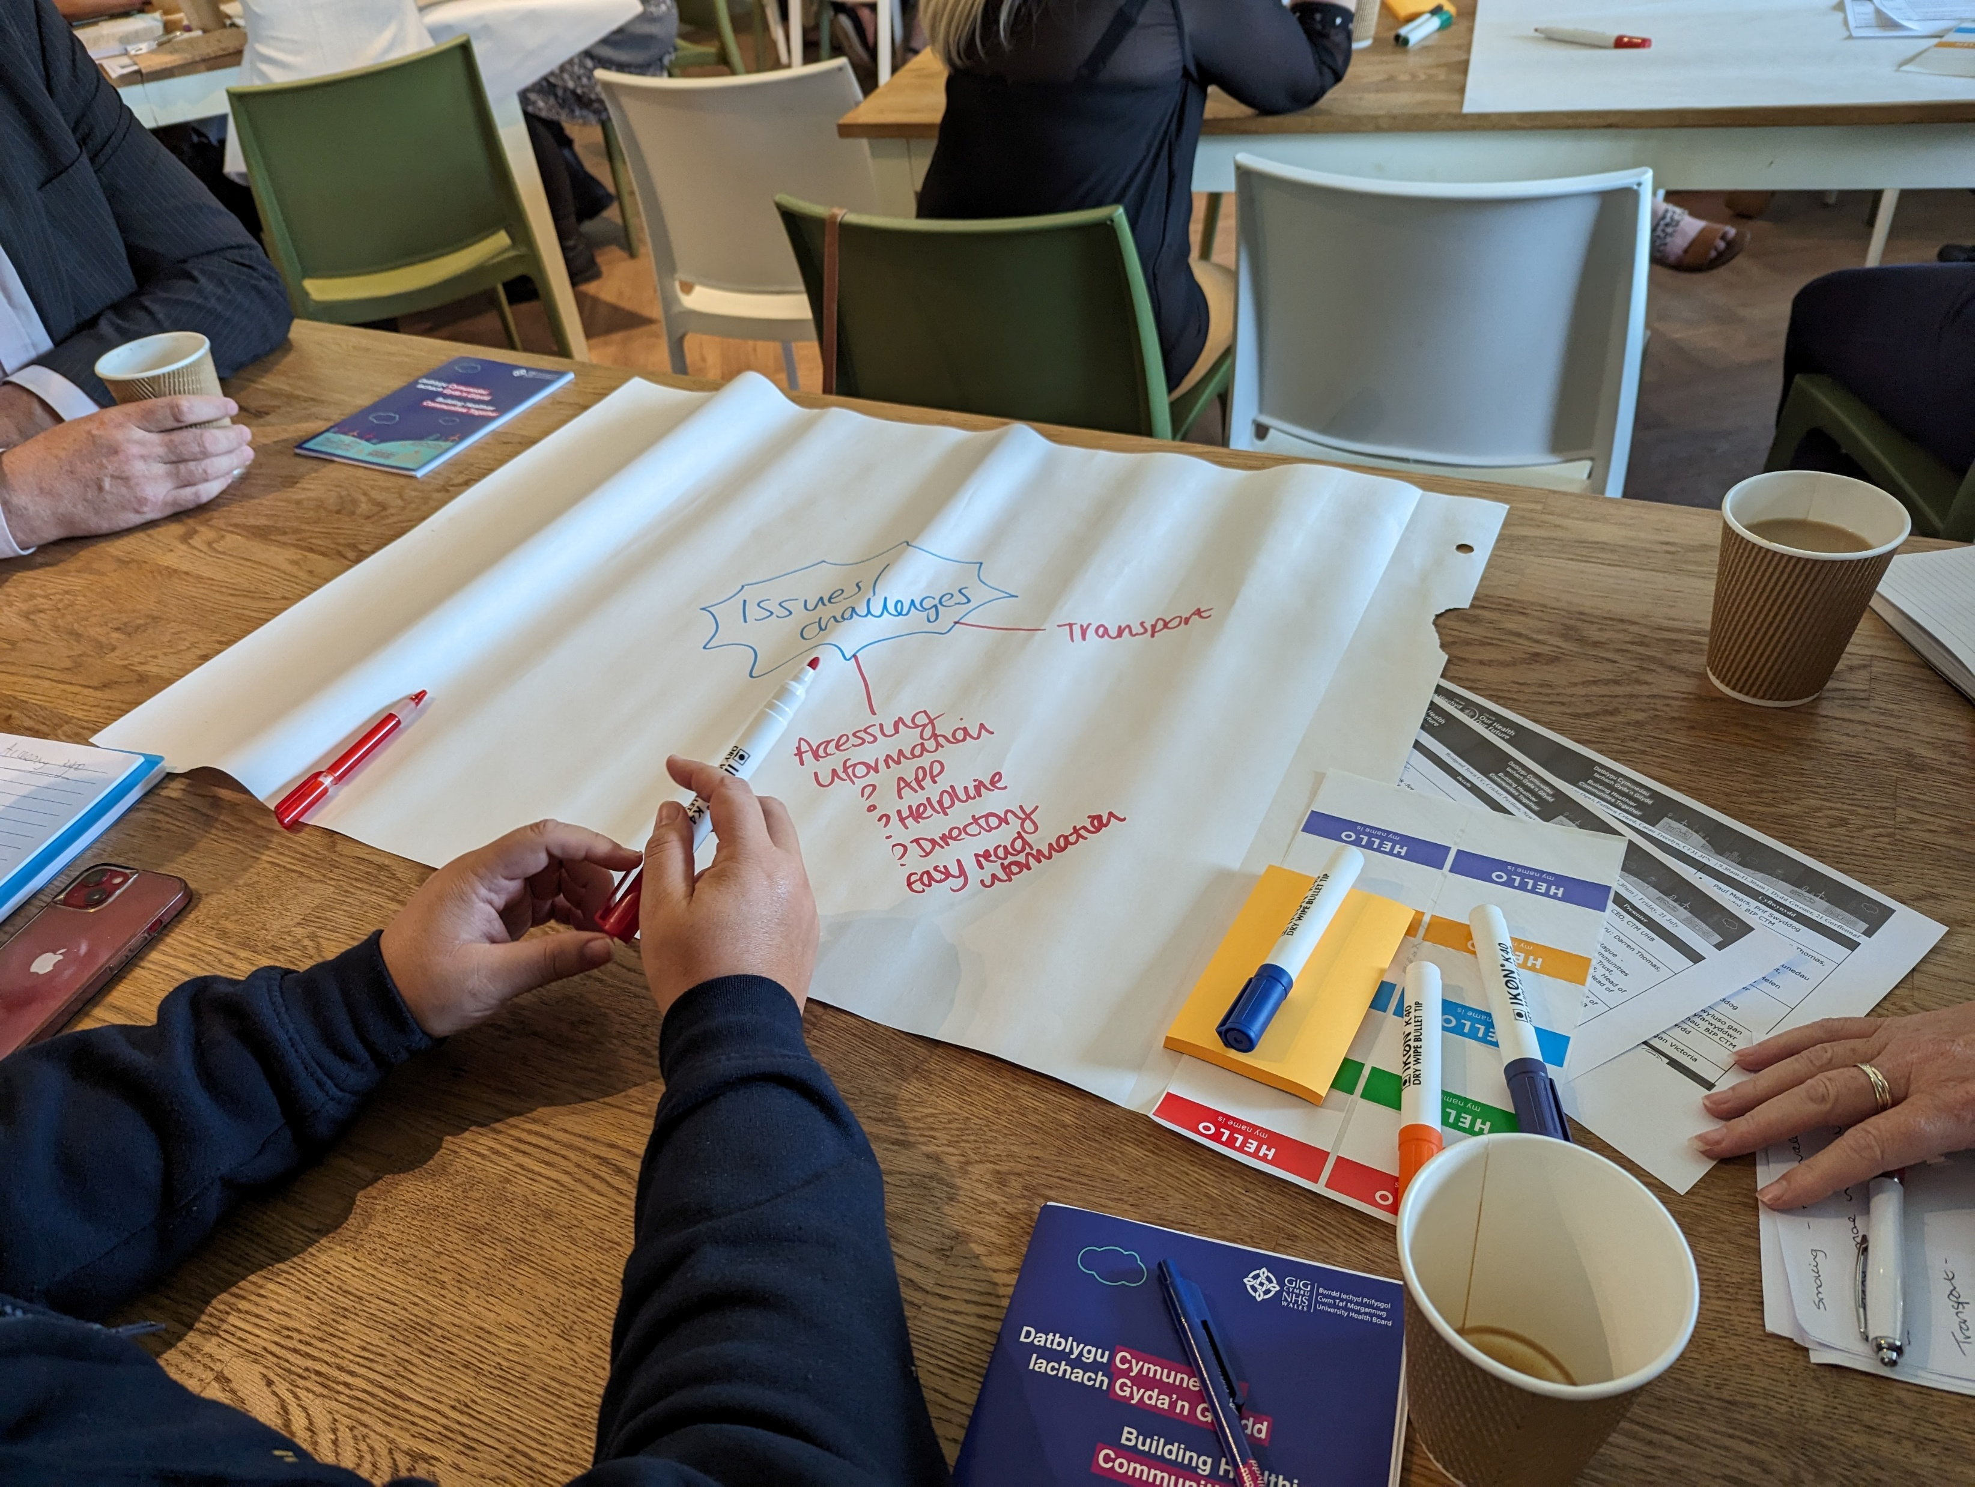
Part 3: Priority Setting (2026/27)
Turning CLN vision into real priorities…
If the Network could only focus on 2–3 things in 2026/27, what should they be to make the biggest difference?
Followed by a grouping of ideas into organised themes and voting

Slide 6
Close
Recap of session i.e.
  Context
  Refreshed vision and value
  Agreed priorities

Slide 7
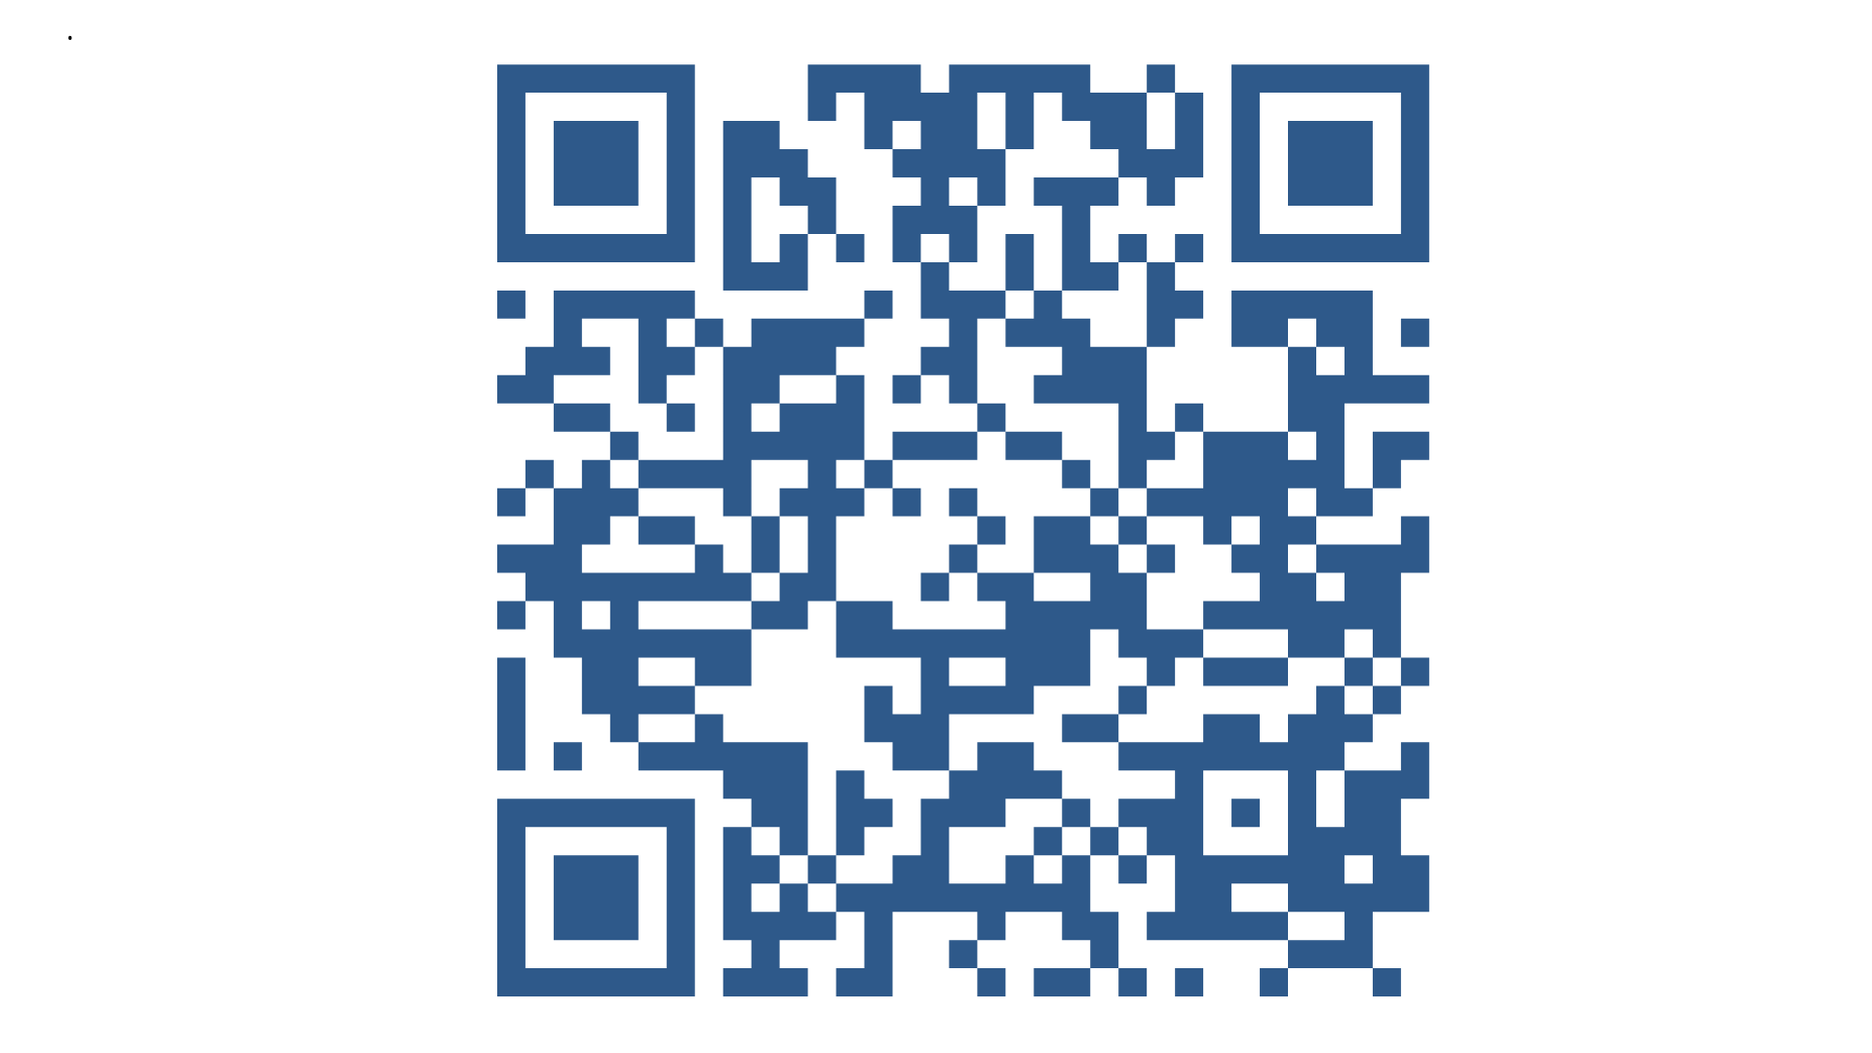
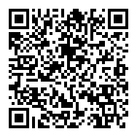
CLN Community Hub for meeting highlights and updates
Next Session:
17th July Merthyr Tydfil (venue TBC)
9.30am-11.30am

