Slide 1

Merthyr Leaders Event October ‘23
cwmtafmorgannwg.wales
Cwm Taf Morgannwg Public Health Team, 2023

Slide 2
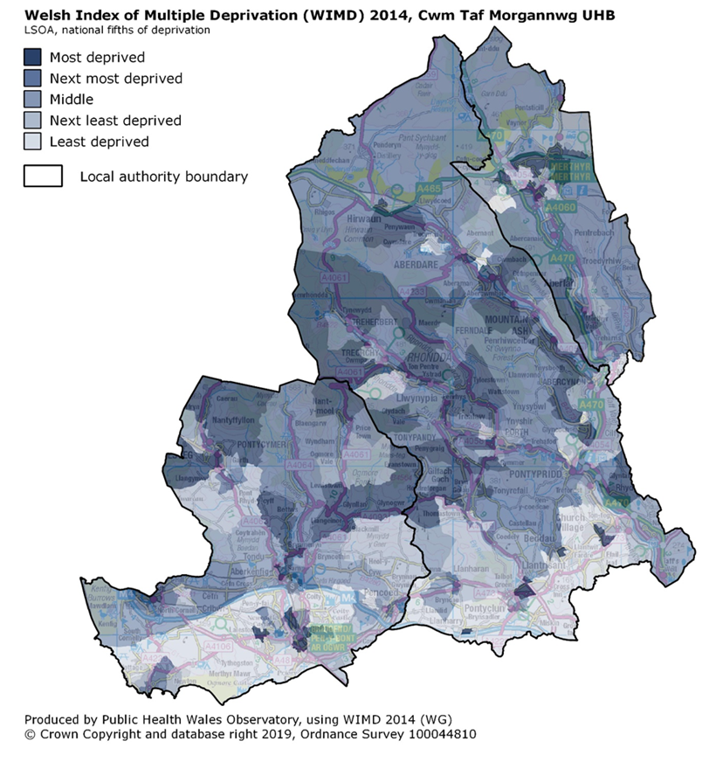
Inequalities
Gap in inequalities across Cwm Taf Morgannwg
Highest levels of deprivation in valleys to the north of the health board
  North of the M4

Slide 3
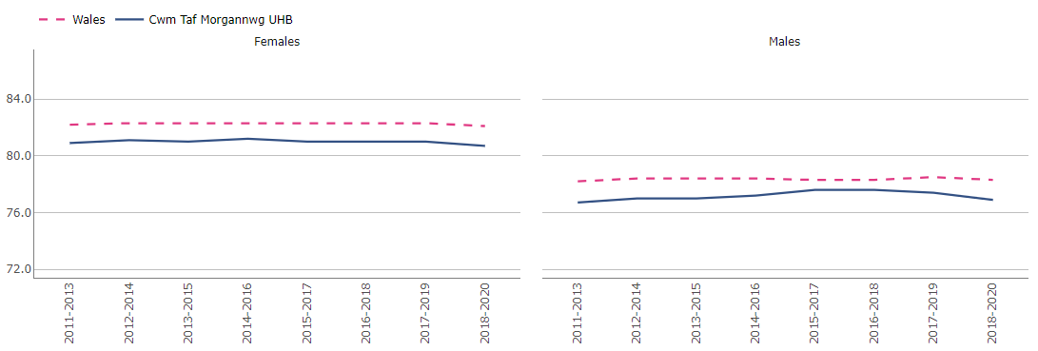
Life expectancy at birth, Total, males and females, 2011-2013 to 2018-2020
Source ©2022 PHW using APS, 2011 Census, PHM, MYE (ONS)
Between 2011-2013 and 2018-2020, Life expectancy (LE) at birth (Total) in CTM has remained roughly stable and below the Wales average for both men and women.

Slide 4
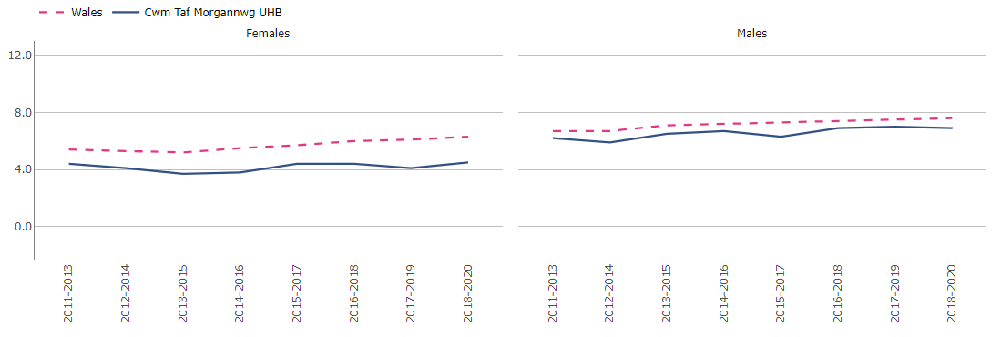
The gap in life expectancy at birth between the most and least deprived, males and females, 2011-2013 to 2018-2020
Source ©2022 PHW using APS, 2011 Census, PHM, MYE (ONS)
Between 2011-2013 and 2018-2020, the inequality gap* in life expectancy at birth in Wales has increased for both men and women; whereas in CTM it has fluctuated over the years and has overall slightly increased for men, and remained roughly the same for women.
*The inequality gap in life expectancy represents the absolute difference between the least deprived fifth and the most deprived fifth, calculated in years.

Slide 5
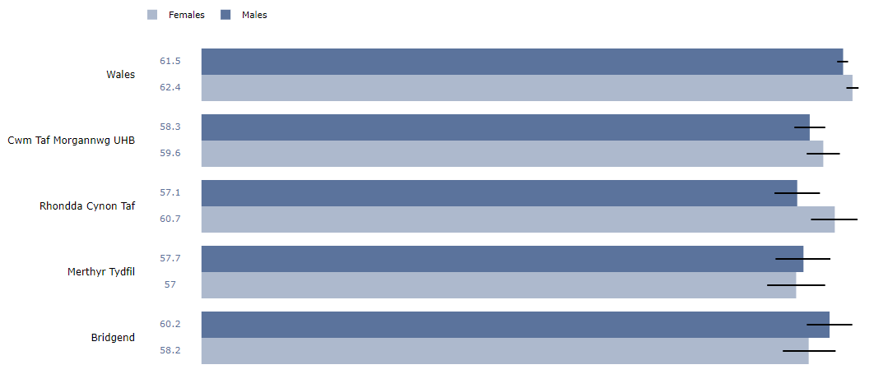
Healthy life expectancy at birth, males and females, 2018-2020
Source ©2022 PHW using APS, 2011 Census, PHM, MYE (ONS)
In 2018-2020, Healthy life expectancy (HLE) at birth in CTM was statistically significantly lower than the Wales average, for both men and women. At Local Authority level, among men, Bridgend had the highest HLE rate; whereas Merthyr Tydfil and RCT rates were statistically significantly lower than in Wales. Among women, RCT had the highest HLE rate; whereas Bridgend and Merthyr Tydfil rates were statistically significantly lower than the average in Wales.

Slide 6
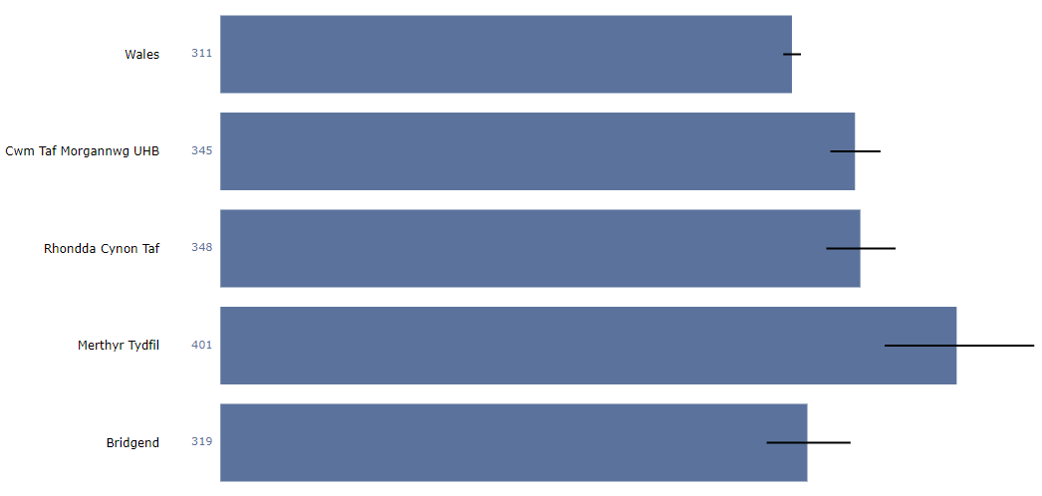
Premature deaths from key non communicable diseases, EASR per 100,000, persons aged 30 – 70, 2019-2021
Source ©2022 PHW Observatory using PHM & MYE (ONS)
In 2019-2021, there were 345.2 premature deaths from key non-communicable diseases (NCDs) per 100,000 people in CTM, which is statistically significantly higher than the average in Wales (310.9 per 100,000). At a Local Authority level, the rates in Merthyr Tydfil (400.5 per 100,000) and RCT (348.1 per 100,000) were also statistically significantly higher rate than the Wales average; Bridgend had the lowest rate (319.3 per 100,000) across CTM.

Slide 7
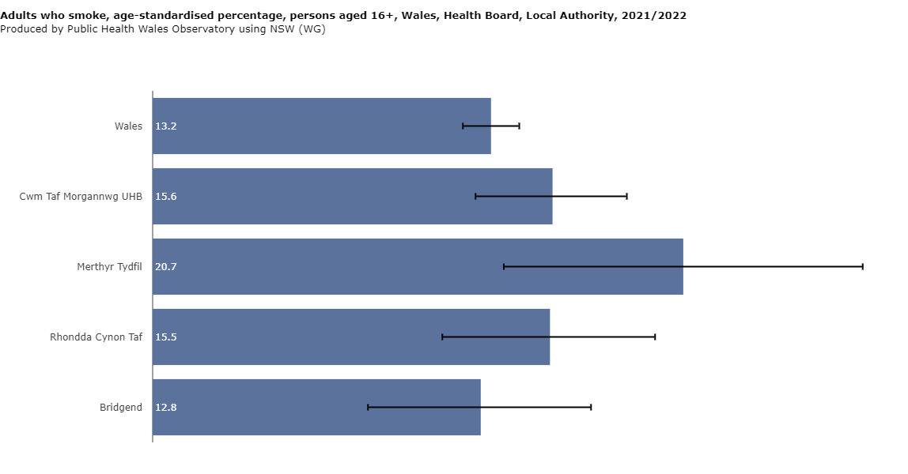
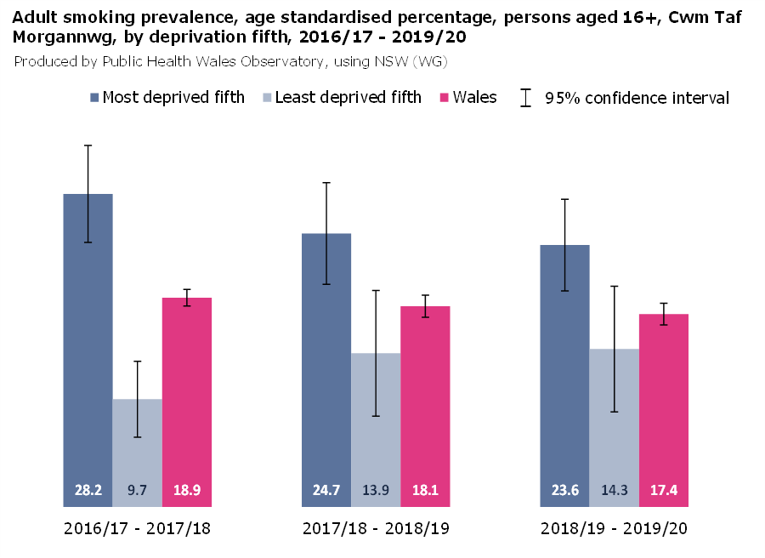
Smoking prevalence
Cwm Taf Morgannwg still has high smoking prevalence
The gap between smoking prevalence between the most and least deprived quintiles decreased from 2016/17 to 2019/20 but current prevalence ranges from 20.7% in Merthyr to 12.8% in Bridgend

Slide 8
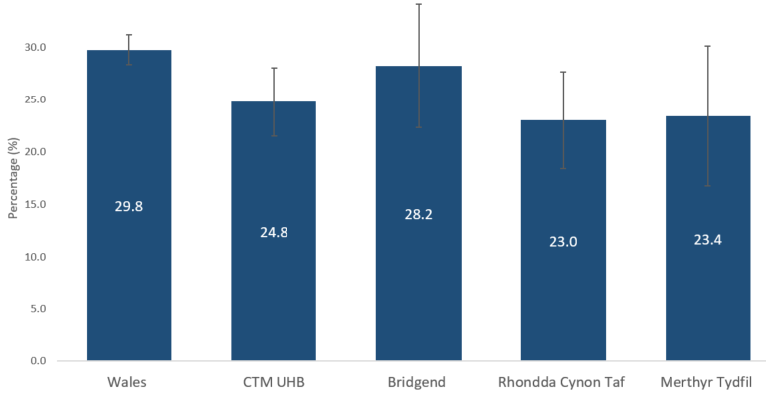
Adults eating five fruit or vegetable portions a day, age-standardised percentage, persons aged 16+, 2021-2022
Produced by the LPHT at CTM UHB using NSW (WG) data
In 2021-2022, 24.8% of adults (aged 16 or over) in CTM reported eating five or more portions of fruit or vegetables the previous day, which is statistically significantly lower than in Wales (29.8%). At a Local Authority level, Bridgend had the highest rate (28.2%), followed by Merthyr Tydfil (23.4%); RCT had the lowest rate (23.0%), which is statistically significantly lower than the average in Wales.

Slide 9
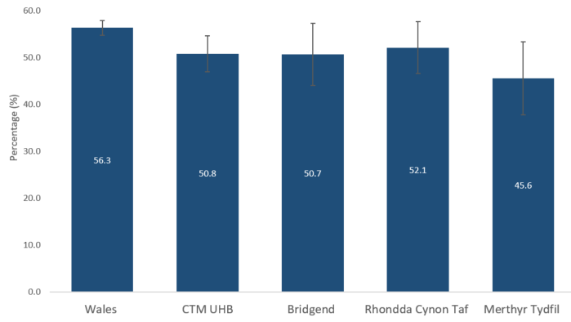
Adults meeting physical activity guidelines, age-standardised percentage, persons aged 16+, 2021-2022
Produced by the LPHT at CTM UHB using NSW (WG) data
In 2021-2022, 50.8% of adults (aged 16 or over) in CTM reported being active in the previous week*, compared to 56.3% in Wales. At Local Authority level, RCT had the highest rate (52.1%), followed by Bridgend (50.7%); Merthyr Tydfil had the lowest activity reported (45.6%), which is statistically significantly lower than the average in Wales (56.3%).
*Defined as 150 minutes or more of moderate or vigorous physical activity in the previous week.

Slide 10
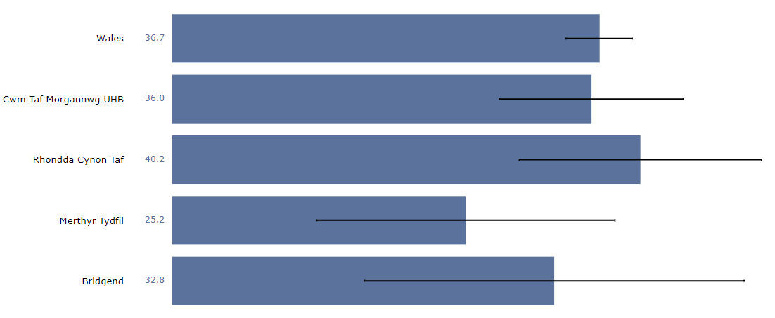
Working age adults of healthy weight, age-specific percentage, persons aged 16-64, 2020-2021
Source ©2022 PHW Observatory using NSW (WG)
In 2020-2021, 36.0% of working age adults (aged 16-64) in CTM reported having a healthy weight*, compared to 36.7% in Wales. At Local Authority level, RCT had the highest rate (40.2%), followed by Bridgend (32.8%) and Merthyr Tydfil (25.2%). All three Local Authorities exhibit wide confidence intervals, potentially due to a smaller sample size or increased variability.
*Body Mass Index (BMI) between 18.5 and 25

Slide 11
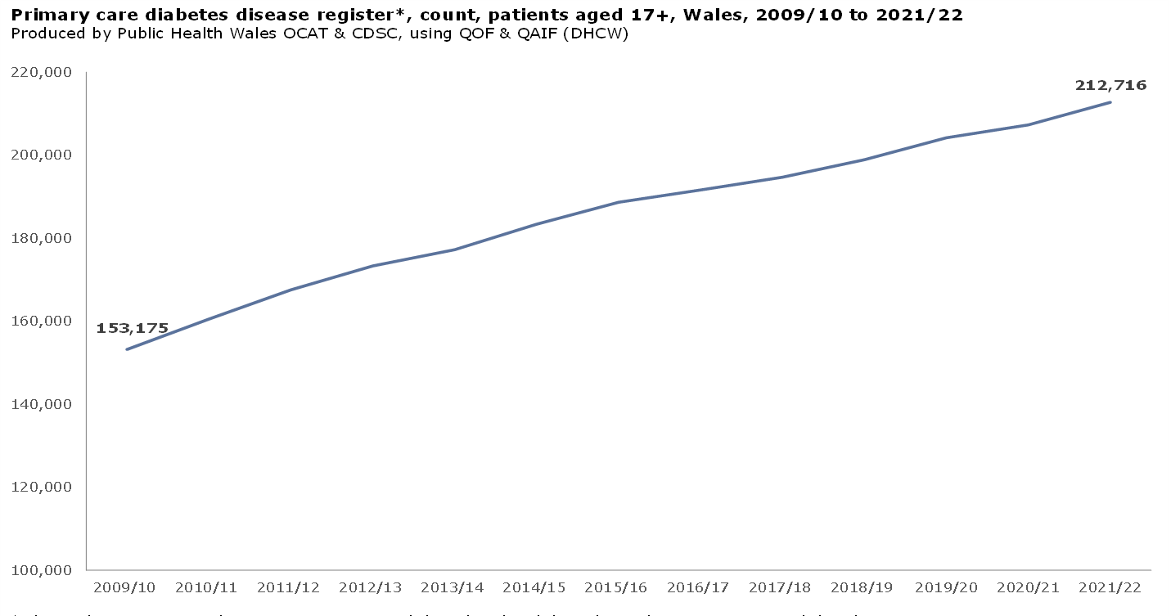
Diabetes in Wales increased by almost 60,000 people (17+ years) between 2009/10 and 2021/22 (13 years)
This is an increase of almost 40%
number of people aged 17+ with diabetes
increase
= 60,000 people
= 40%
Primary care prevalence

Slide 12
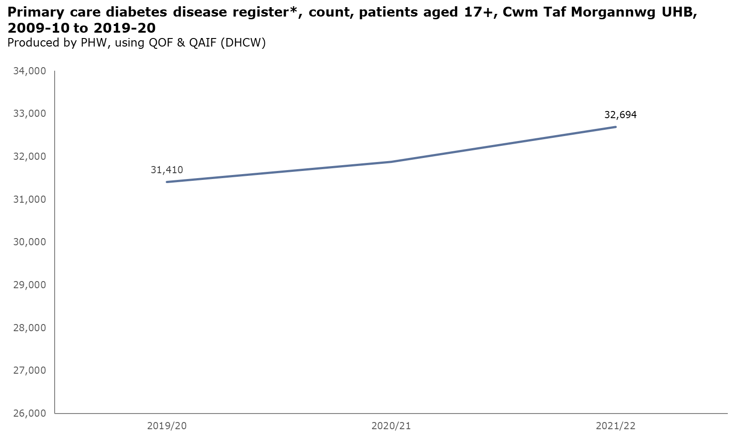
The number of people with diabetes in Cwm Taf Morgannwg increased by almost 1,300 people (17+ years) between 2019/20 and 2021/22 (3 years). This is an increase of around 4%.
increase
= 1,300 people
= 4%
number of people aged 17+ with diabetes
Primary care prevalence

Slide 13
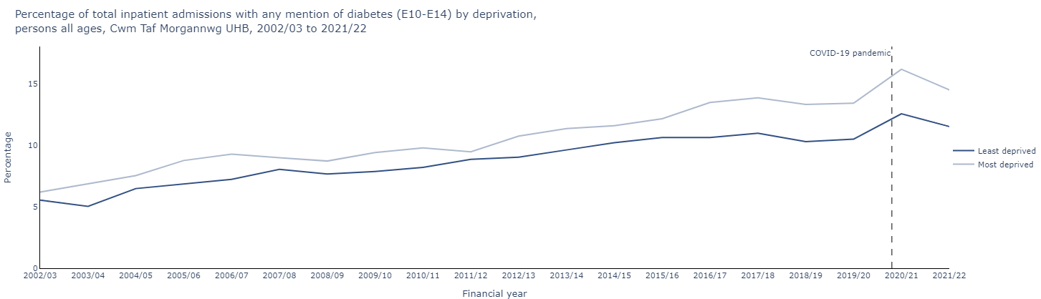
The percentage of all hospital admissions in Cwm Taf Morgannwg UHB that included a primary or secondary diabetes diagnosis has increased in both the most and least deprived fifths. The gap between the deprivation fifths has increased in recent years.
Hospital admissions

Slide 14
In 2021/22, diabetes related hospital spells in Cwm Taf Morgannwg UHB that required an amputation cost over £15,000 per spell and averaged 18 days in hospital. There were over 14,000 diabetes related spells that didn't involve amputation at an average cost of almost £4,800 per spell.
Amputation
•98 Total Spells
•83 Total Patients
•£15,325 per Spell
•18 Admitted Days per Spell
•5% Mortality during Spell
•14% Mortality within a year of discharge
•161 Discharge to death days within a year
Other Pathway
•14,037 Total Spells
•6,873 Total Patients
•£4,796 per Spell
•7 Admitted Days per Spell
•4% Mortality during Spell
•7% Mortality within a year of discharge
•170 Discharge to death days within a year
Hospital spell costs (£69m)

Slide 15
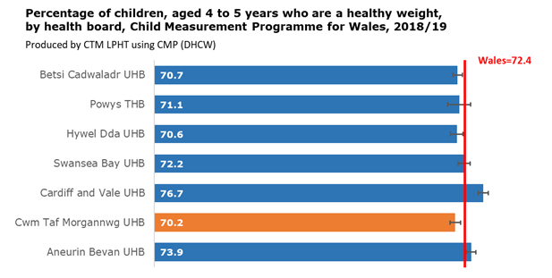
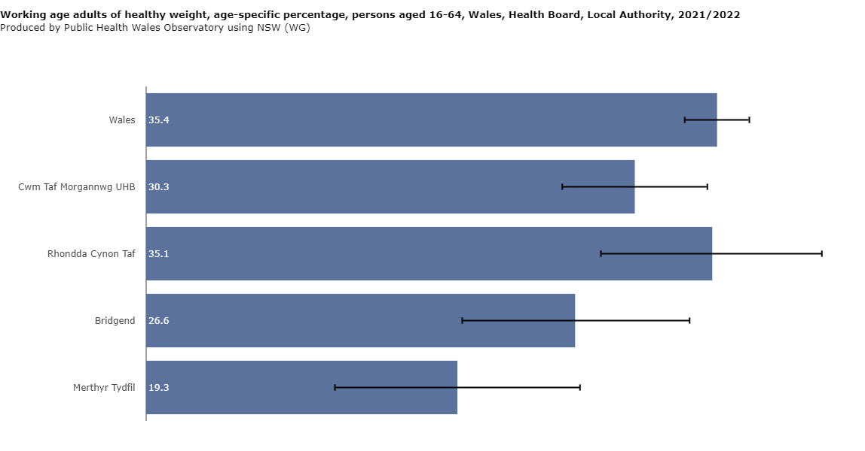
Healthy weight
Lowest percentage of children starting school at a healthy weight out of all health boards in Wales
Inequalities in healthy weight percentages across the health board with Merthyr having a significantly lower percentage than the Wales average

Slide 16
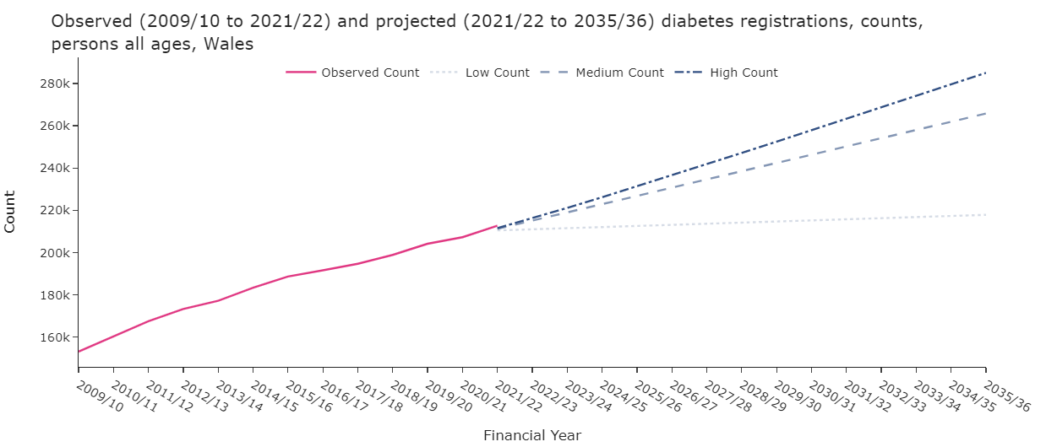
If prevalence remained at current level, 218,000 people would be living with diabetes by 2035/36. If current trends are maintained then this would be 260,000 and a high scenario would mean over 280,000 people. See background notes for methodology.
Diabetes projections
Notes:
Based on past prevalence rates of diabetes, and assuming unchanged rates, diabetes prevalence projections will continue to rise across Wales.
Low count – current prevalence x projected GP registered pop
Medium count – forecast observed counts
High count – forecast prevalence rates x pop projection

Slide 17
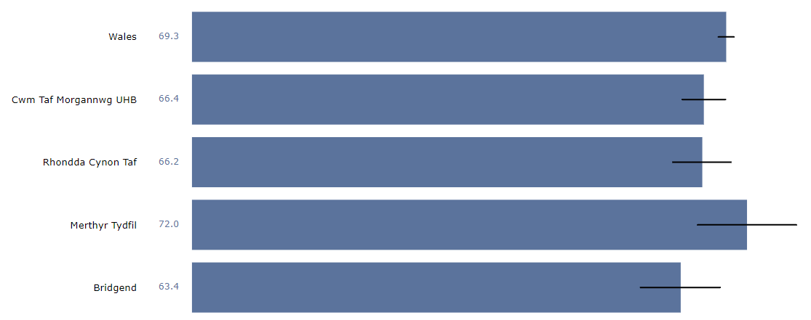
A sense of community, age-standardised percentage, persons, 2020-2021
Source ©2022 PHW Observatory using NSW (WG)
In 2018-2020, 66.4% of people in CTM reported feeling a sense of community, which is statistically significantly lower than the average in Wales (69.3%). At Local Authority level, Merthyr Tydfil had the highest rate (72.0%) of people feeling a sense of community, followed by RCT (66.2%), whereas the rate in Bridgend was the lowest and statistically significantly lower than the average in Wales (63.4%).

Slide 18
How do WE engage people about their health?
Who should we include?
What should we (not) do?

