Slide 1


CTM2030 Leaders’ Network
#BuildingHealthierCommunitiesTogether
Time | Agenda Item | Presenter/s
9:30am - 9:35am | Welcome | Jonathan Morgan, Chair, CTM UHB
9:35am– 10:00am | Part 1: Partnership In Action A multi organisational approach to addressing the gap in Pension Credit uptake among eligible individuals in Cwm Taf Morgannwg. | Kate May, Assistant Director, Public Health, CTM UHB Karen Taylor, Interim CEO, Citizens Advice RCT Rachel Rowlands, Chief Executive, Age Connects Morgannwg
10:00am -11:00am | Part 2: Partnership for Action Working together as a leaders’ Network to protect vulnerable people through vaccination and health protection | Christopher Smith, Senior Health Protection Practitioner, CTM UHB Jane Williams, Immunisation Specialist, CTM UHB
11:00am -11.15am | Table feedback | Facilitated by Jonathan Morgan
11:15am -11.20am | Close | Jonathan Morgan
11:20 – 11:30am (access to the room until midday) | Networking

Slide 2
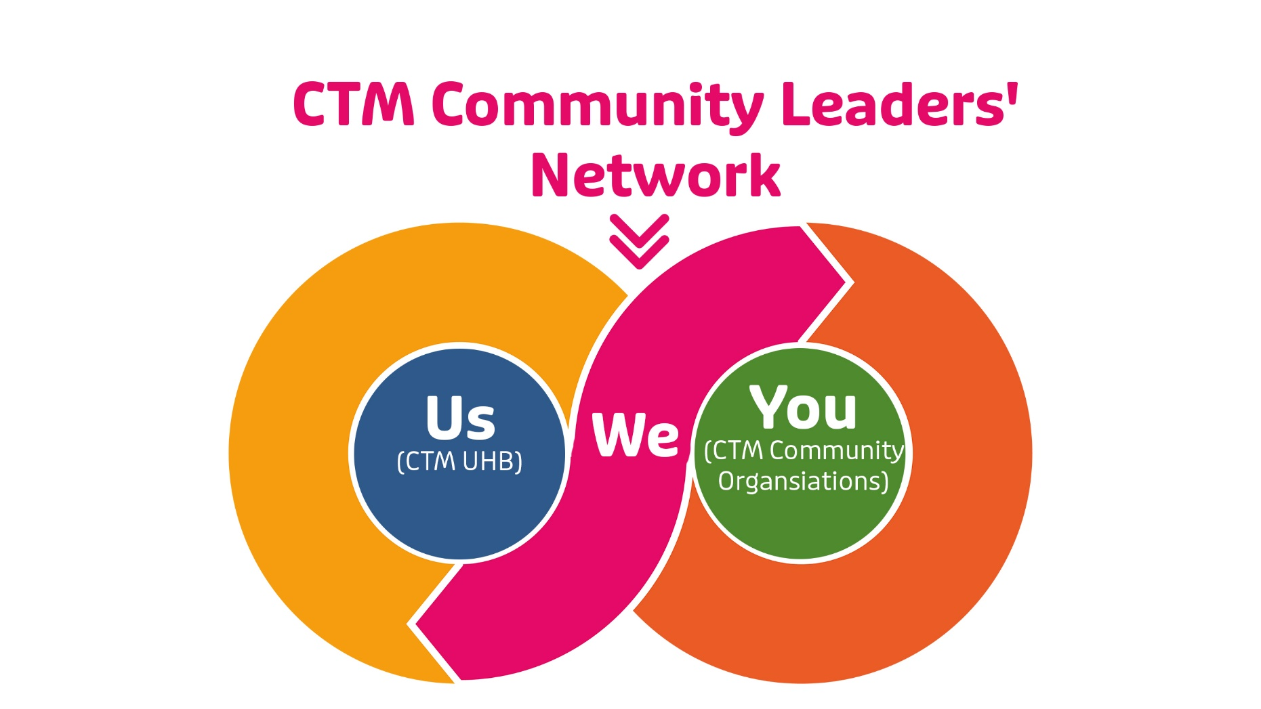

Slide 3

Today’s meeting…
Part 1: Partnership in Action
Hear about a multi-organisational project, involving several CTM Community Leaders who effectively worked together this winter to address the gap in Pension Credit uptake among eligible individuals in Cwm Taf Morgannwg.
Part 2: Partnership For Action
Working together in new ways to protect vulnerable people through vaccination and health protection

Slide 4
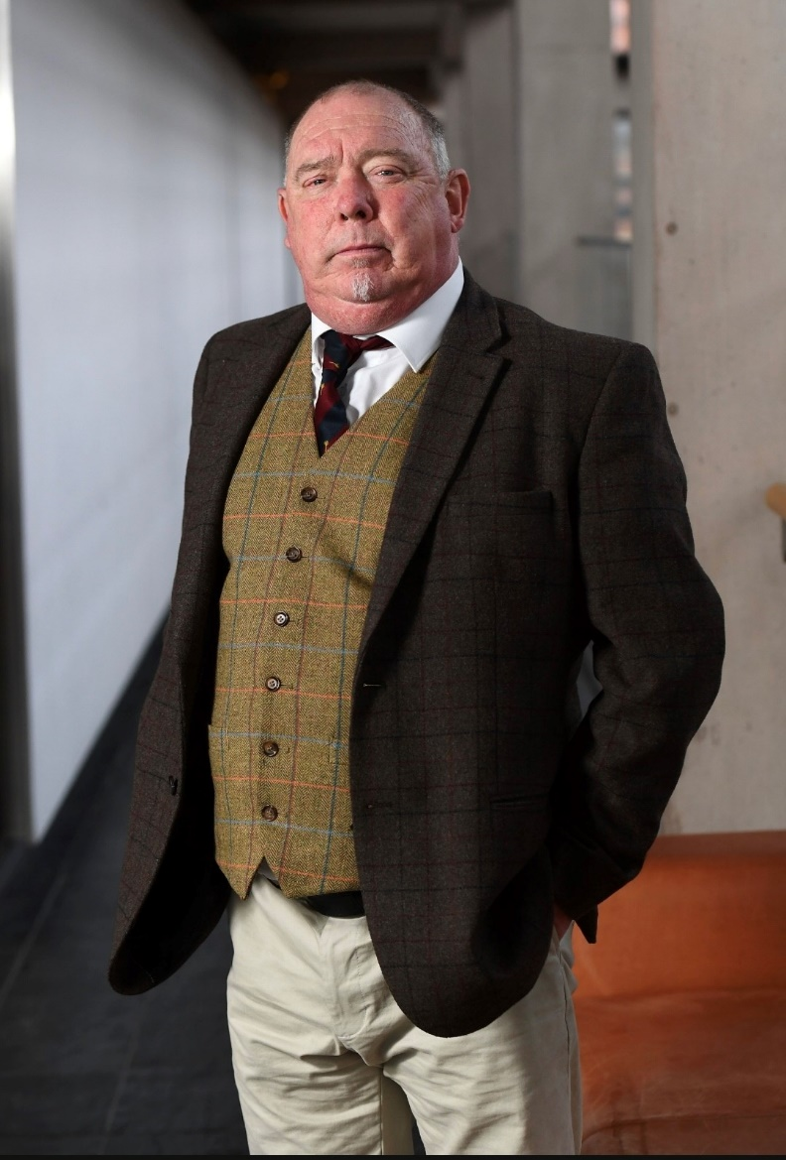
Congratulations…!!
Paul Bromwell - founder and leader of Valley Veterans - proud winner of this year’s St David (Senedd) Awards in the Category of Community Champion

Slide 5
PART 1
A multi organisational approach to addressing the gap in Pension Credit uptake among eligible individuals in Cwm Taf Morgannwg.

Slide 6


Slide 7
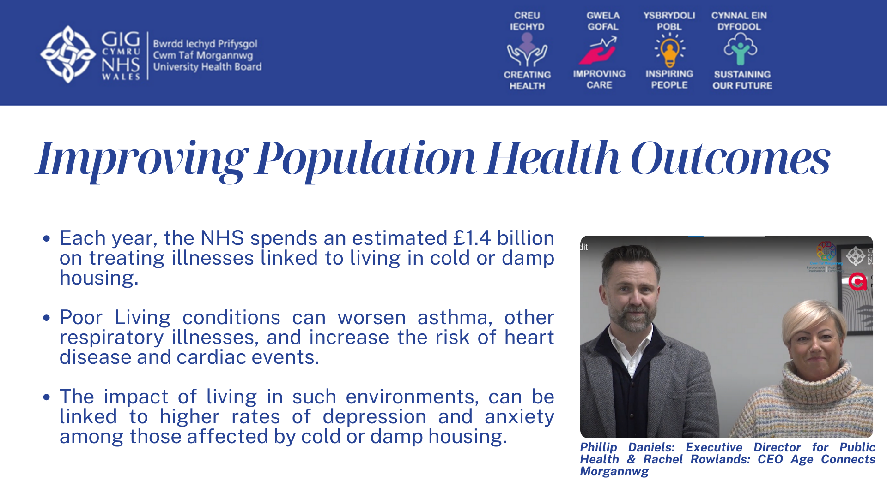

Slide 8
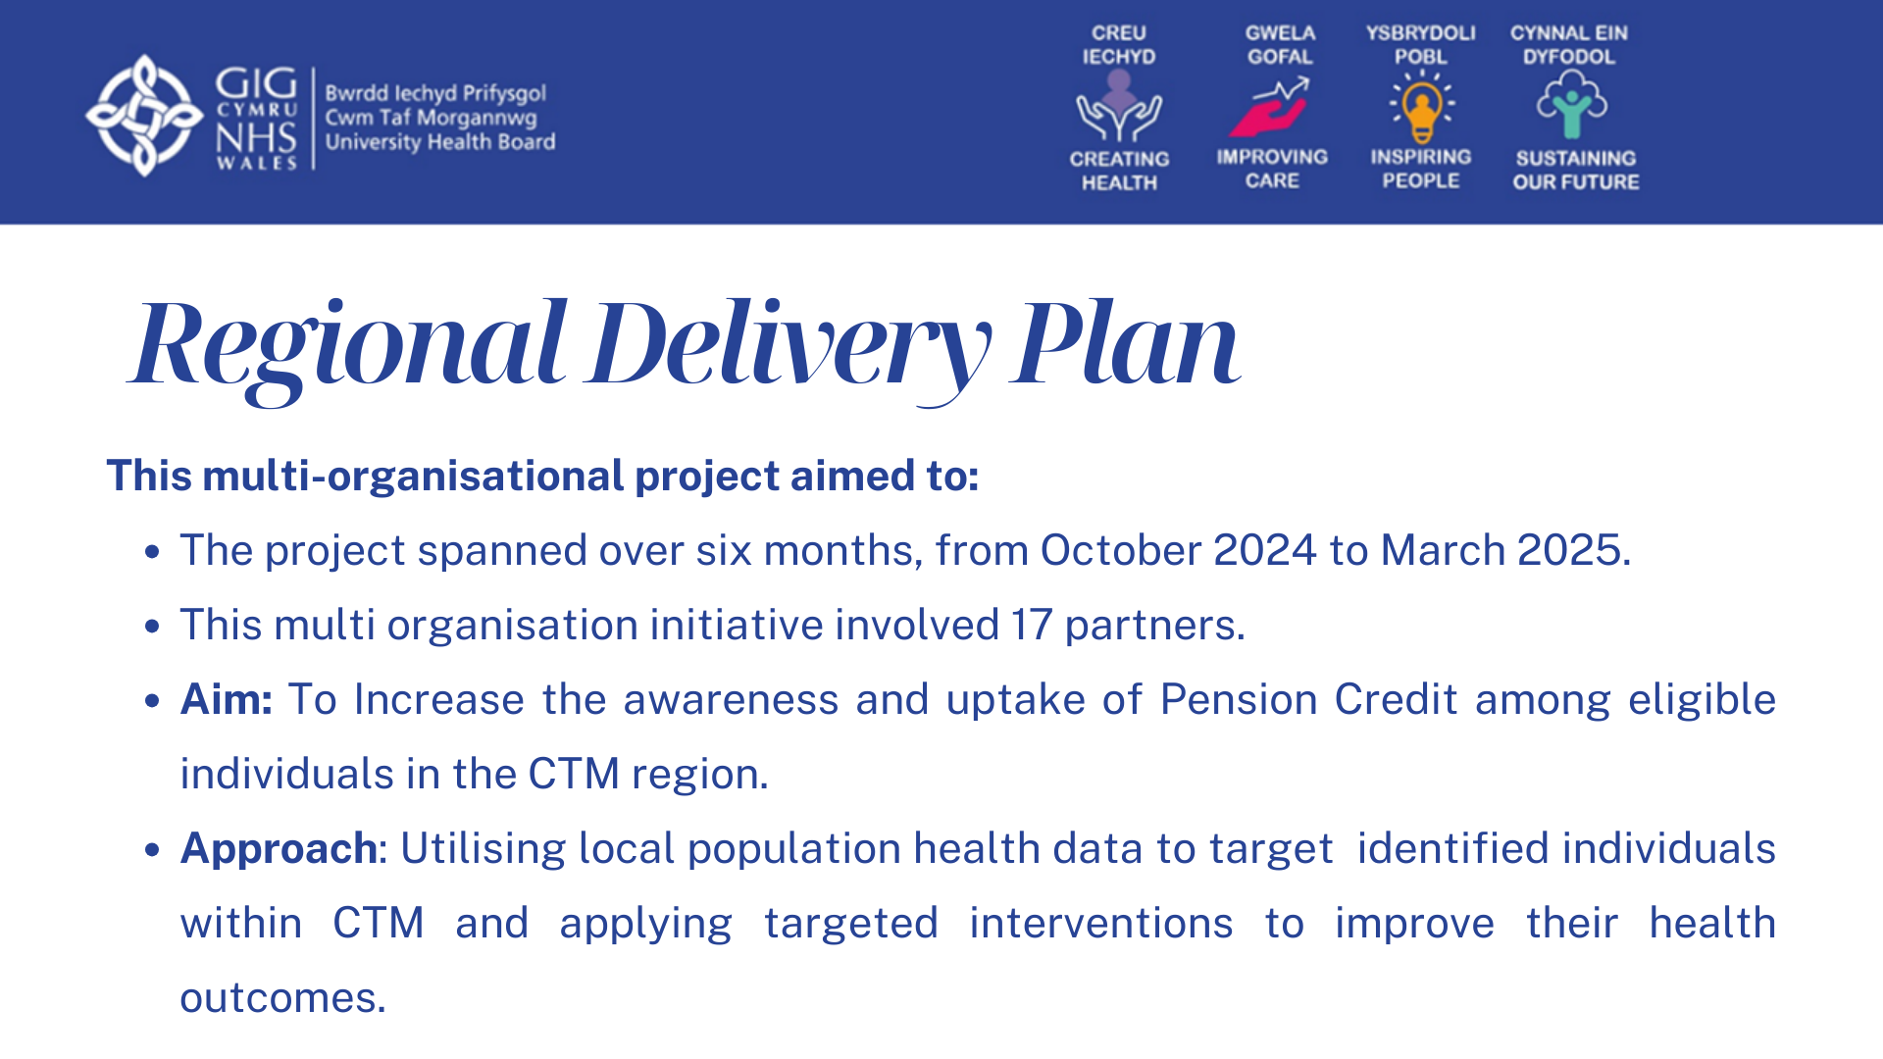

Slide 9
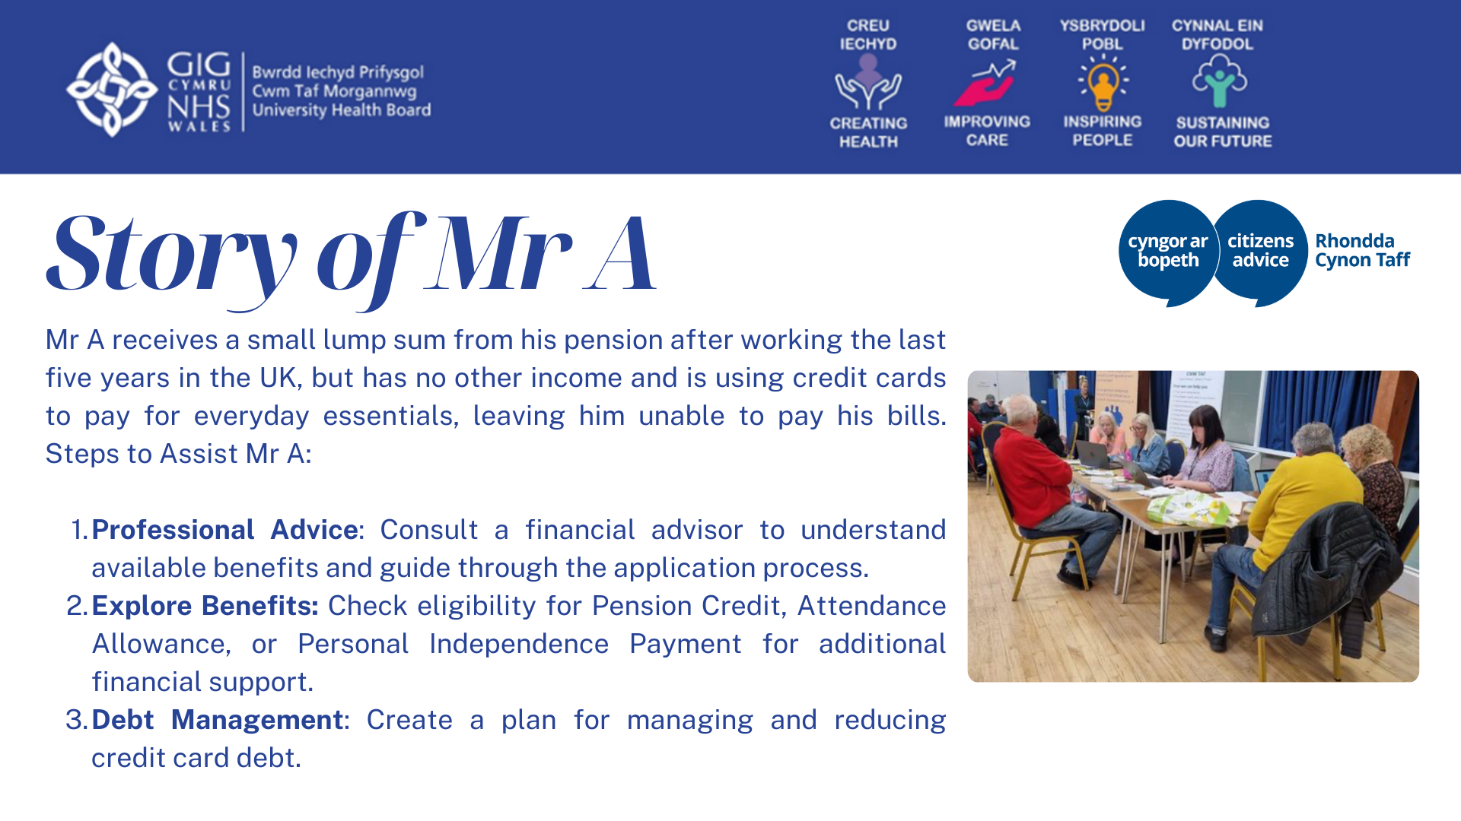

Slide 10
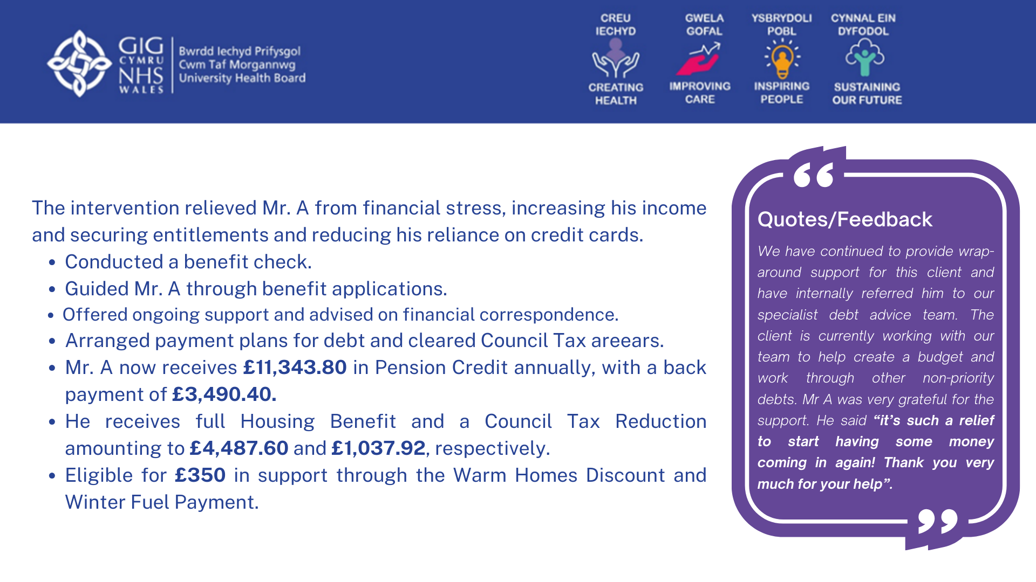

Slide 11
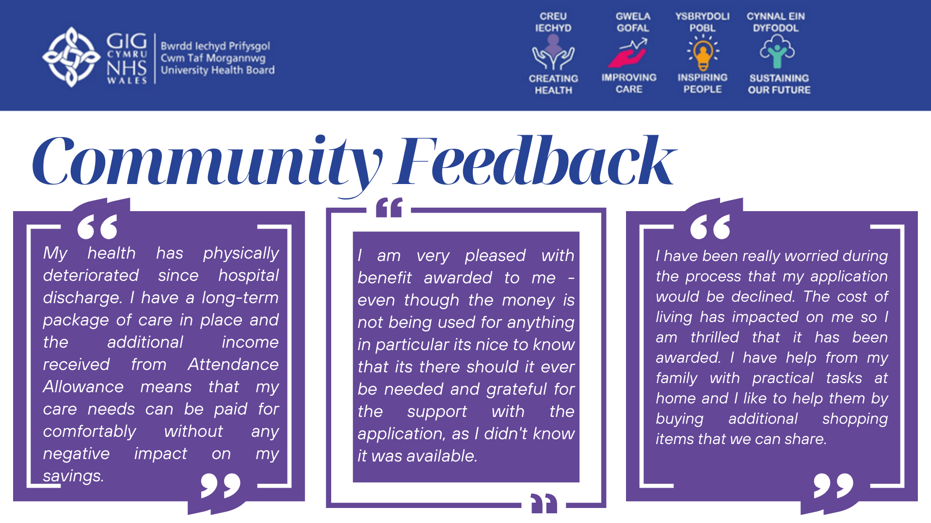

Slide 12
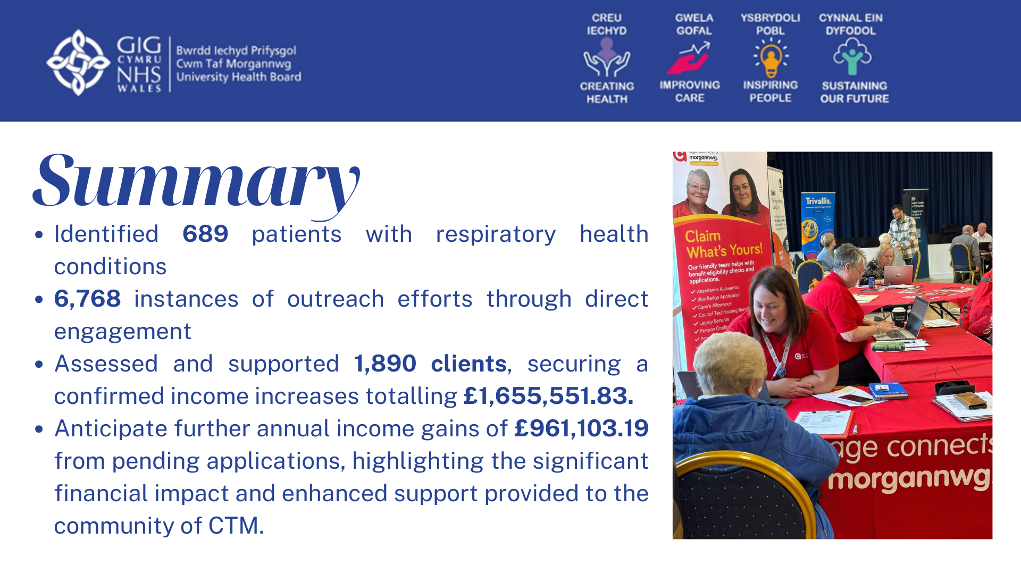

Slide 13
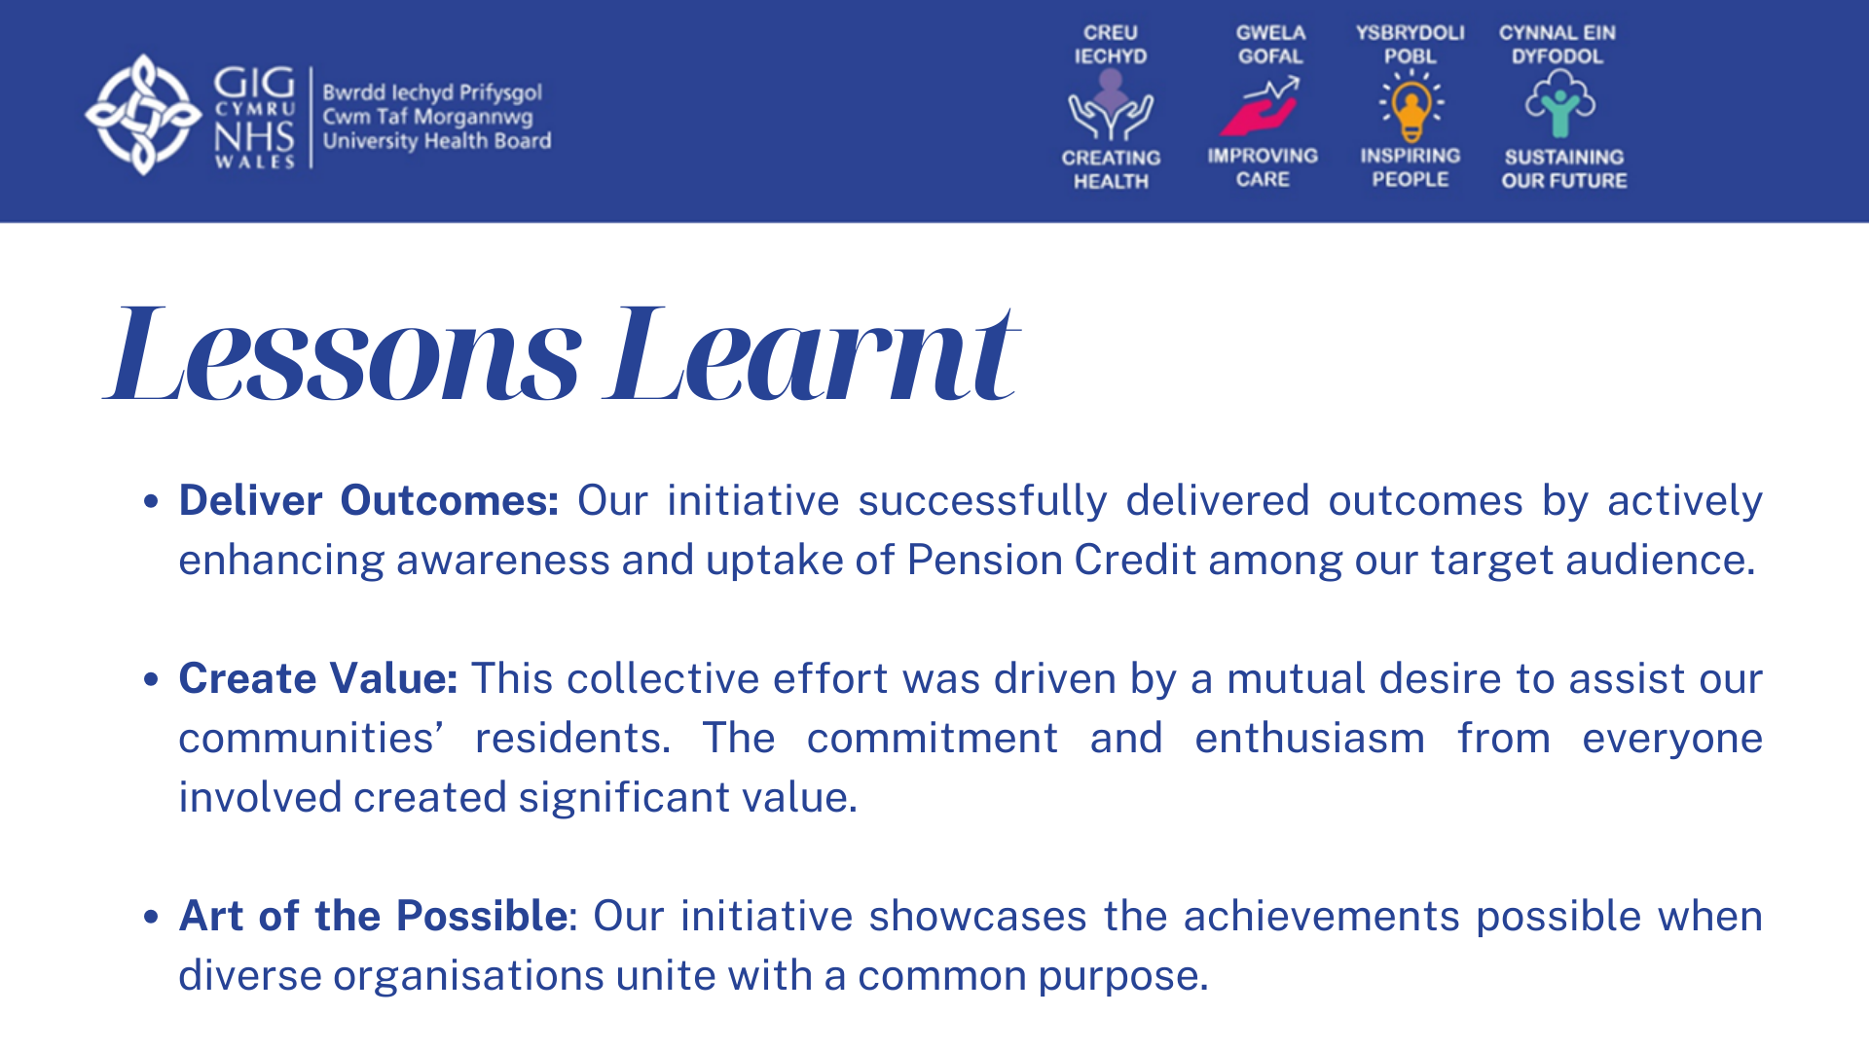

Slide 14
PART 2
Working together as a Community Leaders’ Network to protect vulnerable people through vaccination and health protection this winter

Slide 15
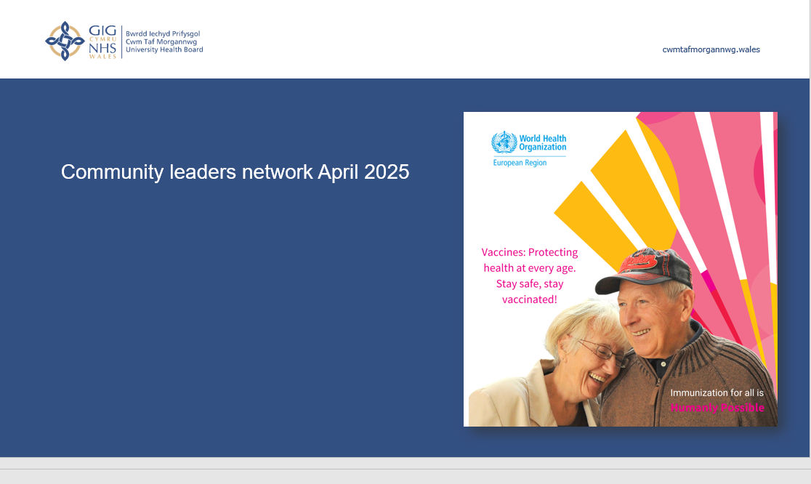
Community leaders network April 2025

Slide 16
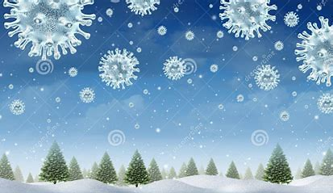
Aims
To look at
-Why we vaccinate
-Vaccine preventable diseases
-Hesitancy
-Help a collective goal
Heath Protection Team

Slide 17

Vaccination Saves Lives
The World Health Organisation state that the two greatest public health interventions are clean water and vaccinations
WHO estimates vaccination saves 3.5 – 5 million lives every year
Immunisation is key to primary health care, an indisputable human right
Heath Protection Team

Slide 18
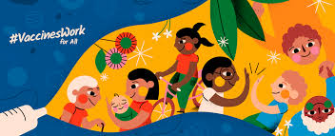
How do Vaccinations protect?
Vaccination provides direct protection to the individual
  Produces the same immune response to the actual disease but without the associated risks/complications of the disease
  Produces long lasting immunological memory
Herd immunity (95% uptake) protects those most vulnerable
  Too young to be vaccinated
  Immunosuppressed
  We have vaccines to prevent more than 20
  Infections, these infections are know as
  vaccine preventable diseases and include our
  Winter viruses of Flu, RSV and COVID-19
Heath Protection Team

Slide 19
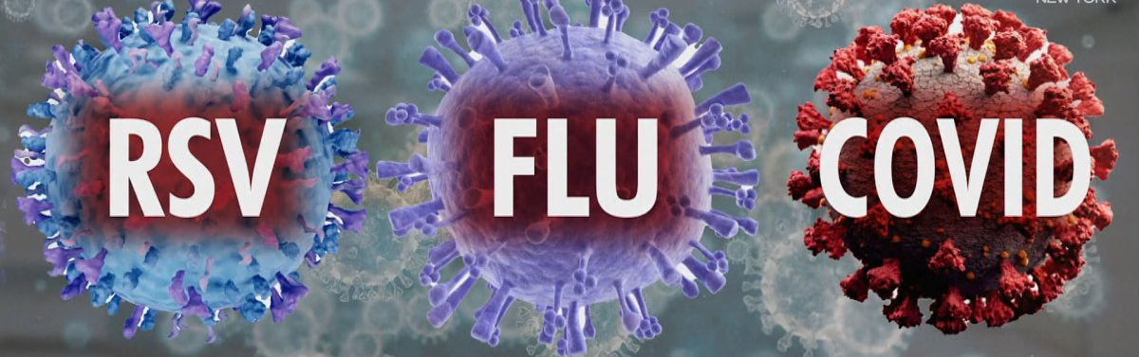
Acute respiratory infections
We are all at risk form winter viruses that can case illness but more so if we are younger, older, have an underlying heath conditions or pregnant.
Symptoms for all can be very similar including headaches, coughs, runny/blocked noses, sore throats, fevers, chills, achy and sore muscles.
Those who are more vulnerable may have worse symptoms needing hospital admission for treatment, complications of these infections can include bronchitis, pneumonia and meningitis.
Heath Protection Team

Slide 20
Infection | Who is able to be vaccinated
Covid | Those eligible for antivirals and in priority groups
RSV | Pregnant women (+32weeks) Adults turning 75 this year (catch up programme this year)
Flu | Children aged 2-16 (via GP or school programme) Those in clinical risk groups 6mth – 65 years Adults over 65 years old Health care staff Priority groups listed each year Others who are not at clinical risk but can choose to buy a vaccine via pharmacy.
20
Heath Protection Team

Slide 21
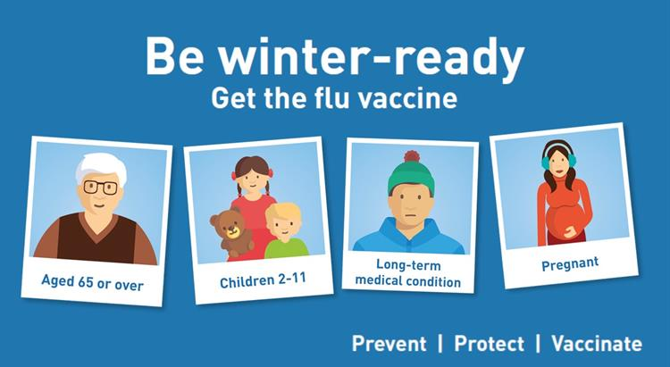
Influenza risk
Individuals who have chronic liver disease are around 48 times more likely to die if they catch flu than someone with no underlying health condition
Individuals with neurological disease are around 40 times more likely to die if they catch flu
Individuals who are immunosuppressed are around 47 times more likely to die if they catch flu
Pregnant women who catch Flu are about 7 times more likely to die than non pregnant women with flu
Individuals aged 65 years and over who catch flu are about 20 times more likely to die than those under 65 who get flu
Green book chapter 19 Influenza
Heath Protection Team

Slide 22
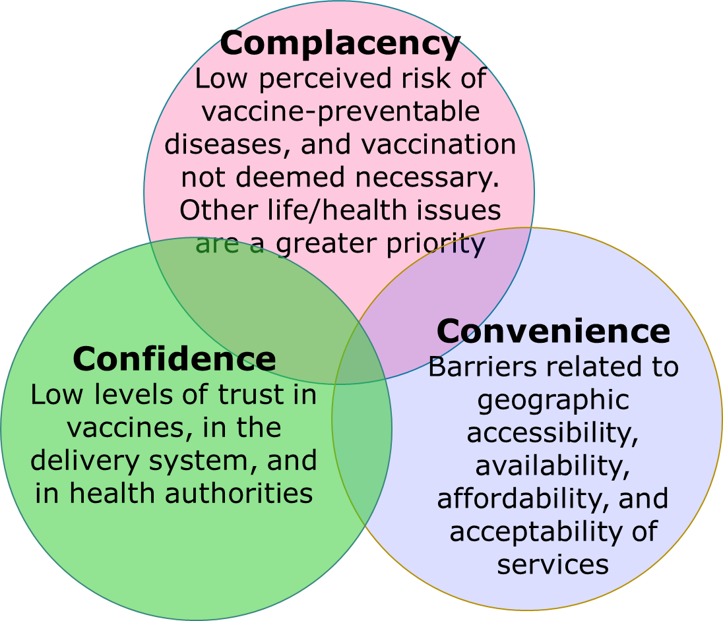
Factors contributing to vaccine hesitancy
CTM_ImmunisationService@wales.nhs.uk

Slide 23
Table discussion: What did you hear from your communities this winter?
What were the good things about accessing and having vaccinations this winter.
What were the problems around about accessing and having vaccinations this winter.
23
Heath Protection Team

Slide 24
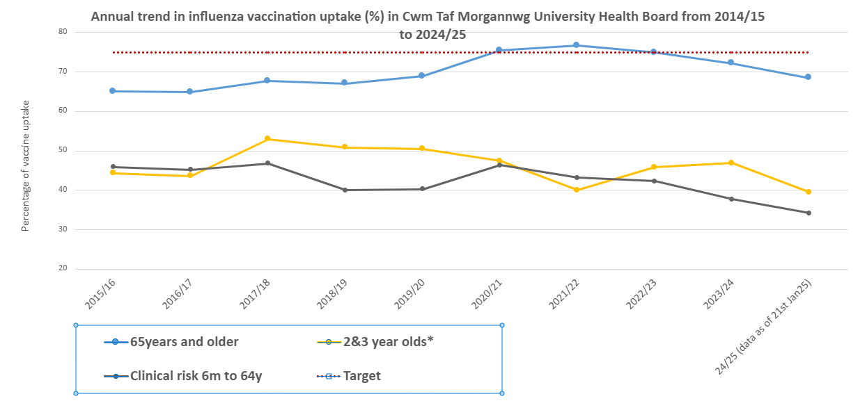
Notes:
The first graph is the influenza uptake in CTM and the take home message is that we have never achieved even 50% for our clinically at risk under 65’s, have only met the Welsh target during the pandemic for over 65’s and rates in all groups are falling again.
Second graph shows how

Slide 25
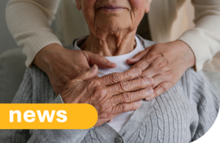
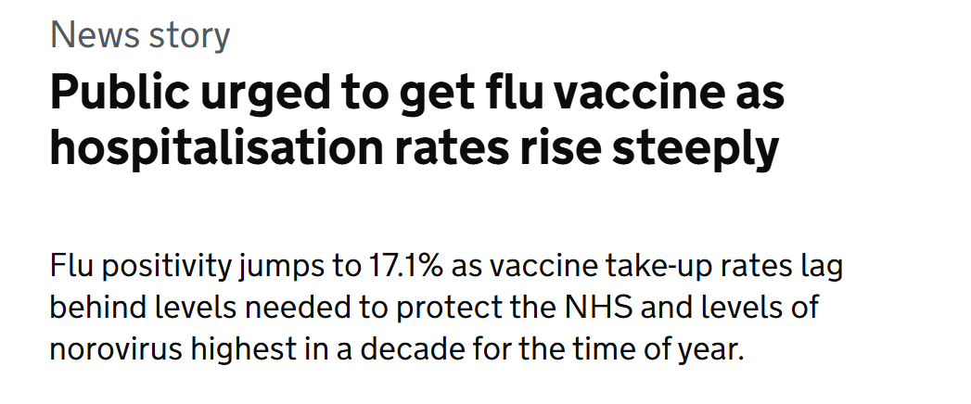
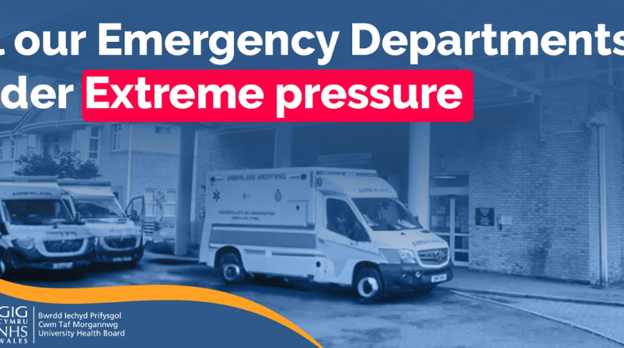
Headlines
RSV vaccination for older people reduces hospital admissions by 30%
UK's first RSV vaccination programme protects older people - GOV.UK
Heath Protection Team

Slide 26
What is the collective goal?
Protect those in our communities where we live and work from becoming ill this winter
Help protect health services from becoming overwhelmed by vaccine preventable infections
As community group use our influence to support positive messaging around winter vaccines, increasing uptake and reducing illness
Ensure fair access to vaccines to everyone in our communities
26
Heath Protection Team

Slide 27
As community leaders, how can you help us shape our CTM vaccination and health protection plan in your areas?
What do you think will help people to get vaccinated?
What difficulties do you see in delivering a successful winter plan in your communities
What would help you to be part of this plan, what do you need from us?
27
Heath Protection Team

Slide 28

If you would like to be part of the Vaccine and Health Protection Working group please add your name to the sign up sheet.
28
This Photo by Unknown Author is licensed under CC BY-SA
Heath Protection Team

Slide 29
Future meetings: save the dates…
18 July 2025 (Merthyr) - 9:30-11:30am
24 October (RCT) - 9:30-11:30am
23 Jan 2026 (Bridgend) - 9:30 - 11:30am

Slide 30
